Slide 1
WELCOME TO ODM ONLINE CLASS
CLASS-UKG
SUBJECT-CONVERSATION
T0PIC-CHAPTER-4
( I can count )

Slide 2
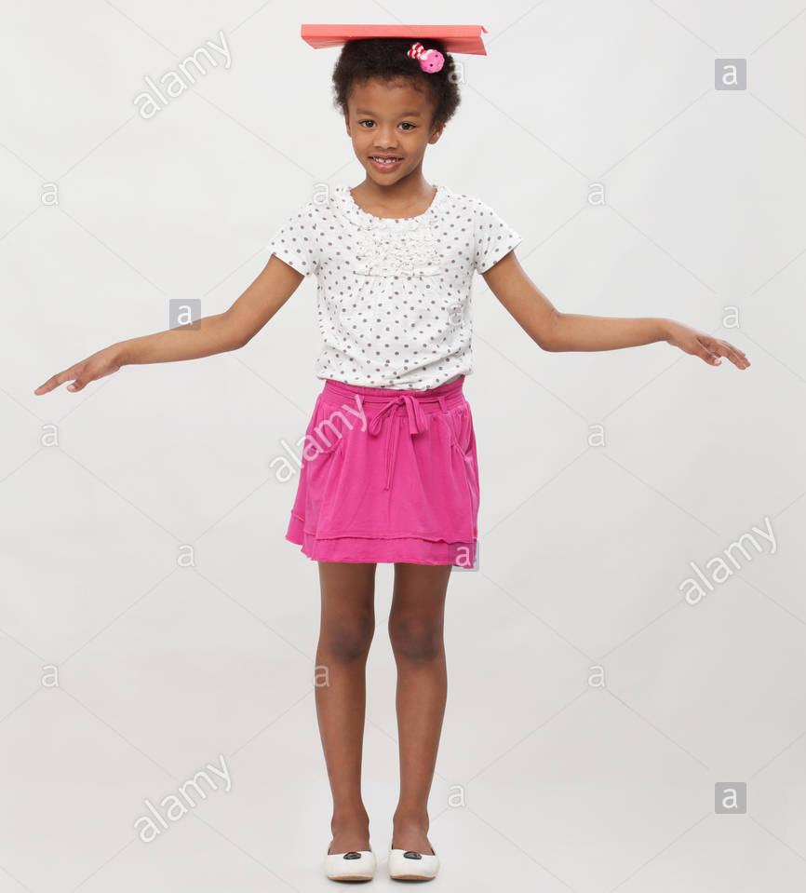
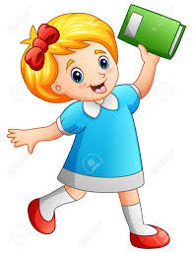
can you put a book
on your head?
yes ,I can

Slide 3
can you put two books
on your head?
yes, I can.

Slide 4
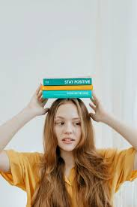
can you put three books
on your head?
yes, I can.

Slide 5
can you put four books
on your head?
yes, I can.

Slide 6
can you put five books
on your head?
yes, I can.

Slide 7
oh , dear
What happened ?
These are falling off.

Slide 8
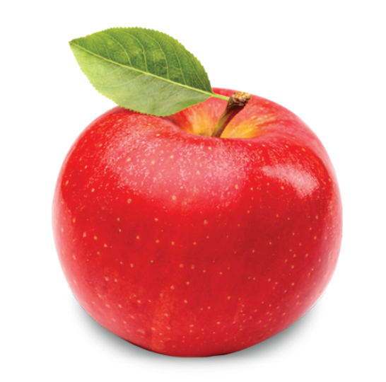
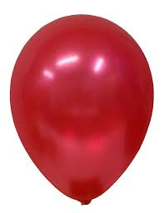
I CAN COUNT ......
7
3
4

Slide 9
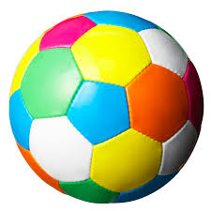
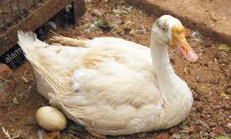

Slide 10
THANKING YOU
ODM EDUCATIONAL GROUP

