Slide 1
WELCOME TO ONLINE CLASS
CLASS : UKG
SUBJECT : ENGLISH
CHAPTER : 9
TOPIC : “sh” sound word

Slide 2
Dt. 6.12.21
INTRODUCTION TO –sh SOUND
-sh makes ssssshhhh.. sound

Slide 3
Words starting with –sh sound
ship
shop

Slide 4
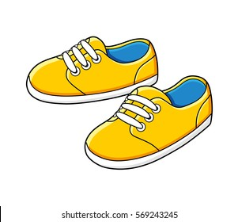
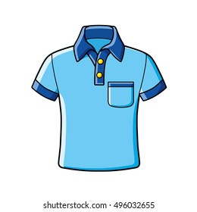
shoes
shirt

Slide 5
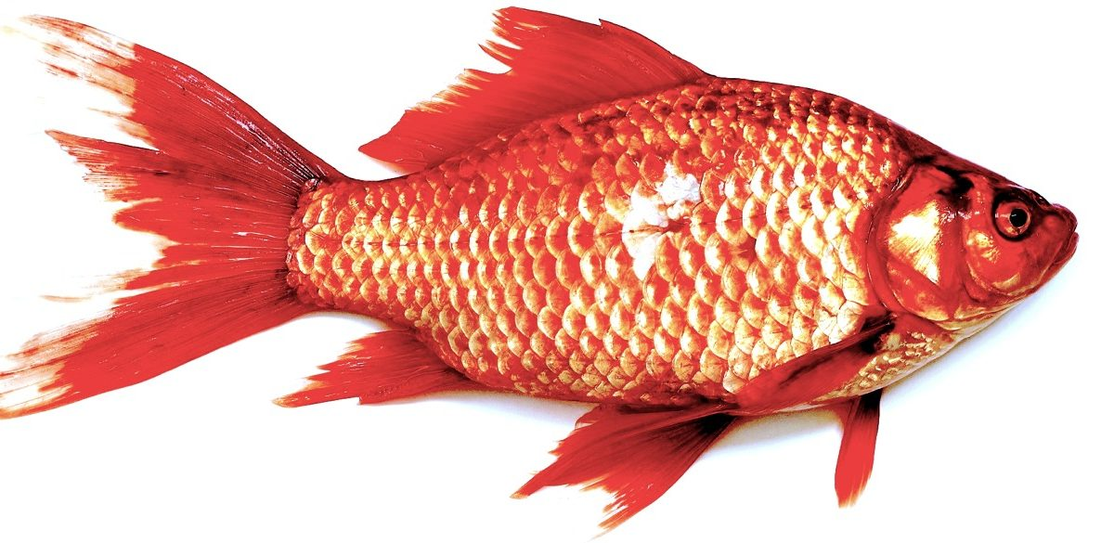
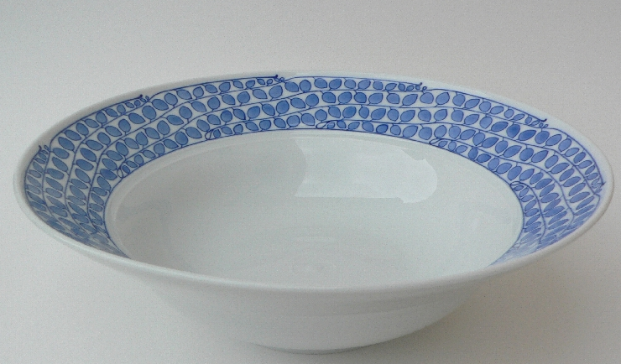
WORDS ENDING WITH –sh SOUND
fish
dish

Slide 6
Read the sentences and identify –sh sound words(oral)
Shut the door.
2. I got a new shirt.
3. I like to eat fish.
4. I lost my shoe.
5. My mother is in the shop.

Slide 7
HOMEASSIGNMENT: Read the words.
She 5. shoot
Sheep 6. shed
Shoe 7. shirt
4. Shut 8. shelf

Slide 8
THANKING YOU
ODM EDUCATIONAL GROUP

