Slide 1
WELCOME TO ON LINE CLASS
CLASS-UKG
SUBJECT-MATHS
TOPIC- NUMBER AND NUMBER
NAMES 21-50(ONCE AGAIN)
(DATE-27.7.21)

Slide 2
Find the correct number for the given number names and say:
Forty nine
Thirty six
36
49
29
49
39
36
46
16
Twenty three
23
Fifty
50
33
43
23
30
50
40
Thirty eight
38
38
28
48

Slide 3
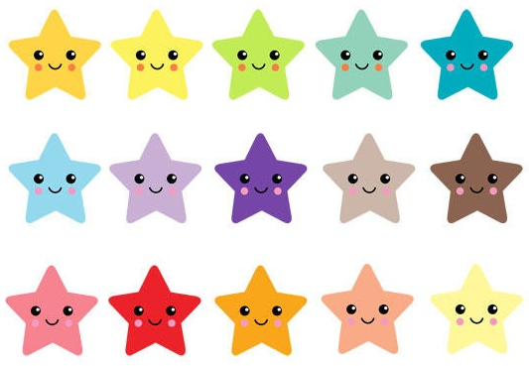
Count how many and match with the number names:
32
30
24
48

Slide 4
c/w 27.7.21
Count forward and fill in the boxes:
24
25
25
17
18
32
33
44
45

Slide 5
H/W 27.7.21
Find the number names and write in your note book:
A | T | W | E | N | T | Y | T | W | O
B | Y | H | I | E | L | E | V | E | N
C | D | E | I | G | H | T | E | E | N
R | T | F | O | R | T | Y | O | N | E
V | Z | X | I | L | T | K | H | U | O
T | W | E | L | V | E | Y | N | H | M
S | I | X | T | E | E | N | S | B | C
X | F | I | F | T | Y | I | F | I | M
S | E | V | E | N | T | E | E | N | X
G | F | O | R | T | Y | N | I | N | E

Slide 6
THANKING YOU
ODM EDUCATIONAL GROUP

