Slide 1
WELCOME TO ON LINE CLASS
CLASS-UKG
SUBJECT-MATHS
TOPIC- NUMBER AND NUMBER
NAMES 21-50

Slide 2
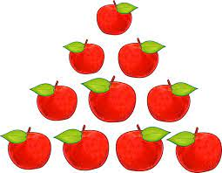
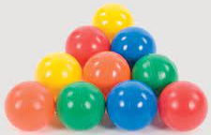
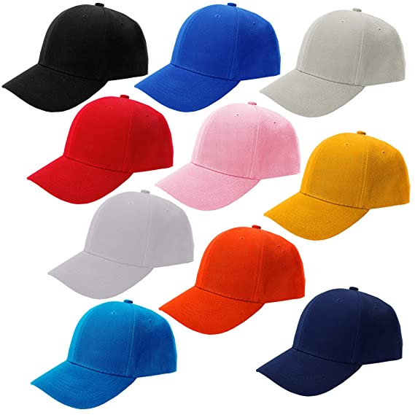
Let’s recap the number names 21 to 50:
10
Ten
20
Twenty
30
Thirty

Slide 3
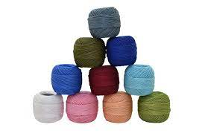
40
Forty
50
Fifty

Slide 4
Fill in the missing letters and say the correct number:
y
Th__rt__s__ve__
i
e
n
37
27
e
i
t
Tw__nt__e__gh__
28
y
18
o
y
i
n
49
39
F__rt__n__ __e
h
i
y
e
33
T__ __rt__t__re__
23
h
i
t
50
F__f__y
40

Slide 5
Fill in the missing numbers:
36
37
33
35
34
45
46
44
43
42
34
32
33
30
31

Slide 6
Find and circle the hidden numbers
49
34
28
44
47
43
23
21
20
40
42
26
27
29
22
36
37
35
45
30
50

Slide 7
Class assignment:
19/7/21
Fill in the missing letters and write the correct number in the given boxes:
Th__rt__n__ n__
F__rt__e__ g__t
Th__rt__ __ n
Tw__nt__t__ r__ __
Fo__t__ f__ v__

Slide 8
THANKING YOU
ODM EDUCATIONAL GROUP

