Slide 1
SUPPLEMENTARY
STD-VIII
SUBJECT : ENGLISH
CHAPTER NUMBER: 6
PERIOD NUMBER : 1
CHAPTER NAME :THE PEACOCK
BY SUJATA BHATT

Slide 2
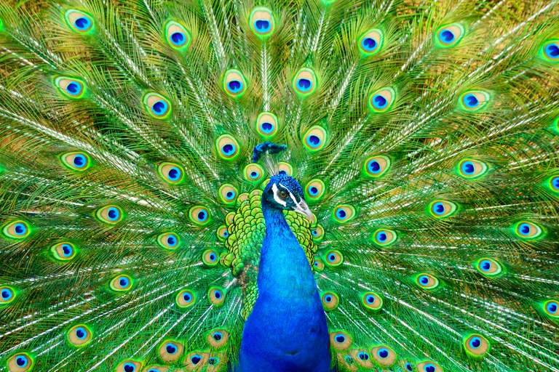
EXPECTED LEARNING OUTCOMES
GENERAL OBJECTIVES Recitation of the poem Being acquainted with poem and poet’s biography Understanding the idea Appreciate the language of the poem Developing LSRW Skills
SPECIFIC OBJECTIVES/ EXTENDED OBJECTIVES Recitation of the poem Being acquainted with poem and poet’s biography Understanding the idea Appreciate the language of the poem Developing LSRW Skills

Slide 3
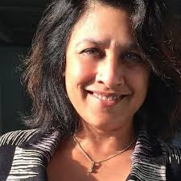
INTRODUCTION TO THE POET
Sujata Bhatt was born in Ahmedabad, Gujarat and brought up in Pune until 1968, when she immigrated to United States with her family. She has an MFA from the University of Iowa, and for a time was writer-in-residence at the University of Victoria, Canada. She received the Commonwealth Poetry Prize (Asia) and Alice Hunt Bartlett Prize for her first collection Brunizem in 1987.^{[1]} She received a Cholmondeley Award in 1991 and Italian Tratti Poetry Prize in 2000. She has translated Gujarati poetry into English for the Penguin Anthology of Contemporary Indian Women Poets. Combining Gujarati and English, Bhatt writes "Indian-English rather than Anglo-Indian poetry." Michael Schmidt (poet) observed that her "free verse is fast-moving, urgent with narratives, softly spoken. Bhatt lives in Bremen, Germany with her husband, the German writer Michael Augustin, and daughter.
Born: 6 May 1956 in Ahmedabad, Nationality: Indian Genres: Poem, Awards: Commonwealth Poetry Prize in 1988.

Slide 4
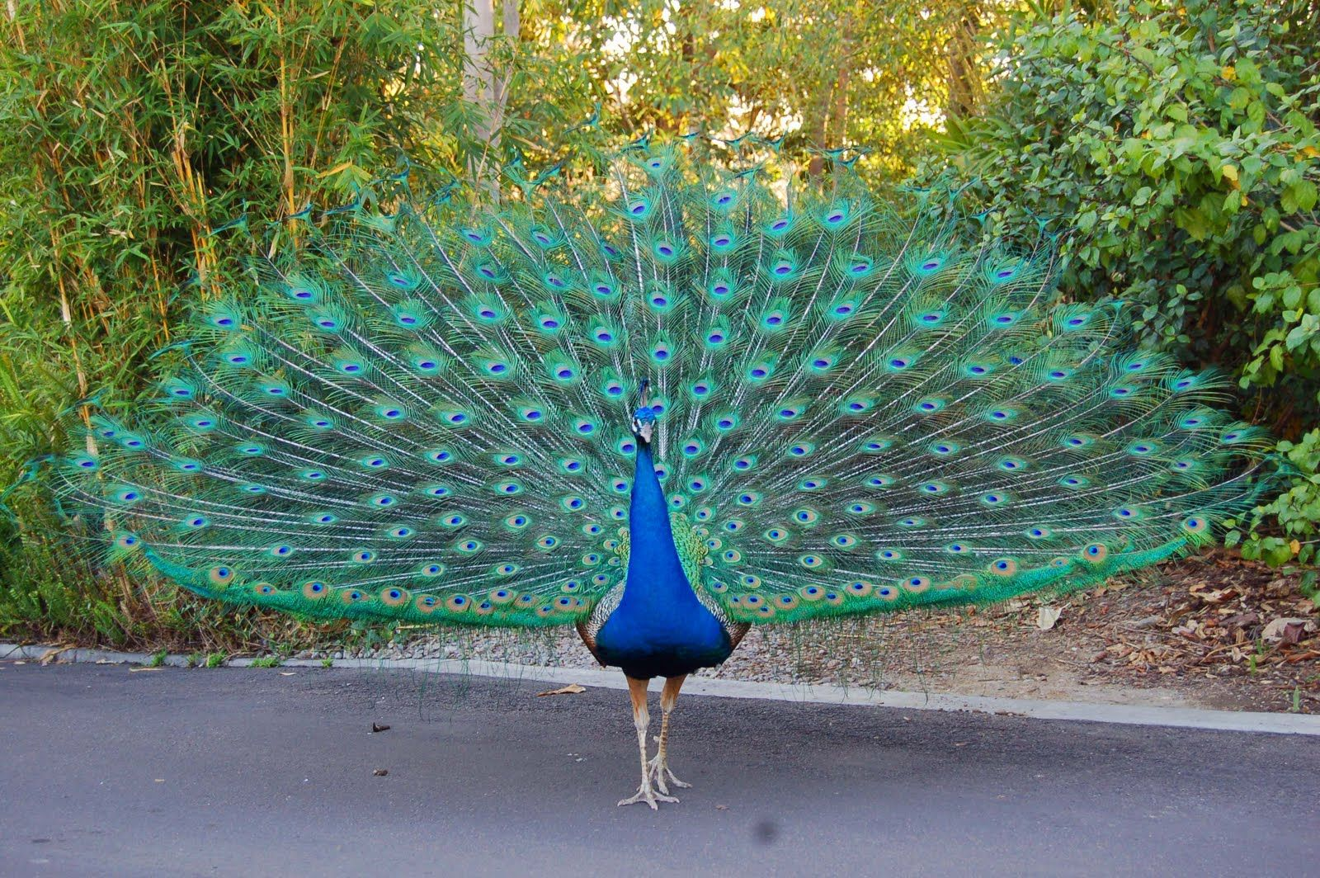
THEME OF THE POEM
The poem ‘The Peacock’ by Sujata Bhatt explains how she saw a glimpse of a bird which according to her seems like a peacock. She explains more about the beauty, appearance, and magnificence of the peacock in the first stanza. The second stanza pictures the poet waiting upon the peacock. She remembers how the elders told her to read a book while waiting for the bird. Keeping full concentration in the book, she long waits doesn’t take a toll on her. As she keeps the mind away from the bird, she feels a blue shadow. At the right time, she looks up to see the peacock with all its beauty, ending the poem with a happy tone

Slide 5
ANALYSIS, STANZA BY STANZA
Stanza One
His loud sharp call seems to come from nowhere. ( . . . )
and as he darts away, a glimpse of the very end of his tail.
The first stanza of the poem ‘The Peacock’ details on the royal, fascinating, mind-blowing, appearance, and nature of the peacock. The poet begins the poem with the pronoun “his” to give a sense of familiarity and closeness. The peacock makes an enigmatic appearance with its sound echoing from nowhere and its turquoise (bluish-green) appears like a flash on the papal tree. It descends like majesty with its “slender neck arched away”. If one tries to look at it, they could get only a glimpse of its tail, as it darts away.

Slide 6
Stanza Two
I was told that you have to sit in the veranda ( . . . )
It is the tail that has to blink For eyes that are always open.
In the second long stanza of ‘The Peacock’, the poet shares the idea given to him on how to wait for a peacock. The use of the first-person pronoun “I”, gives a more personal touch and tone to the poem. The poet was told to sit in the veranda, reading a favorite book with great concentration, for the peacock does not appear that easy. Finally, it appears the moment one changes their focus from the peacock to the book, and “begins to live inside the book”. Even now it doesn’t appear in full shape but like a shadow of “blue”.

Slide 7
VOCABULARY
Turquoise-a kind of bluish green colour
Pipal-a tree of banyan family
Slender-thin
Dart-move suddenly
Fringed-bordered
Amber-yellowish brown colour
Home Assignment:
Describe the peacock
1 page handwriting

Slide 8
THANK YOU
ODM EDUCATIONAL GROUP

