Slide 1
MCB
STD-VI
SUBJECT : ENGLISH
CHAPTER NUMBER: 3
PERIOD NUMBER : 1
CHAPTER NAME :NIGHT OF THE SCORPION
BY NISSIM EZEKIEL

Slide 2
EXPECTED LEARNING OUTCOMES
GENERAL OBJECTIVES
Recitation of the poem
Being acquainted with poem and poet’s biography
Understanding the idea
Appreciate the language of the poem
Developing LSRW Skills

Slide 3
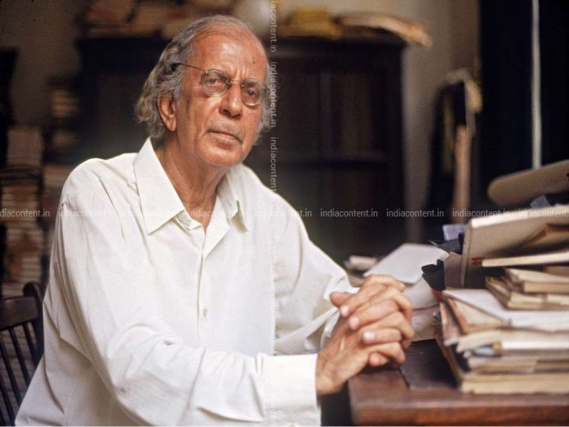
INTRODUCTION TO THE POET
Nissim Ezekiel (1924 - 2004) was born in India to an Indian Jewish family. He studied in Bombay and London. He wrote eight collections of poetry and won the Akademi Award for a volume called 'Latter Day Psalms'. He was also a renowned playwright, art critic, lecturer and editor.
The Night of the Scorpion is a eight stanza poem, each stanza of which contains between three and eighteen lines. This is one of Ezekiel’s first poems, it was first anthologized in Collected Poems (1952-1988)

Slide 4
What is Night of the Scorpion about?
The poem is about the night when a woman (the poet's mother) in a poor village in India is stung by a
scorpion. Concerned neighbours pour into her hut to offer advice and help. All sorts of cures are tried
by the neighbours, her husband and the local holy man, but time proves to be the best healer- After twenty hours / it lost its sting.'
After her ordeal, the mother is merely thankful that the scorpion stung her and not the children.
The poem exposes the superstitions that dominate the minds of Indians and also the motherhood of a lady who just only of her children even in the worst condition. The poem has no rhyme scheme. It has eight stanzas with a different number of lines in each.

Slide 5
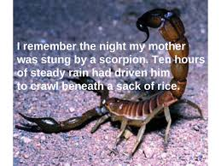
EXPLANATION OF THE 1ST STANZA
Stanza 1
The poet says that he remembers well that night when her mother was stung by a scorpion.
The poet is of the view that the heavy rain which lasted for 10 hours made the scorpion crawl beneath a sack of rice.
The last phrase shows the poet’s sympathy towards the scorpion.

Slide 6
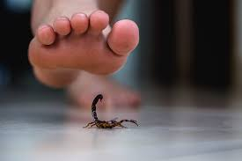
EXPLANATION OF THE 2nd STANZA
The poet says that after biting his mother with its diabolic (monstrous tail), the scorpion went back to rain outside again.
The poet here shows sympathy as well as anger towards the scorpion.
He is angry when he talks about its biting and sympathetic when he talks about its going to rain again.

Slide 7
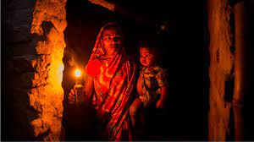
EXPLANATION OF THE 3rd STANZA
Hearing about the incident, the villagers rush to the poet’s home.
However, he is not happy with them and calls them swarms of flies who buzz the name of God a hundred times to paralyse the Evil One.

Slide 8
EXPLANATION OF THE 4th STANZA
The poet then explains how the villagers searched for the scorpion.
According to him, the villagers began searching for the scorpion and their shadows themselves seemed to be like a giant scorpion on the mud-baked walls.
The villagers begin searching for the scorpion because they believe that the poison spreads across the body with the movement of scorpion so if the latter is stopped and paralyzed, the poison effect can also be controlled.
This is a superstition and Nissim knows that well. Therefore, he hates the coming of villagers to his home.
The stanza also depicts the Indianness that prevails in countryside.

Slide 9
VOCABULARY
Sting: If an insect, plant, or animal stings, it produces a small but painful injury, usually with a poison, by brushing against the skin or making a very small hole in the skin
Steady: happening in a smooth, gradual, and regular way
Crawl: to move along on hands and knees or with your body stretched out along a surface
Beneath: under someone or something
Sack: a large bag made of strong cloth, paper, or plastic, used to store large amounts of something
Diabolic: having the qualities of devil or wicked
Paralyse: to stop an activity
Diminished: to lessen; reduce
Groaning: a mournful sound conveying pain or grief
Rationalist: a person who believes in reason and knowledge than opinion and belief
Incantation: the chanting of words claim to have magical power
Peasants: a member of a low social class of farm workers and owners of small farms
Swarm of flies: A swarm of bees or other insects is a large group of them flying together.
Home Assignment: Get Going A, Page 65,one page handwriting
Activity: Recitation of the Poem

Slide 10
EXPLANATION OF THE 5th STANZA
Having failed in finding the scorpion, they begin giving their own interpretation to the biting of the scorpion.
Some of them said that his mother’s sins which she committed in her previous birth (as believed in Hinduism) have been forgiven.
The others assumed that she is going to die and said that the pain that she is suffering from will decrease the troubles in her next birth.
Some others put forward that her good deeds will be balanced against her bad deeds because of the bite of the scorpion.

Slide 11
EXPLANATION OF THE 6th STANZA
Some others said that the poison will purify and refresh her flesh of desire and her spirit of ambition.
All of them seemed to be in peace because of their thoughts.

Slide 12
EXPLANATION OF THE 7th STANZA
More and more people come with candles & lanterns.
His mother is however crying and rolling on the mat with severe pain, but nobody cares for her except for his father who is a sceptic, rationalist.
He leaves no stone unturned to cure her.
He uses powder, mixture, herb and hybrid to help her recover from the pain.
He even poured a little paraffin upon the bitten toe and then fires it up.
The poet watches the flames of fire burning on the skin of his mother.
He also watches the holy man perform his rites to tame the poison with an incantation.
The phrase again refers to superstitious people of his village who believe in irrational measures to cure a person.
His mother ultimately recovers from the poison after 24 hours.

Slide 13
EXPLANATION OF THE 8th STANZA
The last line is quite emotional and heart touching. It reflects the motherhood of a lady.
The poet says that after recovering from the poison, his mother’s words were Thank God the scorpion picked on me and spared my children.
Even in such condition, his mother remains more concerned about the safety and health of her children.
The mother stands as a symbol of selfless love for her children.

Slide 14
VOCABULARY
Buzz: to make a continuous, low sound such as the one a bee makes
Evil one: morally bad, cruel, or very unpleasant
Giant: extremely large
Mudbaked: rectangular block of clay baked by the sun or in a kiln; used as a building or paving material
Sins: the offence of breaking, or the breaking of, a religious or moral law
Twisted: bent so that the original shape is changed
Spared: bent so that the original shape is changed
Literary Devices - Night Of The Scorpion
Alliteration - stung by a scorpion, Parting with his poison, diabolic tail in the dark, risked the rain, poison purfiy, through and through, poured a little paraffin, flame feeding.
Antonyms - previous/next, evil/good, sceptic/rationalist, curse/blessing.
Metaphor - scorpion is the Evil One.
Simile - like swarms of flies.
Onomatopoeia: Buzzed
Personification: 1) Diabolic Tail, 2) He risked the rain again
Home Assignment: Vocabulary, Page 66,one page handwriting
Activity: Recitation of the Poem

Slide 15
THANK YOU
ODM EDUCATIONAL GROUP

