Slide 1
WELCOME TO ONLINE CLASS
CLASS : UKG
SUBJECT : Conversation
CHAPTER : About Myself

Slide 2
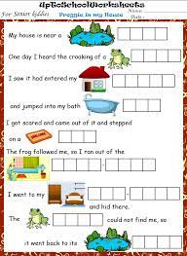
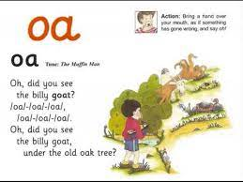
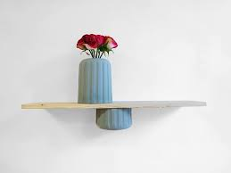
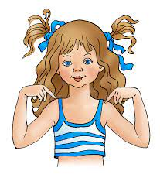
This is me
LET’S LEARN ONCE AGAIN
(ABOUT MYSELF)
I am Rahul

Slide 3
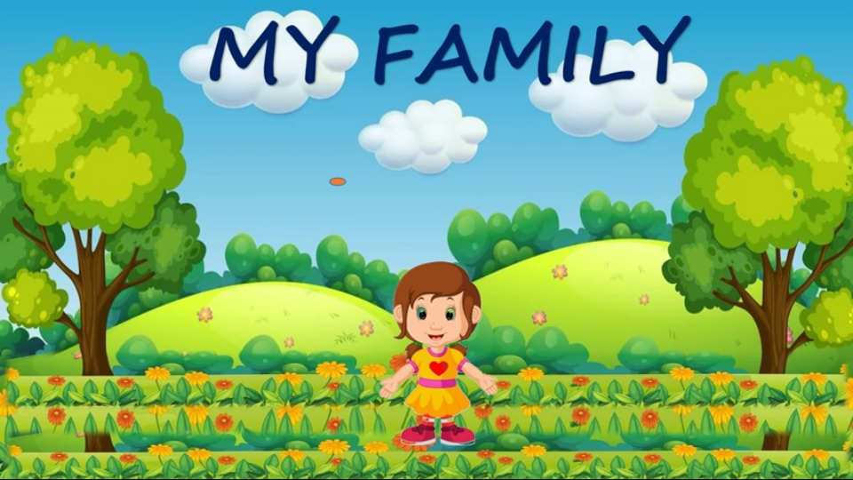
Hello………..
My name is Ria Das.
I am a girl.
I am 6 years old.
I study in UKG.
I read in ODM Public school
I live in Bhubaneswar.
My favourite food is pizza.
My favourite colour is pink.

Slide 4
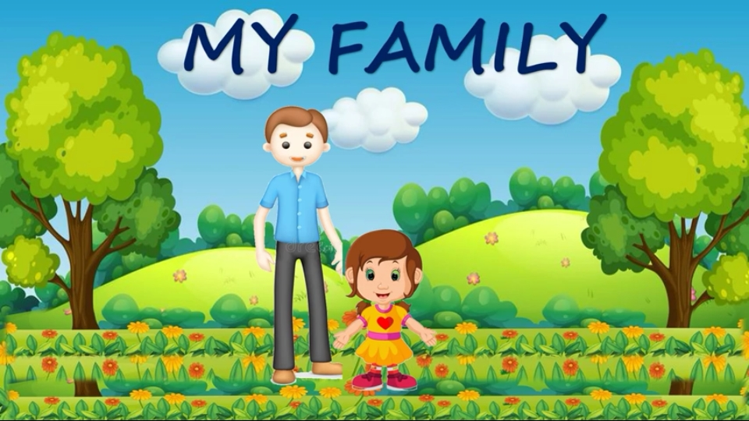
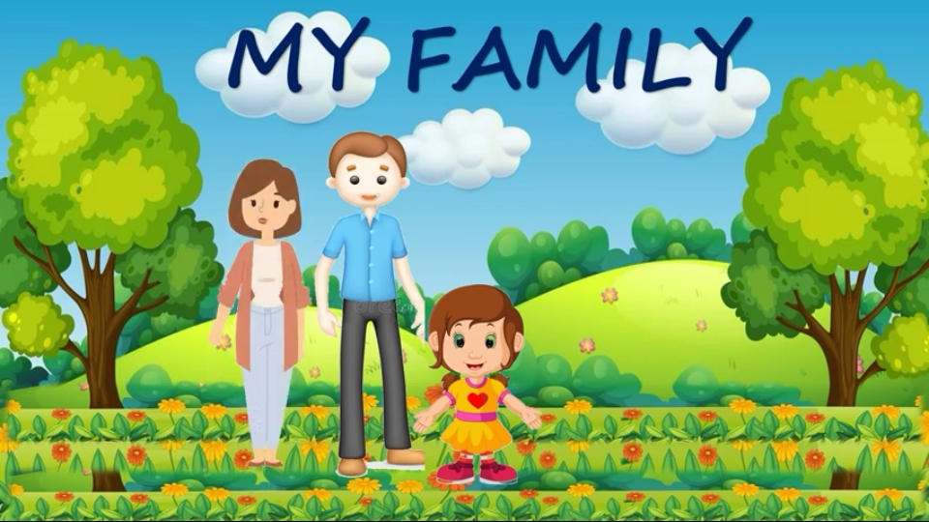
LET’S MEET WTH MY PARENTS.
He is my father.
His name is Mr. Subrata Das.
She is my mother.
Her name is Mrs. Sasmita Das.

Slide 5
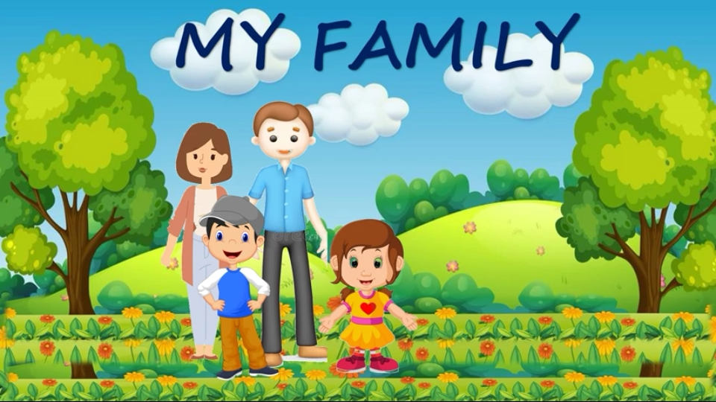
He is my brother.
His name is Rohan.

Slide 6
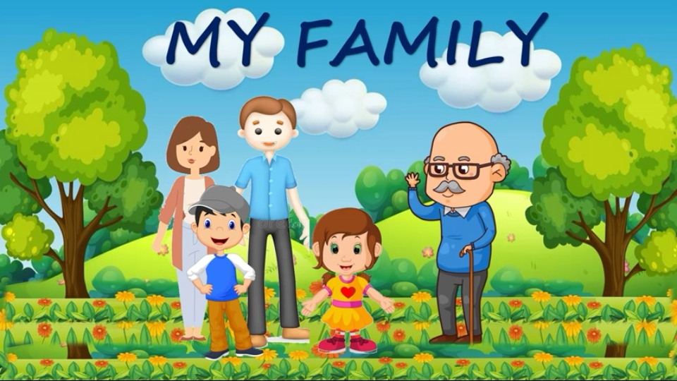
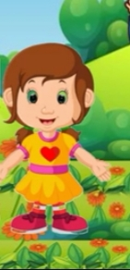
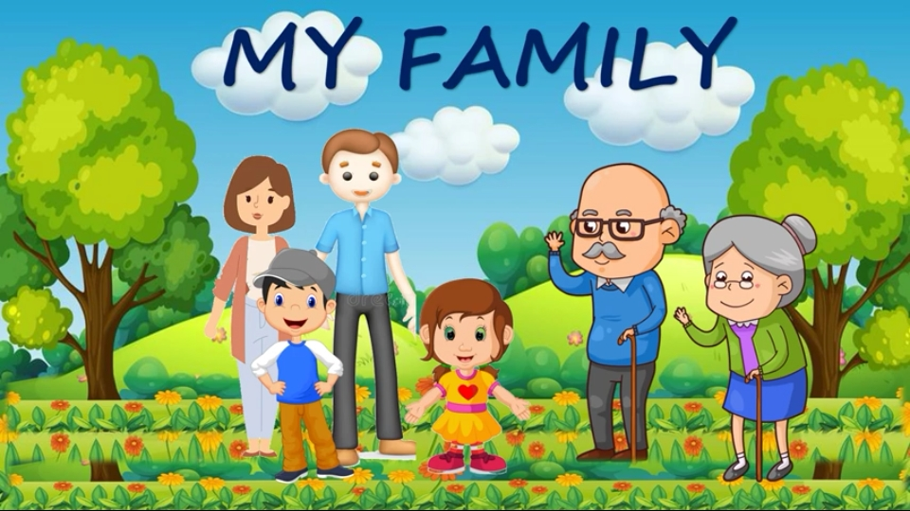
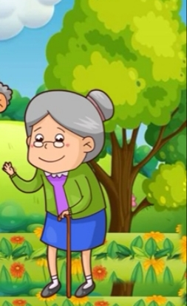
LET’S MEET WTH MY GRANDPARENTS.
He is my grandfather.
His name is Mr. Subas Das.
She is my grandmother.
Her name is Mrs. Laxmi Das.

Slide 7
THIS IS MY FAMILY.
I LOVE MY FAMILY VERY MUCH.

Slide 8
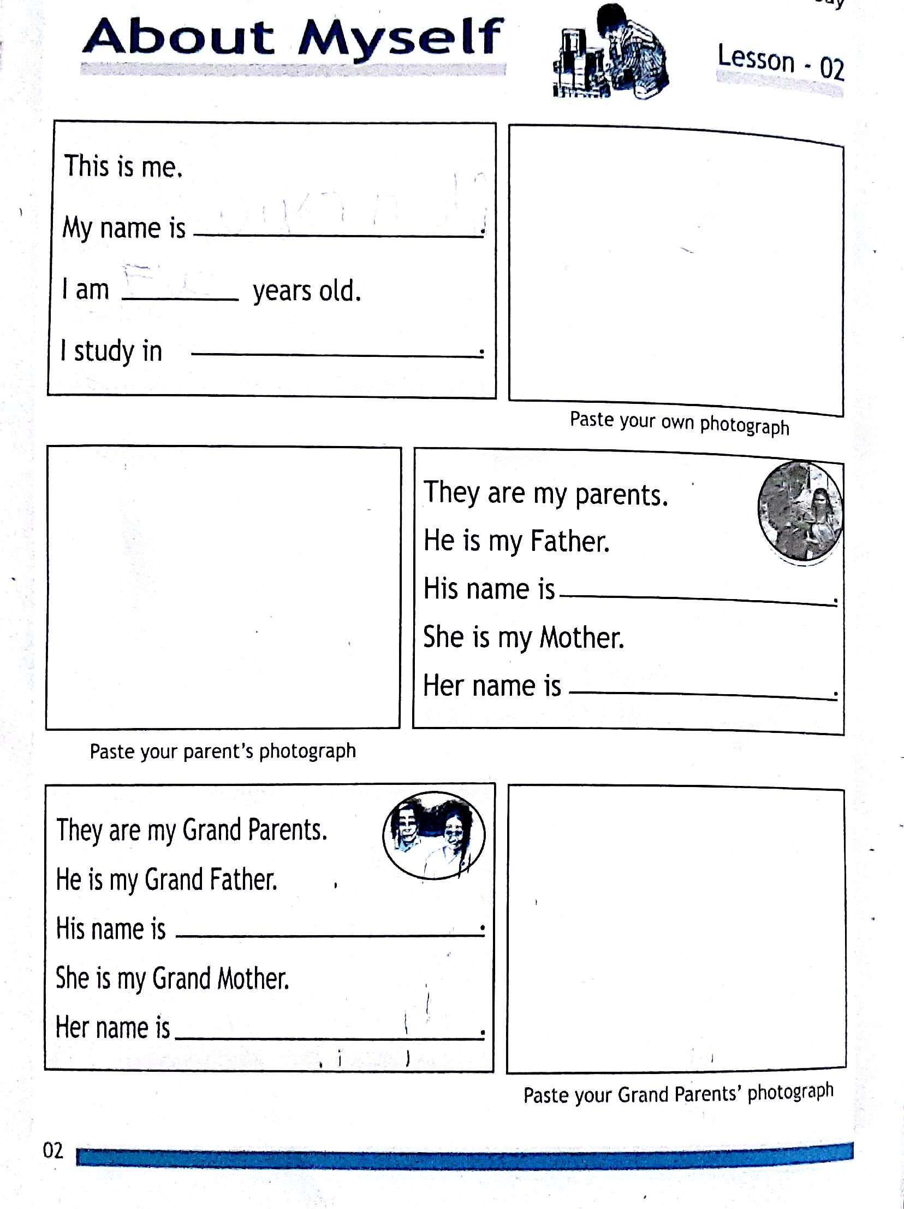
HOME ASSIGNMENT

Slide 9
THANKING YOU
ODM EDUCATIONAL GROUP

