Slide 1
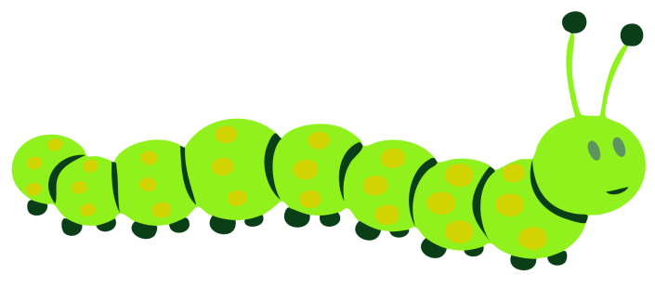
WELCOME TO ONLINE CLASS
CLASS-UKG
SUBJECT-RHYME
TOPIC-ENGLISH RHYME
(five little caterpillars)

Slide 2
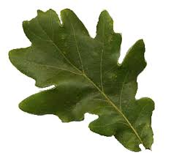
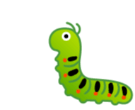
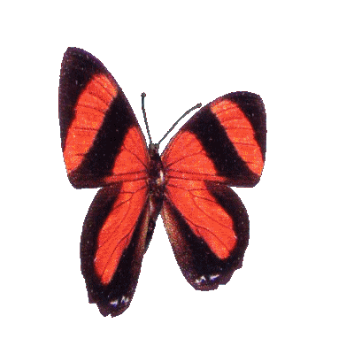
Five little caterpillars sitting on a leaf
one falls off and goes to sleep
closes her eyes and waits a week
up comes a butterfly floating on the breeze.

Slide 3
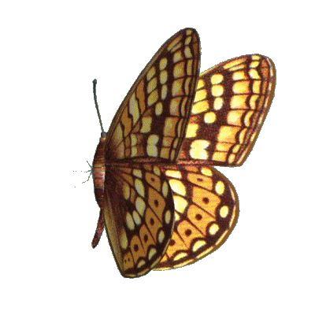
Four little caterpillars sitting on a leaf
one falls off and goes to sleep
closes her eyes and waits a week
up comes a butterfly floating on the breeze.

Slide 4
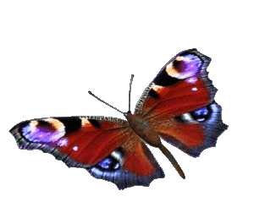
Three little caterpillars sitting on a leaf
one falls off and goes to sleep
closes her eyes and waits a week
up comes a butterfly floating on the breeze.

Slide 5
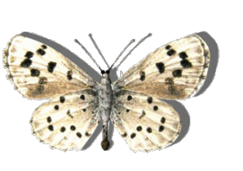
Two little caterpillars sitting on a leaf
one falls off and goes to sleep
closes her eyes and waits a week
up comes a butterfly floating on the breeze.

Slide 6
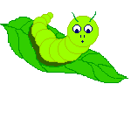
One little caterpillars sitting on a leaf
she falls off and goes to sleep
closes her eyes and waits a week
up comes a butterfly floating on the breeze.

Slide 7
BACKWARD COUNTING
Five little caterpillars sitting on a leaf,
One falls off,and goes to sleep
Closes her eyes and waits for a week
Up comes a butterfly floating on the breeze.
Four little caterpillars sitting on a leaf,
One falls off and goes to sleep.
Closes her eyes and waits for a week
Up comes a butterfly floating on the breeze.

Slide 8
Three little caterpillars sitting on a leaf,
One falls off and goes to sleep
Closes her eyes and waits a week
Up comes a butterfly floating on the breeze.
Two little caterpillars sitting on a leaf,
One falls off and goes to sleep.
Closes her eyes and waits for a week,
Up comes a butterfly floating on the breeze.
One little caterpillar sitting on a leaf,
She falls off and goes to sleep
Closes her eyes and waits for a week
Up comes a butterfly floating on the breeze.

Slide 9
THANKING YOU
ODM EDUCATIONAL GROUP

