Slide 1
WELCOME TO ONLINE CLASS
CLASS-UKG
SUBJECT-RHYME
TOPIC- THUMAK THUMAK KAR..
(INTRODUCTION)

Slide 2
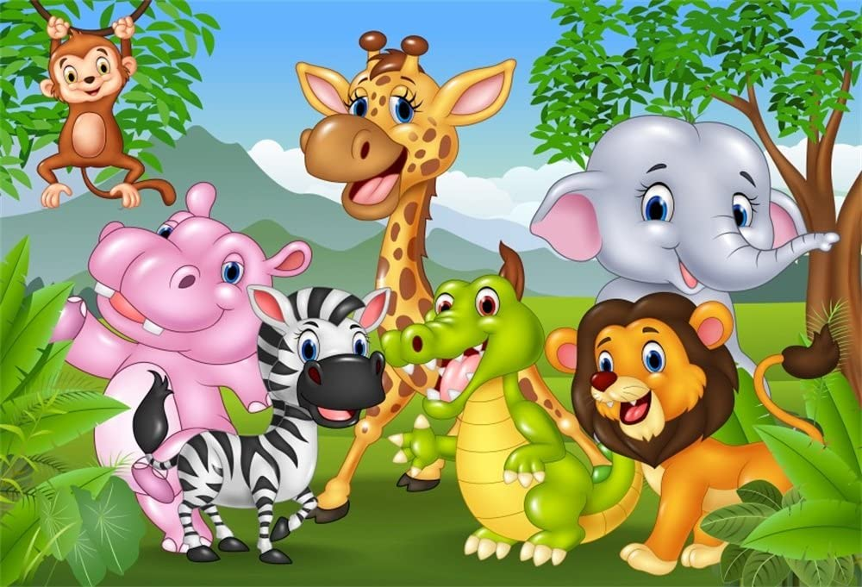
Animals are the part
of living being. They
Live, eat, play, run, sleep,
breath like human beings.
Animals play an important
role in our life.

Slide 3
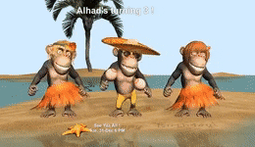
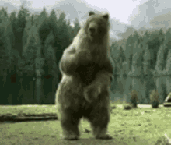
In the olden days making
animals dance on the
streets by training them
was very common.

Slide 4
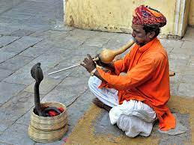
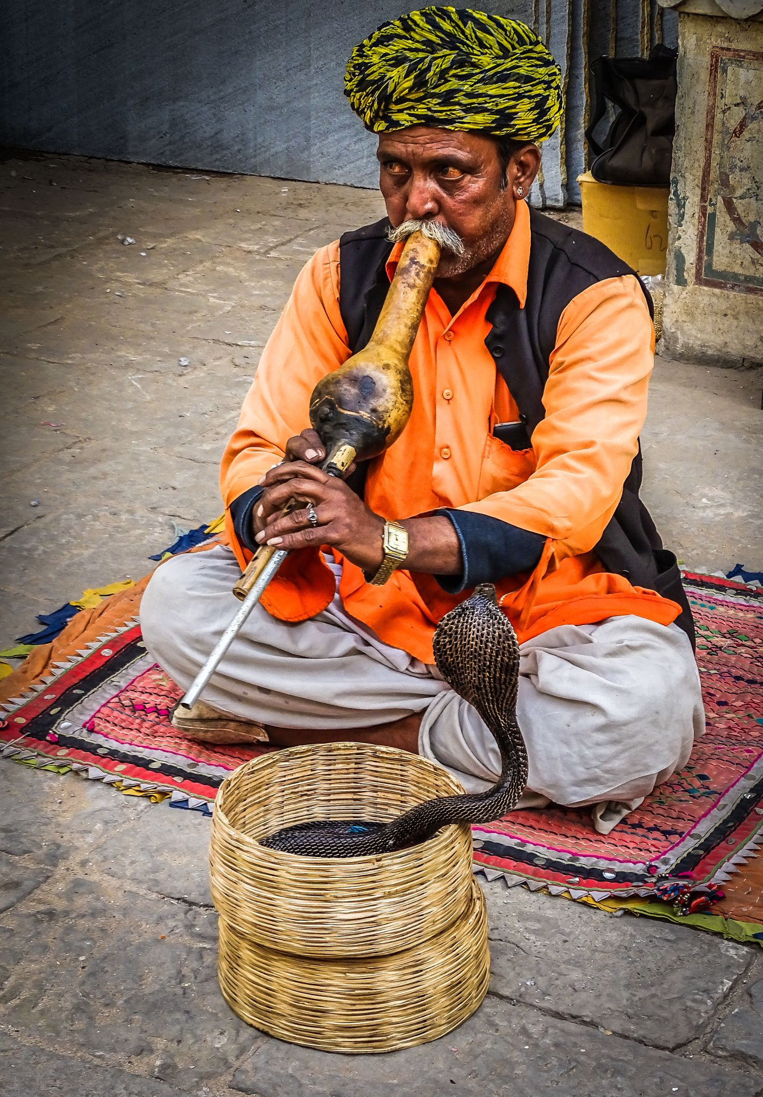
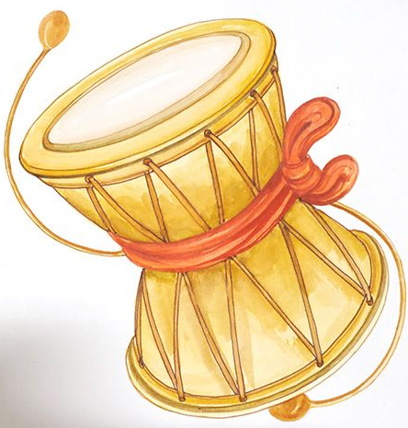

Slide 5
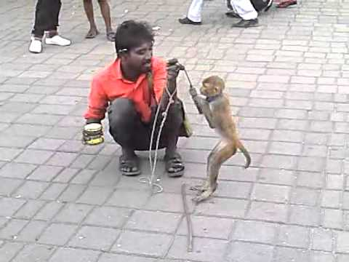
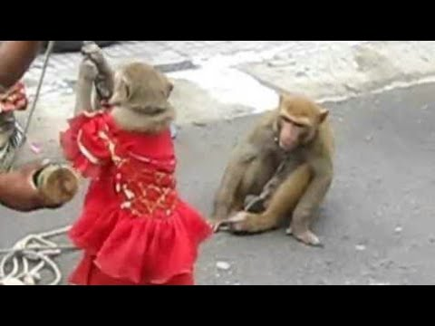

Slide 6
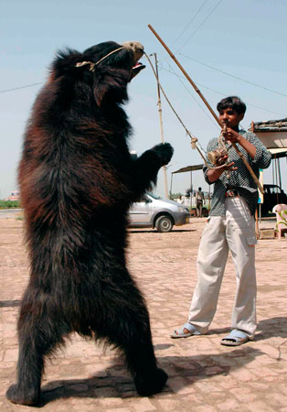
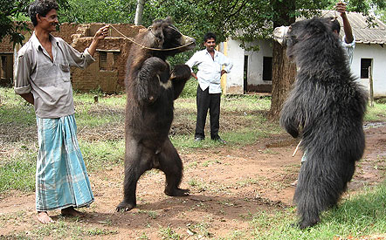

Slide 7
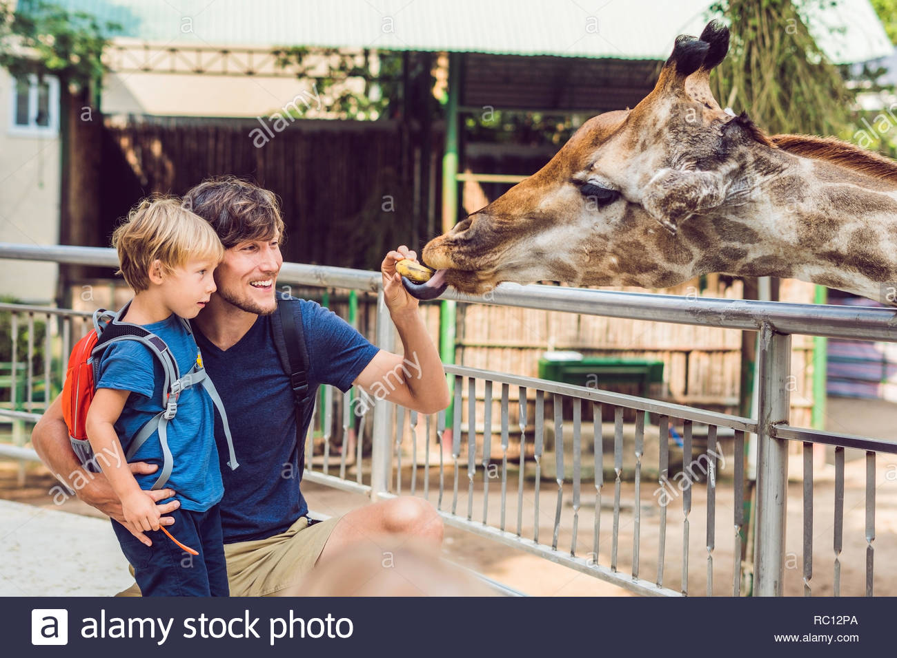
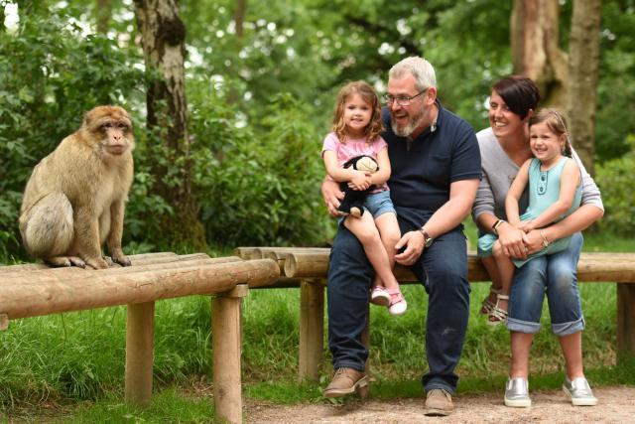
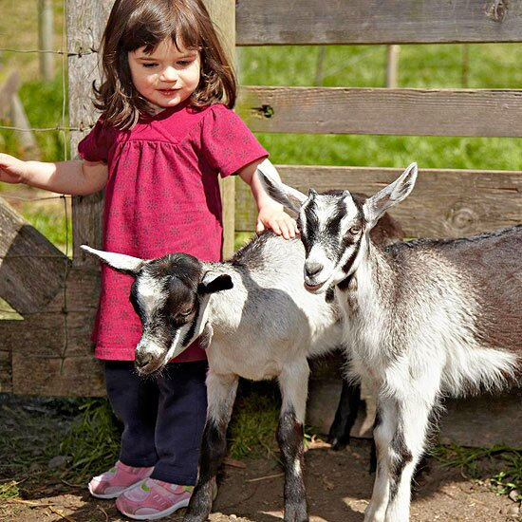
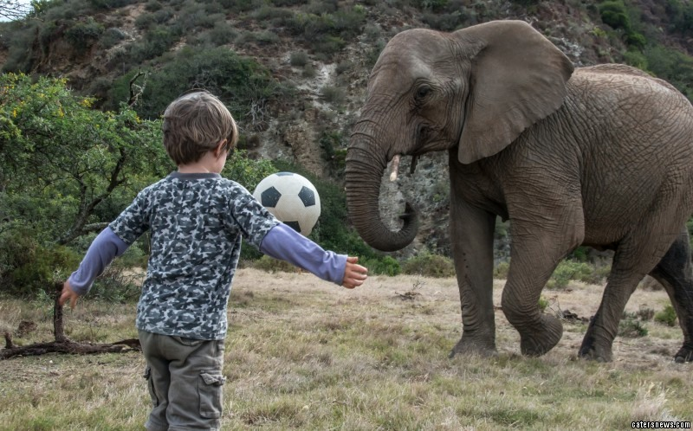
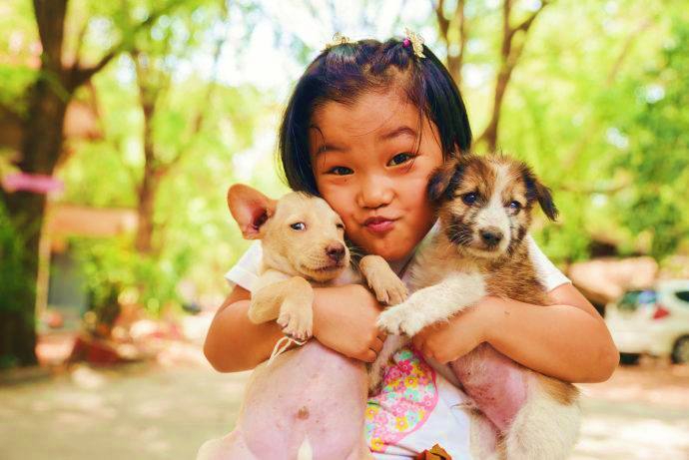
However,today this has
reduced because of the
awareness about animal
safety.Animals since then
taught us discipline,respect
for others and cooperation.

Slide 8
Let’s wait & watch how & what
the animals taught us

Slide 9
THANKING YOU
ODM EDUCATIONAL GROUP

