Slide 1
SEXUAL REPRODUCTION IN FLOWERING PLANTS
DOUBLE FERTILISATION AND POST FERTILISATION EVENTS
SUBJECT : BIOLOGY
CHAPTER NUMBER:02
CHAPTER NAME :SEXUAL REPRODUCTION IN FLOWERING PLANTS

Slide 2
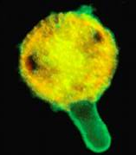
DOUBLE FERTILISATION
Pollen germination
Releasing of male gametes into Embryo sac
Fertilisation
Double Fertilisation
Embryogenesis

Slide 3
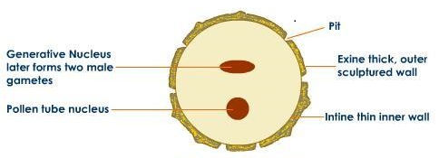
POLLEN STRUCTURE
MATURED POLLEN

Slide 4
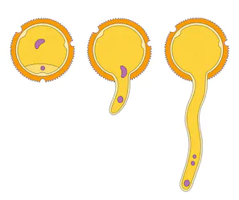
GERMINATING POLLEN
Male Nuclei
Tube Nucleus
GERMINATING POLLEN

Slide 5
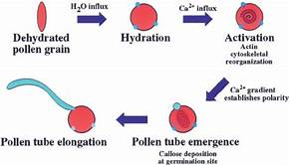
STAGES OF POLLEN GERMINATION

Slide 6
MICROSCOPIC VIEW OF GERMINATINGPOLLEN

Slide 7
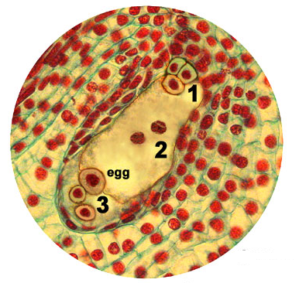
MATURED EMBRYO SAC
1 ANTIPODAL CELLS
2 POLAR NUCLEI
3 EGG APPRATUS
Matured embryo sac

Slide 8
FERTILISATION
Release of 2 male gametes from pollen tube into the embryo sac
Fusion of one male gamete with egg cell called Syngamy and form zygote(2n)
which develops into embryo.
Fusion of other male gamete with polar nuclei of central
cell to form PEN (3n). This is also known as triple fusion.

Slide 9
DOUBLE FERTILISATION
As syngamy and triple fusion occur in an embryo sac, the phenomenon is known as
double fertilisation.
Central cell with PEN is called PEC which develops into endosperm.
One Male Nuclei + Egg Zygote
(n)
(n)
(2n)
Other Male Nuclei + Two Polar Nuclei PEN
(n)
(n+n)
(3n)

Slide 10
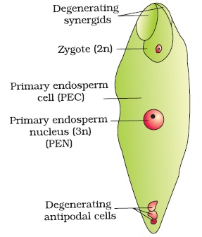
FERTILISED EMBRYO SAC
Fertilised Embryosac

Slide 11
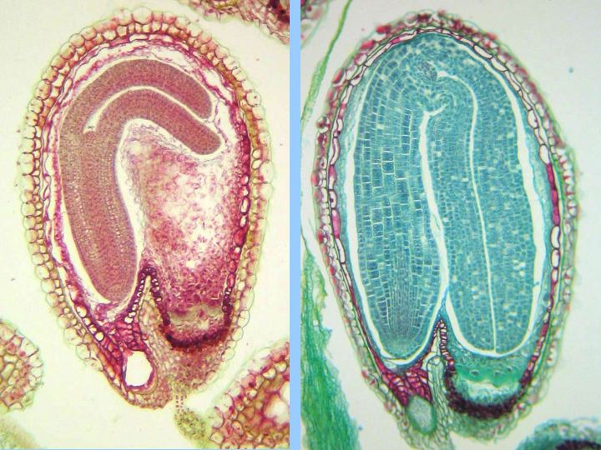
POST FERTILISATION EVENTS
DEVELOPMENT OF EMBRYO AND ENDOSPERM

Slide 12
POST FERTILISATION EVENTS
Development of endosperm
-Development of embryo
-Maturation of ovule into seed
-Maturation of ovary into fruit

Slide 13
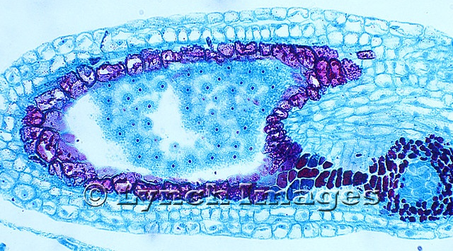
ENDOSPERM
Endosperm development precedes embryo development,why?
PEN divides and redivides mitotically to form endosperm.
It provides food to developing embryo.
Developing Endosperm

Slide 14
DEVELOPMENT OF ENDOSPERM
PEN divides and redivides to form a large number of free nuclei. It gives rise to multinucleated endosperm named as nuclear endosperm.
E.g.- Tender coconut water possess free nuclear liquid endosperm (nuclear endosperm)
Cytokinesis occurs after every nuclear division so that endosperm is of cellular form, that is called as cellular endosperm.
E.g.- White kernel of coconut is cellular endosperm.

Slide 15
EMBRYOGENESIS
Embryo develops at the micropylar end of the embryo sac where the zygote is situated.
Most zygotes divide only after certain amount of endosperm is formed. This is an adaptation
to provide assured nutrition to the developing embryo.
Though the seeds differ greatly, the early stages of embryo development (embryogeny) are
similar in both monocotyledons and dicotyledons.
The zygote gives rise to the proembryo and subsequently to the globular, heart-shaped and
mature embryo.

Slide 16
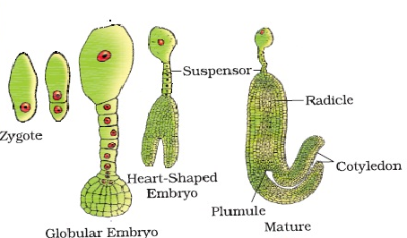
STAGES OF EMBRYO DEVELOPMENT

Slide 17
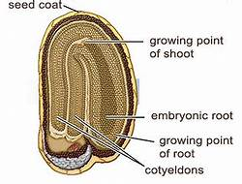
DICOT EMBRYO
A typical dicotyledonous embryo, consists of an embryonal
axis and two cotyledons.
The portion of embryonal axis above the level of cotyledons
is the epicotyl, which terminates with the plumule or stem
tip.
The cylindrical portion below the level of cotyledons is
hypocotyl that terminates at its lower end in the radicle or
root tip.
The root tip is covered with a root cap.

Slide 18
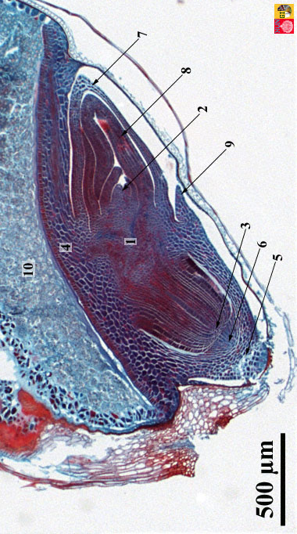
MONOCOT EMBRYO
Embryos of monocotyledons possess only one cotyledon.
In the grass family the cotyledon is called scutellum that is
situated towards one side (lateral) of the embryonal axis.
At its lower end, the embryonal axis has the radical and root
cap enclosed in an undifferentiated sheath called
coleorrhiza.
The portion of the embryonal axis above the level of
attachment of scutellum is the epicotyl.
Epicotyl has a shoot apex and a few leaf primordia enclosed
in a hollow foliar structure, the coleoptile.
7-coleoptile
8- plumule
2- shoot meristem
9- epiblast
3-root meristem
6- root cap
5- coleorhiza
10- endosperm
4-scutellum
1-mesocotyl
Triticum aestivum (Wheat)

Slide 19
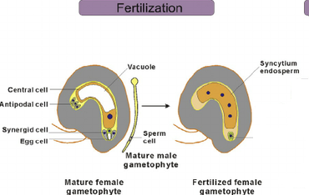
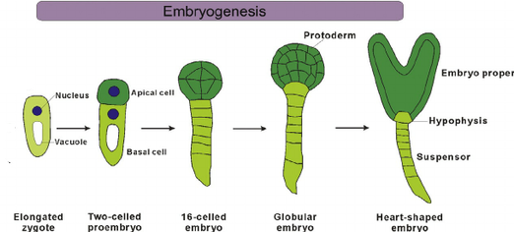
FERTILISATION AND EMBRYOGENESIS

Slide 20
THANKING YOU
ODM EDUCATIONAL GROUP

