Slide 1
HUMAN REPRODUCTION
FEMALE REPRODUCTIVE SYSTEM
SUBJECT : BIOLOGY
CHAPTER NUMBER:03
CHAPTER NAME :HUMAN REPRODUCTION

Slide 2
PUBERTY
It is the period when primary sex organ become functional and start secreting sex hormones which bring about development of secondary sex organs and appearance of secondary sex characters.
Hence sexual maturity is attained.
In female period of puberty is 10-14 years and changes include increase in size of ovaries, fallopian tubules, uterus.
It also include development of mammary gland, voice with high pitch, growth of pubic hair and many more.

Slide 3
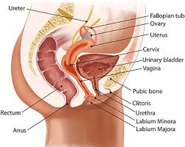
FEMALE REPRODUCTIVE SYSTEM
The female reproductive system is located in the pelvis region.
It includes a pair of ovaries which are primary sex organs in human females.
The system also include accessory ducts, glands and the external genitalia.
They are accessory sex organs.
Accessory ducts are fallopian tubules (oviducts), uterus, cervix, vagina .
Mammary glands are accessory glands.
There is the external genitalia (vulva)
in pelvic region.

Slide 4
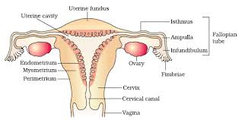
DIAGRAM SHOWING FEMALE REPRODUCTIVE SYSTEM

Slide 5
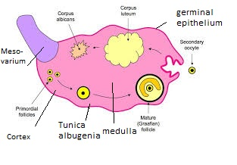
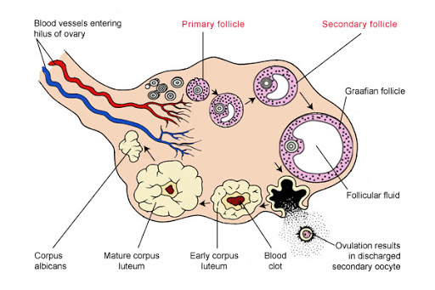
PRIMARY SEX ORGAN-OVARIES
The ovaries are situated on each side of lower abdomen.
The ovaries are the primary female sex organs that produce the female gamete (ovum) and several steroid hormones (ovarian hormones).
In adults, each ovary is almond shaped in structure shape, with a length of about 2 to 4 cm and a width of about 1.5 cm.
It is suspended from the dorsal body wall by a fold of peritoneum called mesovarium.
It is held in position by ovarian ligament which attach it to both pelvic wall and uterus
The stroma is divided into two zones- a peripheral cortex and an inner medulla.
The ovary is covered by a layer of cuboidal epithelium called
as germinal epithelium.
Beneath the epithelium lies a connective tissue called as tunica albugenia which encloses ovarian stroma.
The germinal epithelium grows and differenciate to form egg mother cell (oogonia) which undergoes meiosis to produce mature ovum.

Slide 6
ACCESSORY DUCTS:OVIDUCTS(FALLOPIAN TUBULES)
They are a pair of muscular tubules of about 10-12cm in length which remain connected with ovary and uterus.
It has following parts:
Infundibulum: It is the funnel shaped fimbriated free end which catches released ovum from ovary.
Ampulla: It is the curved dilated part of oviduct which acts as site for fertilisation.
Isthmus: It is the straight part of oviduct which remain connected with ampulla.
Uterine part: It is a part of oviduct which passes into uterus and allows the fertilized ovum to move into uterus

Slide 7
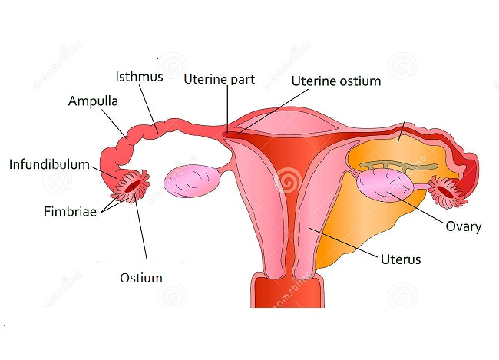
DIAGRAM SHOWING FALLOPIAN TUBULE

Slide 8
ACCESSORY ORGAN: UTERUS (WOMB)
It is an inverted pear shaped large distensible part which anchors and nourishes developing foetus.
It is supported by ligaments attached to the pelvic wall. The wall of the uterus has 3 layers .
The external thin membranous- perimetrium, middle thick layer of smooth muscle- myometrium and inner glandular layer-endometrial that lines the uterine cavity.
The endometrial undergoes cyclic changes during
menstrual cycle while the myometrium exhibit strong contraction during delivery of the baby.

Slide 9
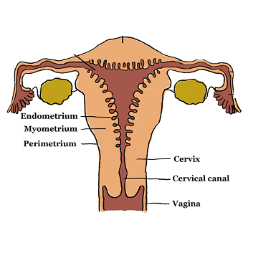
DIAGRAM SHOWING UTERUS, CERVIX, VAGINA

Slide 10
CERVIX:
The uterus opens into vagina through a narrow cylindrical cavity called cervix
The cavity of the cervix is called cervical canal which along with the vagina forms the birth canal.
VAGINA:
It is an elastic muscular tube of 8-10 cm length which functions as female copulatory organ.

Slide 11
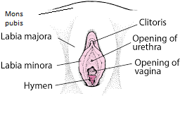
EXTERNAL GENITALIA
The female external genitalia include mons pubis, labia majora, labia minora, hymen and clitoris .
Mons pubis is a cushion of fatty tissue covered by skin and pubic hair.
The labia majora are fleshy folds of tissue, which extend
down from the mons pubis andsurround the vaginal opening.
The labia minora are paired folds of tissue under the labia majora.
The opening of the vagina is often covered partially by a membrane called hymen.
The clitoris a tiny finger-like structure which lies at the upper junction of the two labia minora above the urethral opening.
The hymen is often torn during the first coitus (intercourse).

Slide 12
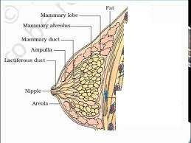
ACCESSORY GLAND: MAMMARY GLAND:
A functional mammary gland is characteristic of all female mammals.
The mammary glands are paired structures (breasts) that contain glandular tissue and variable amount of fat.
The glandular tissue of each breast is divided into
15-20 mammary lobes containing clusters
of cells called alveoli .
The cells of alveoli secrete milk, which is stored in the cavities (lumen) of alveoli.
The alveoli open into mammary tubules. The tubules of each lobe join to form a mammary duct.
Several mammary ducts join to form a wider mammary ampulla which is connected to lactiferous duct through which milk is sucked out.

Slide 13
THANKING YOU
ODM EDUCATIONAL GROUP

