Slide 1
HUMAN REPRODUCTION
GAMETOGENESIS
SUBJECT : BIOLOGY
CHAPTER NUMBER:03
CHAPTER NAME :HUMAN REPRODUCTION

Slide 2
LECTURE-3
RECAPITULATION
FEMALE REPRODUCTIVE SYSTEM
Ovaries
Fallopian tube
Uterus
Vagina GAMETOGENESIS
Spermatogenesis
Hormonal control of spermatogenesis
Oogenesis
Hormonal control of Oogenesis
Structure of Ovum and Egg

Slide 3
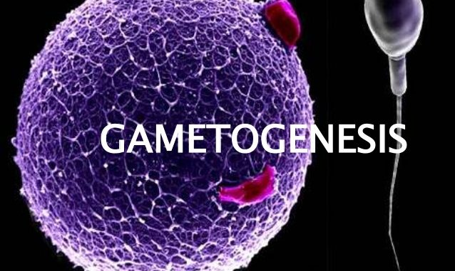
LEARNINIG OUTOME
Students will able to know about
Gametogenesis
Spermatogenesis
Hormonal control of spermatogenesis
Oogenesis
Hormonal control of Oogenesis
Structure of Ovum and Egg

Slide 4
GAMETOGENESIS
It is the process of formation of gametes which occurs in gonads.
Gametogenesis includes 3 phases:
Multiplication phase
Growth phase
Maturation phase
Gametogenesis is of two types: Spermatogenesis & Oogenesis

Slide 5
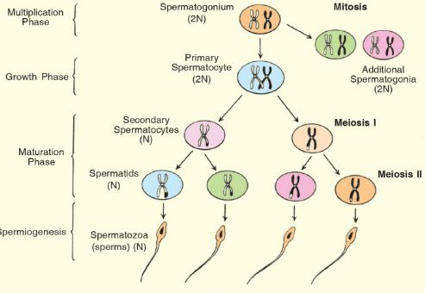
SPERMATOGENESIS
The process of formation of sperm in seminiferous tubule of the testis is called as spermatogenesis.
MULTIPLICATION PHASE
GROWTH PHASE
MATURE PHASE

Slide 6
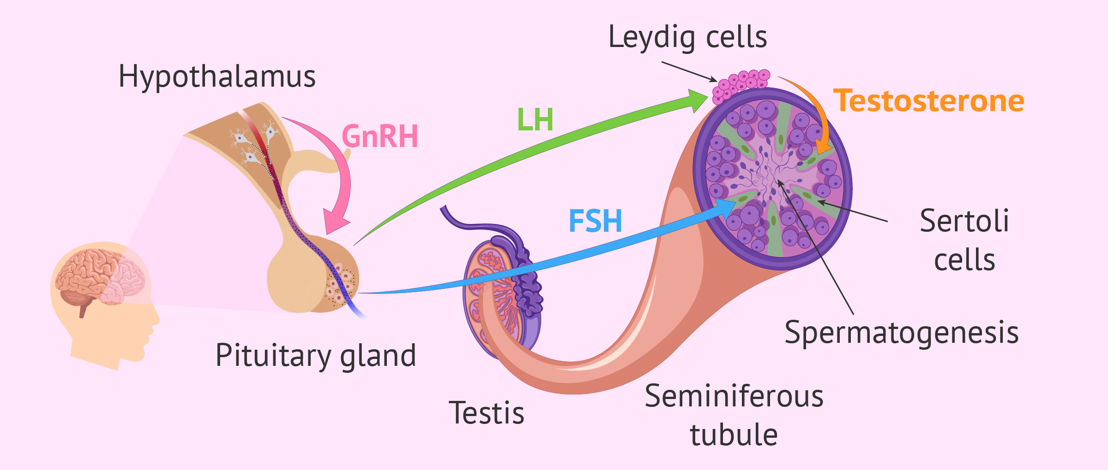
HORMONAL CONTROL OF SPERMATOGENESIS

Slide 7
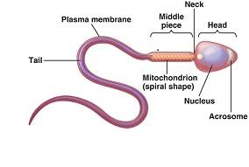
STRUCTURE OF SPERM
Middle Piece
Tail
Semen
It consists of:
Acrosome

Slide 8
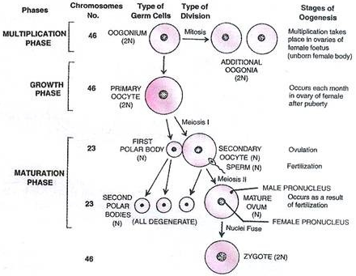
OOGENESIS
The process of formation of a mature female gamete (ovum) inside ovary is called oogenesis.
MULTIPLICATION PHASE
GROWTH PHASE
MATURATION PHASE

Slide 9
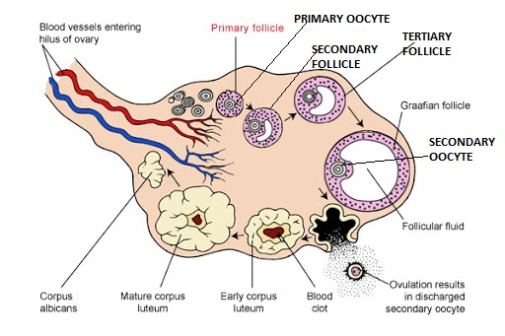
DIAGRAMATIC SECTION VIEW OF OVARY

Slide 10
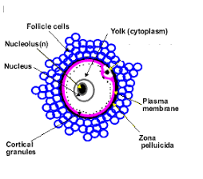
STRUCTURE OF OVUM
It is a non motile female gamete.
Ovum is covered with a
non cellular zona pellucida (glycoprotein)&
a multicellular corona radiata

Slide 11
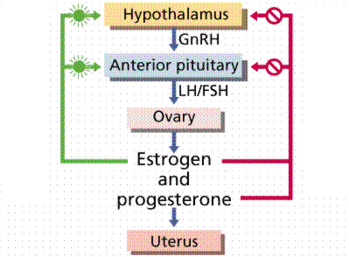
HORMONAL CONTROL OF OOGENESIS

Slide 12
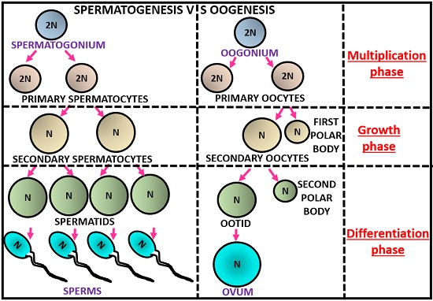
COMPARISION : SPERMATOGENESIS & OOGENESIS

Slide 13
SUMMARY
Gametogenesis
Spermatogenesis
Hormonal control of spermatogenesis
Oogenesis
Hormonal control of Oogenesis
Structure of Ovum and Egg

Slide 14
HOME ASSIGNMENT
1.What is the number of chromosomes in
(i) spermatogonial cells. (ii) Spermatids (iii) Primary spermatocytes (iv) Sertoli cells ?
2.At which stage of life does gametogenesis begin in human males ?
3.Name the organ where spermatogenesis gets completed in human male.
4.Why do mitosis of spermatogonia and meiosis of spermatocytes occurs ?
5.Write the difference between spermatids and spermatozoa

Slide 15
THANKING YOU
ODM EDUCATIONAL GROUP

