Slide 1
HUMAN REPRODUCTION
EMBRYONIC DEVELOPEMENT, PARTURITION,LACTATION
SUBJECT : BIOLOGY
CHAPTER NUMBER:03
CHAPTER NAME :HUMAN REPRODUCTION

Slide 2
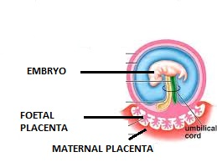
EMBRYONIC DEVELOPMENT
After implantation, finger like projections appear on the trophoblast called as chorionic villi.
Uterine tissue and maternal blood surrounds
the chorionic villi.
The chorionic villi and uterine tissue together form a structural and functional organic structure between
developing embryo and tissues of the mother called as placenta.

Slide 3
PLACENTA
Placenta is a flattened circular organ in the uterus of pregnant eutherian mammals, nourishing and maintaining the foetus through the umbilical cord.
Placenta functions as a foeto-maternal organ with two components:-
(I)the foetal placenta (II)maternal uterine tissue.
The placenta is expelled from the body upon birth of the foetus.This is called after birth or placental expulsion.
Placental mammals, such as humans, have a chorioallantoic placenta that forms from the chorion and allantois

Slide 4
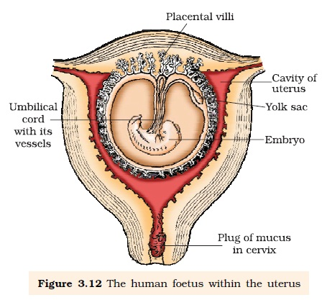
DIAGRAM SHOWING FOETUS INSIDE UTERUS

Slide 5
FUNCTIONS OF PLACENTA
The placenta facilitates the supply of oxygen and nutrients to the embryo.
It help in the removal of carbon dioxide and excretory/waste materials produced by the embryo.
The placenta is connected to the embryo through an umbilical cord which helps in the transport of substances to and from the embryo.
Placenta also acts as an endocrine tissue and produces several hormones like human chorionic gonadotropin (hCG),human placental lactogen (hPL),estrogens, progestogen etc.

Slide 6
GASTRULATION
Gastrulation is a phase early in the embryonic development of most animals, during which the single-layered blastula is reorganized into a multilayered structure known as the gastrula.
Gastrulation occurs when a blastula, made up of one layer, folds inward and enlarges to create a gastrula.
During gastrulation the blastula folds in on itself to form three germ layers the ectoderm, the mesoderm and the endoderm.

Slide 7
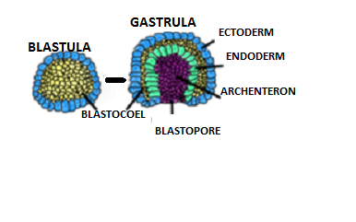
DIAGRAM SHOWING BLASTULA AND GASTRULA

Slide 8
GERM LAYERS
After implantation, the inner cell mass is differentiated into outer layer called ectoderm and an inner layer called endoderm with a middle mesoderm .
Three layers give rise to all organs in adults.
The cells which have the potency to give rise to any types of cells in the body are called stem cells .
FATE OF GERM LAYERS
The ectoderm gives rise to epidermis, the nervous system, and to the neural crest in vertebrates.
The endoderm gives rise to the epithelium of the digestive system and
respiratory system and organs associated with the digestive system, such as the liver and pancreas.
The mesoderm gives rise to many cell types such as muscle, bone, and connective tissue.
Mesoderm derivatives also include the notochord, the heart, blood and blood vessels, the cartilage of the ribs and vertebrae, and the dermi .

Slide 9
The human pregnancy lasts for 9 months, heart develops after one month of pregnancy, limbs develop by the end of second month , major organ systems are formed by the end of 3 months.
First movement and appearance of hairs are during fifth month of pregnancy.
By the end of 24 weeks, the body covers with fine hair, eye-lids separate, eyelashes form.
By the end on nine month, the foetus fully develops.

Slide 10
PARTURITION
The action of giving birth to young is called parturition.
Parturition refers to the process where the fully grown embryo known as foetus is expelled from the mothers womb after the gestation period it refers to giving birth to the baby.
The developed child is born with the release of cortisol.
HORMONES INVOLVED IN PARTURITION
The female hormones involved in parturition include:
Estrogen: This plays a major role in uterine contractions.
Oxytocin: It helps in the uterine contractions during parturition and the release of milk during breastfeeding.
Relaxin: It relaxes the pelvic ligaments and widens the cervix.
Prostaglandin: It is synthesized within the amnion and chorion and facilitates cervix ripening, changing the membrane structures and contraction of the myometrium.

Slide 11
PROCESS OF PARTURITION
The signals for parturition originate from the fully developed foetus and the placenta which induces mild uterine contraction is called foetal ejection reflex.
Foetal ejection reflex causes release oxytocin hormone from the pituitary gland of mother which acts on the uterine muscle and causes contraction of uterus which in turn stimulates further oxytocin secretion
Repeated uterine contractions are followed by cervix dilation under the effect of relaxin secreted by ovary.
This helps the expulsion of the fetus.

Slide 12
LACTATION:
Production of milk at the end of pregnancy by the differentiation of mammary glands is called lactation.
The milk produced during the first few days of lactation is called colostrum.
Colostrum contains antibodies necessary to develop resistance against diseases of the new born baby.
COLOSTRUM:
Colostrum contains large numbers of antibodies called "secretory immunoglobulin" (IgA) that help protect the mucous membranes in the throat, lungs, and intestines of the infant.
Leukocytes are also present in large numbers; these begin protecting the infant from harmful viruses and bacteria.

Slide 13
THANKING YOU
ODM EDUCATIONAL GROUP

