Slide 1

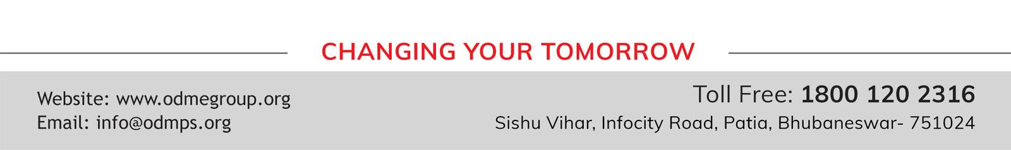
Need for measurement: Units of measurement; systems of units; SI units, fundamental and derived units
XI- SCIENCE
SUBJECT : PHYSICS
CHAPTER NUMBER: 2
CHAPTER NAME : UNITS AND MEASUREMENT

Slide 2
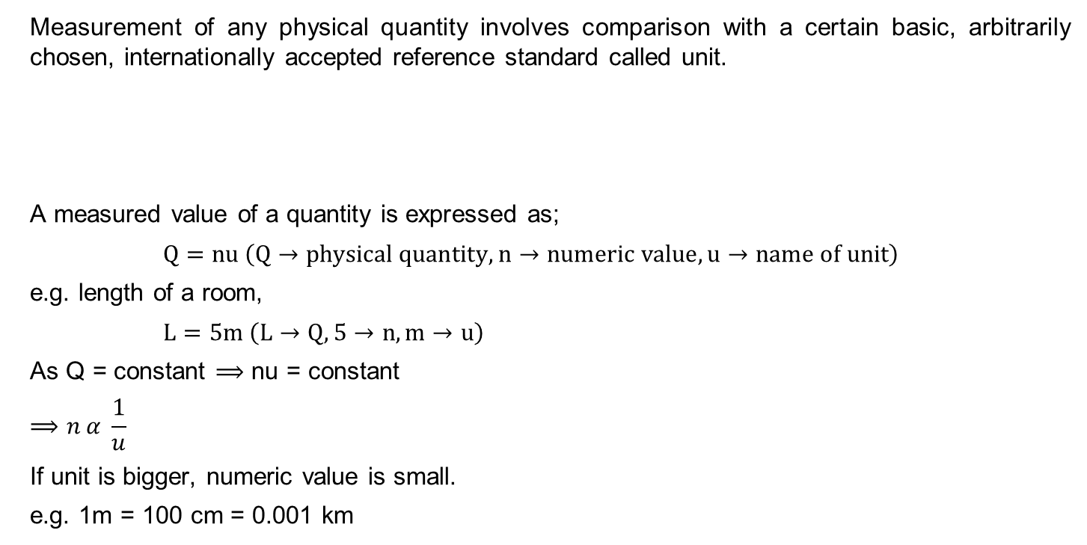
MEASURING PROCESS
Measurement of any physical quantity involves comparison with a certain basic, arbitrarily chosen, internationally accepted reference standard called unit.
A measured value of a quantity is expressed as;
$$Q=nu \left(Q→physical quantity,n→numeric value,u→name of unit\right)$$
e.g. length of a room,
$L=5m \left(L→Q,5→n,m→u\right)$
As Q = constant $⟹$ nu = constant
$$⟹n α \frac{1}{u}$$
If unit is bigger, numeric value is small.
e.g. 1m = 100 cm = 0.001 km
comparison
Unknown physical quantity
Known standard unit

Slide 3
Units and Measurements
Physical Quantity
  A quantity which is measurable is called ‘physical quantity’.
Fundamental Quantity
  A physical quantity which is the base and can not be derived from any other quantity is called ‘fundamental quantity’.
  Examples: Length, Mass, Time, etc.
Derived Quantity
  A physical quantity which can be derived or expressed from base or fundamental quantity / quantities is called ‘derived quantity’.
  Examples: Speed, velocity, acceleration, force, momentum, torque, energy, pressure, density, thermal conductivity, resistance, magnetic moment, etc.

Slide 4
Units and Measurements
Unit
  Measurement of any physical quantity involves comparison with a certain basic, arbitrarily chosen, internationally accepted reference standard called unit.
Fundamental Units
  The units of the fundamental or base quantities are called fundamental or base units.
  Examples: metre, kilogramme, second, etc.
Derived Units
  The units of the derived quantities which can be expressed from the base or fundamental quantities are called derived units.
  Examples: metre/sec, kg/m³, kg m/s², kg m²/s², etc.

Slide 5
System of Units
Some internationally accepted systems of units:
Base Quantities | MKS Unit | Symbol of Unit
MKS System
Mass | kilogram | kg
Length | meter | m
Time | second | s
CGS System
Mass | gram | g
Length | centimeter | cm
Time | second | s

Slide 6
System of Units
Some internationally accepted systems of units:
Base Quantities | MKS Unit | Symbol of Unit
FPS System
Mass | pound | lb
Length | foot | ft
Time | second | s
SI System
Mass | kilogram | kg
Length | meter | m
Time | second | s

Slide 7
Systeme Internationale d’ unites (SI Units)
The SI system with standard scheme of symbols, units and abbreviations was developed and recommended by General Conference on Weights and Measures in 1971 for international usage in scientific, technical, industrial and commercial work.
This is the system of units which is at present accepted internationally.
SI system uses decimal system and therefore conversions within the system are quite simple and convenient.

Slide 8
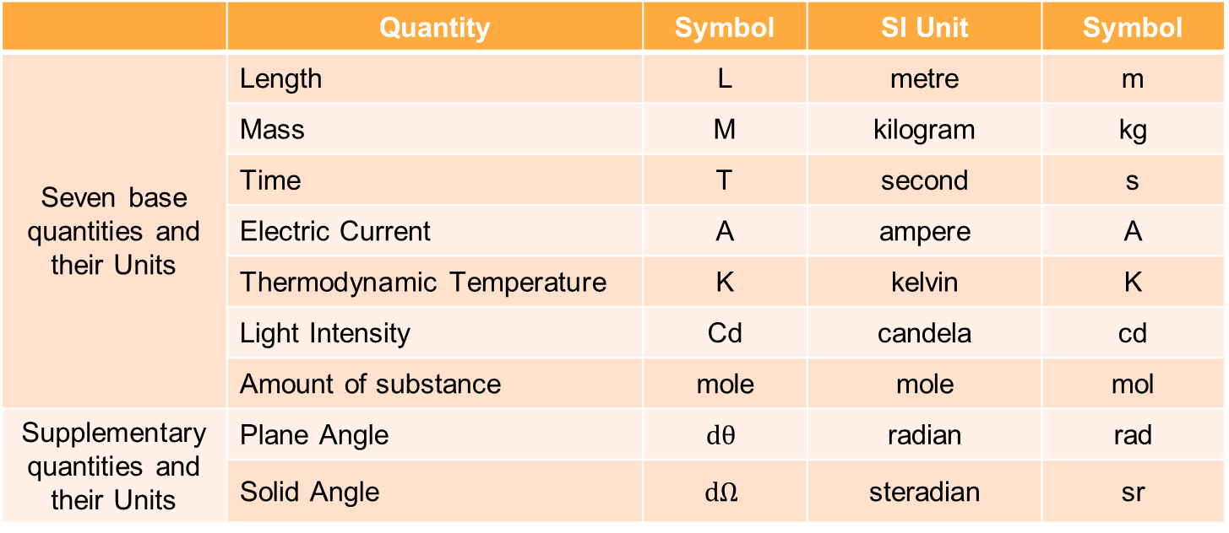
Fundamental Units in SI system
 | Quantity | Symbol | SI Unit | Symbol
Seven base quantities and their Units | Length | L | metre | m
 | Mass | M | kilogram | kg
 | Time | T | second | s
 | Electric Current | A | ampere | A
 | Thermodynamic Temperature | K | kelvin | K
 | Light Intensity | Cd | candela | cd
 | Amount of substance | mole | mole | mol
Supplementary quantities and their Units | Plane Angle | $$dθ$$ | radian | rad
 | Solid Angle | $$dΩ$$ | steradian | sr

Slide 9
Plane Angle
Plane angle ‘dθ’ is the ratio of arc ‘ds’ to the radius ‘r’. Its SI unit is ‘radian’.
ds
r
ds
dθ =
r
dθ
r
O

Slide 10
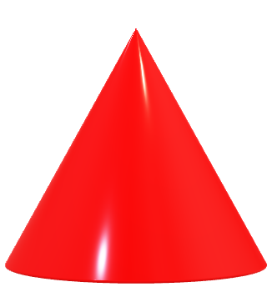
Solid Angle
Solid angle ‘dΩ’ is the ratio of the intercepted area ‘dA’ of the spherical surface described at the apex ‘O’ as the centre, to the square of its radius ‘r’.
Its SI unit is ‘steradian’.
dA
r
r
dΩ
O
dA
dΩ =
r²

Slide 11
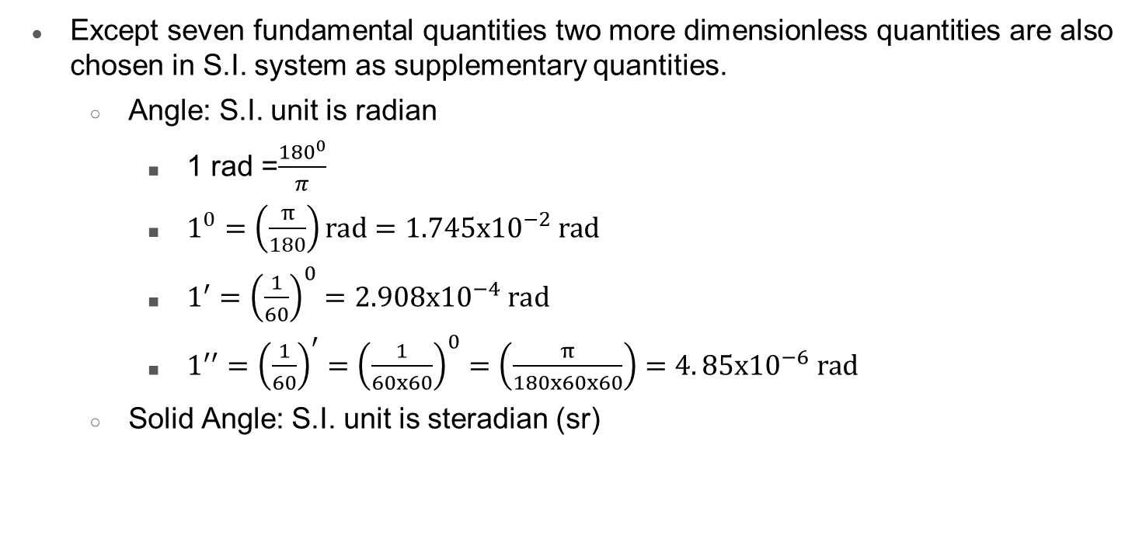
System of Units
Except seven fundamental quantities two more dimensionless quantities are also chosen in S.I. system as supplementary quantities.
  Angle: S.I. unit is radian
    1 rad =$\frac{{180}^{0}}{π}$
    $1^{0}=\left(\frac{π}{180}\right)rad=1.745x{10}^{−2} rad$
    $1^{′}={\left(\frac{1}{60}\right)}^{0}=2.908x{10}^{−4} rad$
    $1^{′′}={\left(\frac{1}{60}\right)}^{′}={\left(\frac{1}{60x60}\right)}^{0}=\left(\frac{π}{180x60x60}\right)=4. 85x{10}^{−6} rad$
  Solid Angle: S.I. unit is steradian (sr)

Slide 12

System of Units
Except the above systems, a system can also be framed by considering some quantities as fundamental quantities, but they should be independent of each other.
$∵energy=force x length$

Slide 13
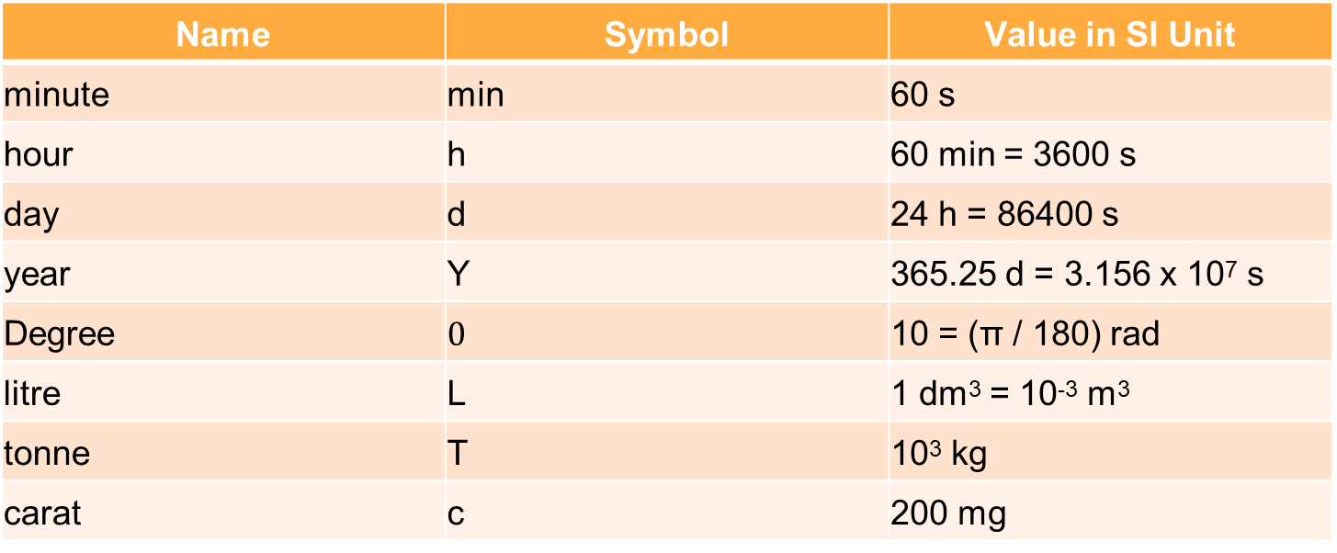
Some Units are retained for general use (Though outside SI)
Name | Symbol | Value in SI Unit
minute | min | 60 s
hour | h | 60 min = 3600 s
day | d | 24 h = 86400 s
year | Y | 365.25 d = 3.156 x 10⁷ s
Degree | $$0$$ | 10 = (π / 180) rad
litre | L | 1 dm³ = 10⁻³ m³
tonne | T | 10³ kg
carat | c | 200 mg

Slide 14
Some Units are retained for general use (Though outside SI)
Name | Symbol | Value in SI Unit
bar | Bar | 0.1 MPa = 10⁵ Pa
curie | ci | 3.7 x 10¹⁰ s⁻¹
roentgen | r | 2.58 x 10 ⁻⁴ C/kg
quintal | q | 100 kg
barn | b | 100 fm² = 10⁻²⁸ m²
are | a | 1 dam² = 10² m²
hectare | ha | 1 hm² = 10⁴ m²
standard atmosphere pressure | atm | 101325 Pa = 1.013 x 10⁵ Pa

Slide 15
MCQ TYPE QUESTIONS
Which of the following sets of quantities can be taken as fundamental quantities of a system.
  force, pressure, length
  mass, length, density
  mass, speed, time
  acceleration, length, time
Which of the following quantities can’t be derived quantities in MKS system?
  force
  electrical energy
  electric potential
  pressure

Slide 16
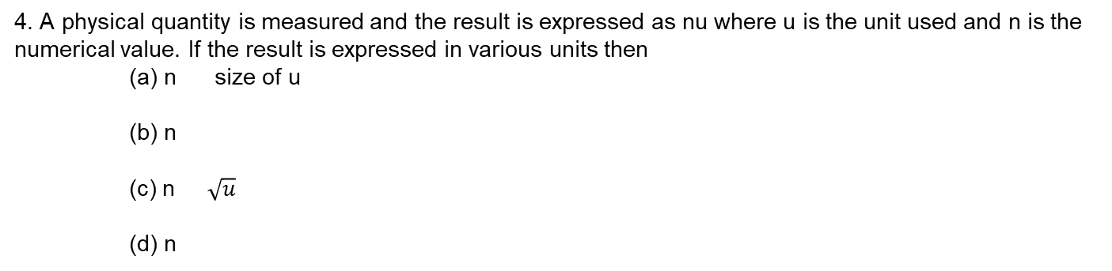




MCQ TYPE QUESTIONS
3. Which of the following sets cannot enter into the list of fundamental quantities in any system of units?
(a) length, mass and velocity,
(b) length, time and velocity,
(c) mass, time and velocity,
(d) length, time and mass.
4. A physical quantity is measured and the result is expressed as nu where u is the unit used and n is the numerical value. If the result is expressed in various units then
(a) n size of u
(b) n
(c) n $\sqrt{u}$
(d) n
$∝$
$∝$
$$u^{2}$$
$∝$
$∝$
$$\frac{1}{u}$$

Slide 17
MCQ TYPE QUESTIONS
Which of the following sets of quantities can be taken as fundamental quantities of a system.
  force, pressure, length
  mass, length, density
  mass, speed, time
  acceleration, length, time
Which of the following quantities can’t be derived quantities in MKS system?
  force
  electrical energy
  electric potential
  pressure

Slide 18
MCQ TYPE QUESTIONS
3. Which of the following sets cannot enter into the list of fundamental quantities in any system of units?
(a) length, mass and velocity,
(b) length, time and velocity,
(c) mass, time and velocity,
(d) length, time and mass.
4. A physical quantity is measured and the result is expressed as nu where u is the unit used and n is the numerical value. If the result is expressed in various units then
(a) n size of u
(b) n
(c) n $\sqrt{u}$
(d) n
$∝$
$∝$
$$u^{2}$$
$∝$
$∝$
$$\frac{1}{u}$$

Slide 19
LENGTH, MASS AND TIME MEASUREMENTS;
XI- SCIENCE
SUBJECT : PHYSICS
CHAPTER NUMBER: 2
CHAPTER NAME : UNITS AND MEASUREMENTS

Slide 20
Measurement of Length
The order of distances varies from ${10}^{−14} m$ (radius of nucleus) to ${10}^{25} m$ (radius of the Universe)
The distances ranging from ${10}^{−5} m$ to ${10}^{2} m$ can be measured by direct methods which involves comparison of the distance or length to be measured with the chosen standard length.
Example:
A metre rod can be used to measure distance as small as ${10}^{−3}$ m.
A vernier callipers can be used to measure as small as ${10}^{−4}$ m.
A screw gauge is used to measure as small as ${10}^{−5}$ m.
For very small distances or very large distances indirect methods are used.

Slide 21
Measurement
Measurement can be done by using instruments, or some mathematical methods or some assumptions.
While using an instruments following points are worth noting
Least count (LC)
It is the least measurement that can be taken by the instrument .
e.g. : Least count of a meter scale = 1mm =0.1 cm
Least count of graph paper for measuring length = 0.1 cm
Least count of graph paper for measuring area = 0.01 ${cm}^{2}$
Least count of wrist watch = 1 s
LC of a slide caliper = 1MSD – 1 VSD
LC of a screw gauge = $\frac{Pitch}{number of divisions in circular scale}$

Slide 22
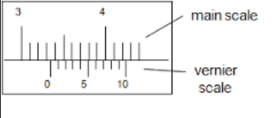
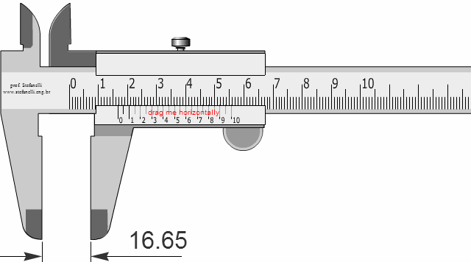
Vernier calliper
LC of a slide caliper = 1MSD – 1 VSD
10 VSD = 9 MSD
1 VSD = 0.9MSD = 0.9x0.1cm=0.09cm
LC = 1 MSD – 1 VSD
= 0.1cm – 0.09 cm
= 0.01 cm

Slide 23
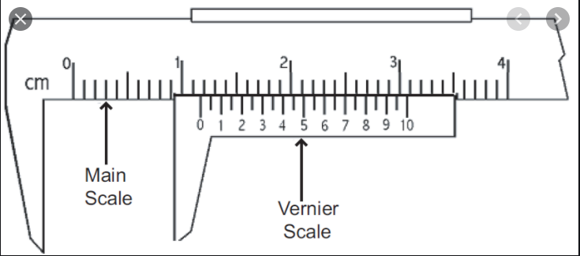
Numerical
Question: A slide caliper has 20 divisions in sliding scale or Vernier scale.
1 MSD = 0.1 cm. Calculate its least count.
Solution:
Generally for a slide caliper if vernier scale has n divisions then,
n vernier scale divisions = ( n-1 ) main scale divisions
So, here
20 VSD = 19 MSD = 1.9 cm
1 VSD = ( 1.9 cm / 20 )
= 0.095 cm
LC = 1 MSD – 1 VSD
= 0.1cm – 0.095 cm
= 0.005 cm

Slide 24
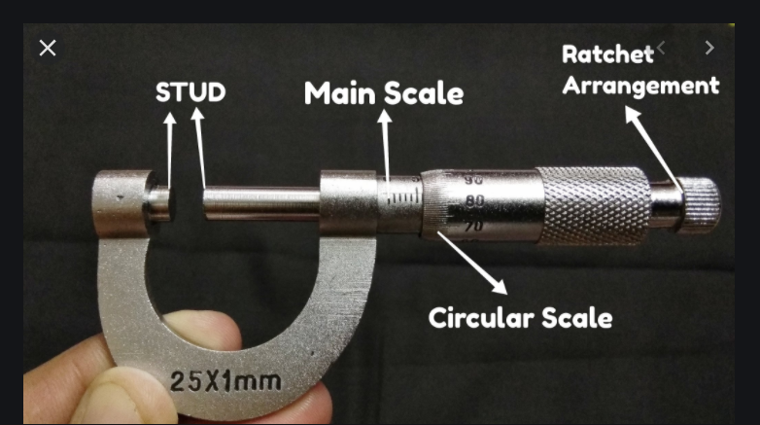
Numerical
Question: A screw gauge has pitch 1mm and 100 divisions on the circular scale. Calculate its least count.
Solution:
LC of a screw gauge = $\frac{Pitch}{number of divisions in circular scale}=\frac{.1 cm}{100}=0.001 cm$

Slide 25
Numerical
Question: An optical instrument can measure length upto a range wavelength of light. What is its least count.
Solution:
LC = ${10}^{−7}m={10}^{−5}cm=0.00001 cm$

Slide 26
Measurement
Precision
It is the degree of uncertainty in a measurement by an instrument.
The observations by an instrument is said to be more precise if the readings are closer to each other. E.g. If we take observations by a meter scale, then two close readings may be 3.5 cm and 3.6 cm differing by 0.1 cm .
If we take observations by a slide caliper, then two close readings may be 3.51 cm and 3.52 cm differing by 0.01 cm.
So measurements taken by slide caliper are more precise than meter scale.
So device with less least count is more precise.

Slide 27
Numerical
Question: Which of the followings is more precise device?
A slide caliper has 20 divisions in sliding scale or vernier scale. 1 MSD = 0.1 cm.
A screw gauge has pitch 1mm and 100 divisions on the circular scale.
An optical instrument can measure length to within a wavelength of light. What is its least count?
Solution:
a) LC = 0.005cm
b) LC = $0.001 cm$
c) LC = $0.00001 cm$
As lowest least count

Slide 28
Measurement
Accuracy
Accuracy is how close is a measurement to the true value .
e.g. : Let length of a cylinder be 2.0345 cm .
Now if an instrument measures the length as 2.03 cm
and other instrument measures as 2.002 cm
then 1st reading is more accurate while the 2nd one is more precise.

Slide 29
Measurement of Large Distances
The following indirect methods may be used to measure very large distances:
Parallax method
Let us consider a far away planet ‘P’ at a distance ‘D’ from our two eyes.
Suppose that the lines joining the planet to the left eye (L) and the right eye (R) subtend an angle θ (in radians).
The angle θ is called ‘parallax angle’ or ‘parallactic angle’ and the distance LR = b is called ‘basis’.
As the planet is far away, b/D << 1, and therefore θ is very small
Then, taking the distance LR = b as a circular arc of radius D, we have
P
θ
D
D
L
b
R
LR
b
θ =
=
D
D
b
D =
θ

Slide 30
System of Units
Except seven fundamental quantities two more dimensionless quantities are also chosen in S.I. system as supplementary quantities.
  Angle: S.I. unit is radian
    1 rad =$\frac{{180}^{0}}{π}$
    $1^{0}=\left(\frac{π}{180}\right)rad=1.745x{10}^{−2} rad$
    $1^{′}={\left(\frac{1}{60}\right)}^{0}=2.908x{10}^{−4} rad$
    $1^{′′}={\left(\frac{1}{60}\right)}^{′}={\left(\frac{1}{60x60}\right)}^{0}=\left(\frac{π}{180x60x60}\right)=4. 85x{10}^{−6} rad$
  Solid Angle: S.I. unit is steradian (sr)

Slide 31
NUMERICALS
Question: The moon is observed from two diametrically opposite points A and B on earth. The angle $θ$ subtended at the moon by the two directions of observation is 1°54'. Given the diameter of the earth to be about $1.276x{10}^{7}$m, compute the distance of the moon from the earth.
Moon
θ
S
S
A
B
d
Earth

Slide 32
NUMERICALS
Question: The moon is observed from two diametrically opposite points A and B on earth. The angle $θ$ subtended at the moon by the two directions of observation is 1°54'. Given the diameter of the earth to be about $1.276x{10}^{7}$m, compute the distance of the moon from the earth.
Solution:
$$θ=1^{0}{54}^{′}={60}^{′}+{54}^{′}={114}^{′}$$
$={\left(114x60\right)}^{′′}=\left(114x60\right)$x(4.85x ${10}^{−5}) rad$
$=3.32x{10}^{−2} rad$
AB= ${1.276x10}^{7}m$
$$θ=\frac{d}{S}$$
$$S=\frac{d}{θ}=\frac{1.276x{10}^{7}m}{3.32x{10}^{−2} rad}=3.84x{10}^{8}m$$
Moon
θ
S
S
A
B
d
Earth

Slide 33
Measurement of the size or angular diameter of an astronomical object
If ‘d’ is the diameter of the planet and ‘α’ is the angular size of the planet (the angle subtended by d at the Earth E), then
α = d/D (angular diameter)
The angle α can be measured from the same location on the earth.
It is the angle between the two directions when two diametrically opposite points of the planet are viewed through the telescope.
Since D is known, the diameter d of the planet can be determined from
d
D
D
α
E
d = α D

Slide 34
NUMERICALS
Question: The sun's angular diameter is measured to be 1920". The distance of the sun from the earth is $1.496x{10}^{11}m$ . What is the diameter of the sun?
d
D
D
α
E
d = α D

Slide 35
NUMERICALS
Question: The sun's angular diameter is measured to be 1920". The distance of the sun from the earth is $1.496x{10}^{11}m$ . What is the diameter of the sun?
Solution:
α = angular diameter
= $1920 x4.85x{10}^{−6}$
= $9.31x{10}^{−3}rad$
α = d/D
$d=αD$
d $=9.31x{10}^{−3}x1.496x{10}^{11}m=1.39x{10}^{9}m$
d
D
D
α
E
d = α D

Slide 36
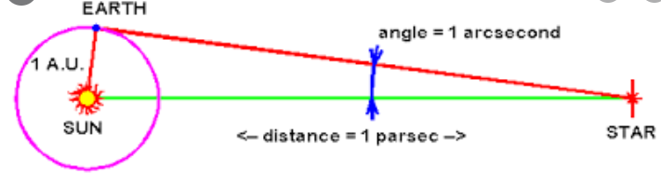
Measurement of Lengths
Astronomical Unit (AU)
It is a unit of length used to express astronomical distance. The mean distance between sun and earth. It is equal to $1.496x{10}^{11}m$.
Parsec
It is a unit of length used to express astronomical distance.
The distance at which the mean radius of earth's orbit subtends an angle of one second of arc.
It is equal to $3.0857x{10}^{16}m$.
Light Year
It is a unit of length used to express astronomical distance.
The distance travelled by light in vacuum in one year.
It is equal to $9.4650x{10}^{15}m$.

Slide 37
Measurement of the size or angular diameter of an astronomical object
The size of the objects we come across in the Universe varies over a very wide range.
These may vary from the size of the order of ${10}^{−14}$ m of the tiny nucleus of an atom to the size of the order of ${10}^{26}$ m of the extent of the observable Universe.
We also use certain special length units for short and large lengths which are given below:
Unit | Symbol | Value | Definition
1 fermi | 1 f | 10^{–15} m
1 angstrom | 1 Å | 10^{–10} m
1 Astronomical Unit | 1 AU | 1.496 × 10¹¹ m | Average distance of the Sun from the Earth
1 light year | 1 ly | 9.46 × 10¹⁵ m | The distance that light travels with speed of 3 × 10⁸ m s^{–1} in 1 year
1 parsec |  | 3.08 × 10¹⁶ m (3.26 ly) | The distance at which average radius of Earth’s orbit subtends an angle of 1 arc second

Slide 38
Range and Order of Lengths
(L_{longest} : L_{shortest} = 10⁴¹ : 1)
S.No | Size of the object or distance | Length (m)
1 | Size of proton | 10⁻¹⁵
2 | Size of atomic nucleus | 10⁻¹⁴
3 | Size of the Hydrogen atom | 10⁻¹⁰
4 | Length of a typical virus | 10⁻⁸
5 | Wavelength of a light | 10⁻⁷
6 | Size of the red blood corpuscle | 10⁻⁵
7 | Thickness of a paper | 10⁻⁴
8 | Height of the Mount Everest from sea level | 10⁴
9 | Radius of the Earth | 10⁷
10 | Distance of the moon from the earth | 10⁸
11 | Distance of the Sun from the earth | 10¹¹
12 | Distance of the Pluto from the Sun | 10¹³
13 | Size of our Galaxy | 10²¹
14 | Distance of the Andromeda galaxy | 10²²
15 | Distance of the boundary of observable universe | 10²⁶

Slide 39
Measurement
Measurement of Mass
Unified atomic mass unit, $u=\frac{1}{12}th$of the mass of carbon-12 atom
Measurement of Time
CESIUM CLOCK we use an atomic standard of time, which is based on the periodic vibrations produced in a cesium atom. This is the basis of cesium clock or atomic clock.

Slide 40
Home Assignment
A slide calliper has 50 divisions on the sliding scale. 1 MSD = 0.1 cm. Calculate its least count.
A screw gauge has pitch 0.5 cm. There are 100 divisions on its circular scale. Calculate the least count.
You are given with a thread and a meter scale. How can you estimate the diameter of the thread?
1 parsec = ……. Ly = ……… A.U.
NCERT exercise 2.1 and 2.2

Slide 41
ERRORS IN MEASUREMENT
XI- SCIENCE
SUBJECT : PHYSICS
CHAPTER NUMBER: 2
CHAPTER NAME : UNITS AND MEASUREMENT

Slide 42
Errors in Measurement
Errors are the deviations of observed values from true values.
ERROR = TV - MV
TV = true value
MV = measured value
Note: In absence of any other method of knowing true value, we consider arithmetic mean as the true value.

Slide 43
Types of Errors
In general, the errors in measurement can be broadly classified as
Systematic errors
Random errors
Types of Errors
Systematic Errors
Random Errors

Slide 44
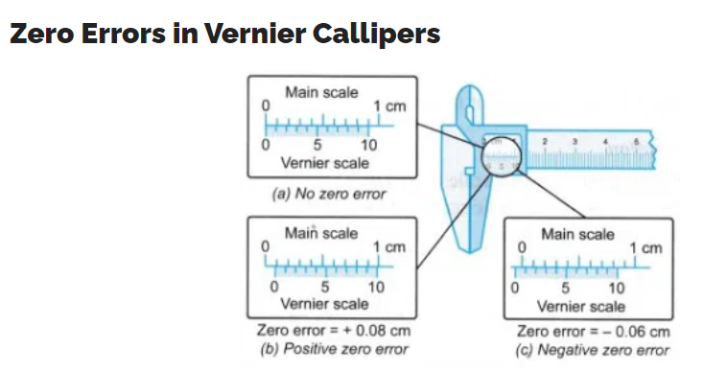
Types of Errors - Systematic Errors
Systematic Errors
The systematic errors are those errors that tend to be in one direction, either positive or negative. Some of the sources of systematic errors are:
Instrumental errors:
The instrumental errors that arise from the errors due to imperfect design or calibration of the measuring instrument, zero error in the instrument, etc.
Example:
The temperature graduations of a thermometer may be inadequately calibrated (it may read 104 °C at the boiling point of water at STP whereas it should read 100 °C);
In a Vernier calipers the zero mark of Vernier scale may not coincide with the zero mark of the main scale;
An ordinary metre scale may be worn off at one end.

Slide 45
Types of Errors - Systematic Errors
Imperfection in experimental technique or procedure
To determine the temperature of a human body, a thermometer placed under the armpit will always give a temperature lower than the actual value of the body temperature.
Personal errors
The personal errors arise due to an individual’s bias, lack of proper setting of the apparatus or individual’s carelessness in taking observations without observing proper precautions, etc.
Example: If you hold your head a bit too far to the right while reading the position of a needle on the scale, you will introduce an error due to parallax.
Systematic errors can be minimized by
improving experimental techniques,
selecting better instruments and
removing personal bias as far as possible

Slide 46
Errors in Measurement
Random errors:
These errors occur irregularly and hence random w.r.t sign and size.
These may arise due to random and unpredictable fluctuations in experimental conditions.
Least count error :
The least count error is the error associated with the resolution of the instrument.
e.g. : If we are measuring by a slide caliper then least count = 0.01 cm. So various observation of a measurement can be ; 3.12 cm , 3.13 cm , 3.14 cm and so on. So error is arising in 2nd decimal place i.e. 0.01 cm. This is least count error.
Least count error occurs with both systematic and random error.
It can be reduced by using instruments of high resolutions or high precision.

Slide 47
Absolute Error, Relative Error and Percentage Error
Absolute error
The magnitude of the difference between the individual measured value and the true value of the quantity is called the absolute error of the measurement.
This is denoted by |Δa|.
Note: In absence of any other method of knowing true value, we consider arithmetic mean as the true value.
The errors in the individual measurement values from the true value are:
Δa₁ = a_{mean} - a₁
Δa₂ = a_{mean} - a₂
.
.
Δa_{n} = a_{mean-} a_{n}
The Δa calculated above may be positive or negative.
But absolute error |Δa| will always be positive.

Slide 48
Absolute Error, Relative Error and Percentage Error
The arithmetic mean of all the absolute errors is taken as the final or mean absolute error of the value of the physical quantity .
It is represented by ${∆a}_{mean}$.
Thus, ${∆a}_{mean}=\frac{(\left|∆a_{1}\right|+\left|∆a_{2}\right|+\left|∆a_{3}\right|+..+\left|∆a_{n}\right|)}{n}=\sum_{i=1}^{n}{\left|∆a_{i}\right|}$
If we do a single measurement, the value we get may be in the range
a_{mean} ± Δa_{mean}
This implies that any measurement of the physical quantity a is likely to lie between
(a_{mean} + Δa_{mean}) and (a_{mean} - Δa_{mean})

Slide 49
Absolute Error, Relative Error and Percentage Error
Relative error
The relative error is the ratio of the mean absolute error ${∆a}_{mean}$to the mean value of the quantity measured.
$$Relative error=\frac{Mean absolute error}{True value or Arithmetic Mean}$$
$$Relative error=\frac{{∆a}_{mean}}{a_{mean}}$$

Slide 50
Absolute Error, Relative Error and Percentage Error
Percentage error
When the relative error is expressed in percent, it is called the percentage error ($δa$).
$$Percentage error=\frac{Mean absolute error}{True value or Arithmetic Mean}x100\%$$
$$Percentage error\left(δa\right)=\frac{{∆a}_{mean}}{a_{mean}}x100\%$$

Slide 51
Numerical
Question: We measure the period of oscillation of a simple pendulum. In successive measurements, the readings turn out to be 2.63s, 2.56s, 2.42s, 2.71s, and 2.80s. Calculate the absolute errors, relative error or percentage error.

Slide 52
Numerical
Question: We measure the period of oscillation of a simple pendulum. In successive measurements, the readings turn out to be 2.63s, 2.56s, 2.42s, 2.71s, and 2.80s. Calculate the absolute errors, relative error or percentage error.
Solution: The mean period of oscillation is
$$\overline{T}=\frac{\text{2.63 + 2.56 + 2.42 + 2.71+ 2.80}}{5}s=2.62s$$
The absolute error are:
$$∆T_{1}=\left|\overline{T}−T_{1}\right|=\left|2.62−2.63\right|s=0.11s$$
$$∆T_{2}=0.06s$$
$$∆T_{3}=0.20s$$
$$∆T_{4}=0.09s$$
$$∆T_{5}=0.18s$$

Slide 53
Numerical
Solution:
The mean absolute error is
$$\overline{∆T}=\frac{\text{0.01+.06+0.20+0.09+0.18}}{5}s=0.11s$$
So the period of the oscillation of simple pendulum is $(2.62±0.11)s$
The relative error is $\frac{0.11}{2.62}=0.04$
The percentage error is $\left(\frac{0.11}{2.62}x100\right)\%=4\%$

Slide 54
MCQ
Potential difference across a resistance measured by a voltmeter is found to be 20 V with 5% error. What is the maximum absolute error of the measurement?
  1 V b) 2V c) 0.1 V d) 0.2 V
Length of a cylinder is measured by a slide caliper and found to be 2.5cm$±$0.03cm. Its percentage error is
  3% b) 2.5% c) 1.2% d) 7.5 %
Least count error undergoes the category of
  systematic error b) Random error
  both random and systematic error d) non of the above

Slide 55
THANKING YOU
ODM EDUCATIONAL GROUP

