Slide 1
SUBJECT : ENGLISH
INTRODUCTION
Concept- Domination of male community, Plight of women

Slide 2
LEARNING OUTCOMES
Students will be able to-
Learn about Feminist trends in literature.
About the suppression of women in a male-dominated society.
Identify poetic devices.
understand the critical appreciation of the poem
understand that man and woman are equal
empathise with the victims of male chauvinism
be prepared to face such oppressions boldly
raise voice against domestic violence
understand that females even have inherent desires and they deserve freedom: mental and emotional both

Slide 3
INTODUCTORY VIDEO LINK
https://youtu.be/R0LXAC2PXuU

Slide 4
AUDIO LINK – OF THE POEM – AN AUNT JENNIFER'S TIGER
https://youtu.be/k0P2IIqVI-0

Slide 5
Chapter No. : 5 (Flamingo)
CHAPTER : AN AUNT JENNIFER'S TIGER By- Adrienne Rich

Slide 6
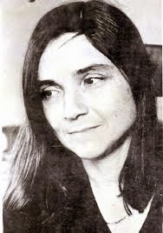
A FEW FACTS ABOUT THE POET ADRIENNE RICH
Adrienne Cecile Rich
· Born – May 16, 1929, Baltimore USA
· Died - March 27, 2017, 2012, Santa Cruz, California, USA
· She was a famous American Poet, essayist and non-fiction writer
Notable works –
1) On lies, secrets and silence
2) A change in the world
3) Poetry and commitment An essay
4) Divinity into the wreck
Awards –
1) National Book Award (1974)
2) Bollingen prize (2003)
3) Griffin Poetry Prize (2010)

Slide 7
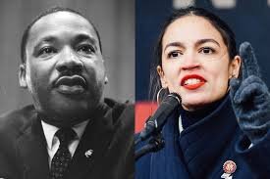
SUB – CONCEPTS
Patriarchy
Ordeals of married life
Wedding responsibility
Racism
Materialism
Feminism
Tiger-like virtues

Slide 8
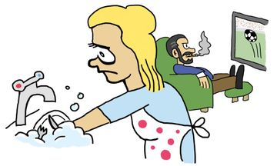
THEME OF THE POEM:
Marriage is unequal due to male domination/Inequality.
The world of art is happier than the real world/Dream versus Reality.
Female Role in Home
Female Role in Marriage
Animals as Symbols
Women and Nature
Patriarchal Power
Individual Freedoms
Political Issues
Art as escapism

Slide 9
BACKGROUND AND SETTING OF THE POEM
Aunt Jennifer’s tigers is a poem by Adrienne Rich illustrating her feminist concerns.
In the male dominant world, a woman of her time was only supposed to be a dutiful homemaker.
This poem through the world of Aunty Jennifer, tells us about her inner desire to free herself from the clutches of an abusive marriage and patriarchal society.

Slide 10
INTRODUCTION
‘Aunt Jennifer’s Tigers’ is a poem which reflects a woman who is stressed because of social restraints and responsibility of an ideal wife.
She is a lady who lacks confidence, strength, and the very sense fearlessness.
She does not dare to go against the established and common way of life.
Rather she chose to rebel by her needlework.
Through the needlework, she rebels against her husband’s dominance and her subdued life.
She gives tongue to her desire through the tigers that she reflected by her needlework.
Her tigers represent what she lacks.
Her tigers are brave, courageous unafraid, proud and chivalric.
What she desires from her husband is a little honour, importance and value as a real wife.
And she desires to bring an end to the social beliefs about women where they are treated as to be ruled by the male dominating society.

Slide 11
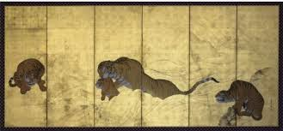
CONTENTS OF AN AUNT JENNIFER’S TIGER
Extract -1 Line – 1-4
“Aunt Jennifer’s tigers prance across a screen,
Bright topaz denizens of a world of green.
They do not fear the men beneath the tree:
They pace in sleek chivalric certainty”
Vocabulary:
Prance ‐ jump or move in a spirited manner
Screen ‐ here, the wall or the surface of the tapestry
Topaz ‐ a bright yellow precious stone
Denizens ‐ inhabitants
Chivalric ‐ brave and honourable
Certainty ‐ confidence

Slide 12
CONTENTS OF AN AUNT JENNIFER’S TIGER
Extract -1 Line – 1-4
Poetic devices in use
1)Rhyme scheme: AABB
2)Anaphora: use of the same word in two consecutive lines (they do not … and they pace in…)
3)Metaphor: Use of topaz to describe the yellow colour of tigers (Bright topaz)
4) Alliteration – “Chivalric certainty”, “the tree” etc.
EXPLANATION
The poet is talking about a lady whom she addresses as an aunt, Jennifer.
She is embroidering a piece of cloth. It could be a table cloth or a wall hanging.
The pattern shows tigers who are moving and jumping around all over the fabric.
They are bright yellow like the colour of the topaz stone (use of metaphor).
The dense green forest background is their home.
They are the proud and fearless citizens of the forest.
Here is a contrast between Aunt Jennifer and her tigers. The tigers are fearless but this lady, who is embroidering them is not so.
The tigers look elegant, shining and full of the gentleman’s grace.

Slide 13
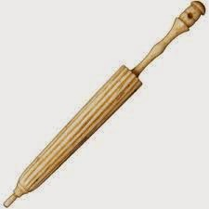
CONTENTS OF AN AUNT JENNIFER’S TIGER
Extract -2 Line – 5-8
“Aunt Jennifer’s fingers fluttering through her wool
Find even the ivory needle hard to pull.
The massive weight of Uncle’s wedding band
Sits heavily upon Aunt Jennifer’s hand.”
Vocabulary:
Fluttering ‐ moving with a light irregular of trembling motion
Massive ‐ heavy
Wedding band ‐ wedding pact, signifying martial duties
Poetic Devices in use
1) Alliteration – ‘fingers fluttering’
2) Enjambment – “...........fluttering through her wool
Find even .............”
3) Hyperbole – The massive weight of the uncle’s wedding band
4) Rhyme scheme: AABB

Slide 14
CONTENTS OF AN AUNT JENNIFER’S TIGER
Extract -2 Line – 5-8
EXPLANATION
The lady’s fingers are trembling with the fear of her husband.
She is pursuing her hobby in her free time but probably, she is still afraid of her husband who could scold her.
Her fingers are so tired of working endlessly all her life
The needle is also heavy for her to pull out of the cloth.
The words ‘uncle’s wedding band’ as the band was bought by her husband, it is his till today.
The lady is dependent on her husband.
She is still burdened by the weight of the ring. ‘weight’ means the encirclement or trapping that has fallen upon her by getting married to him, she has been burdened by the obligations of married life, has become the man’s property.
She has been living a demanding life due to which she has worn out in her old age.

Slide 15
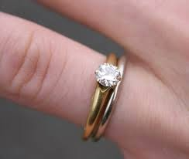
CONTENTS OF AN AUNT JENNIFER’S TIGER
Extract -3 Line – 9-12
“When Aunt is dead, her terrified hands will lie
Still ringed with ordeals she was mastered by
The tigers in the panel that she made
Will go on prancing, proud and unafraid.”
Vocabulary:
Ringed ‐ confident of tied up
Ordeals ‐ unpleasant or painful experiences
Mastered ‐ controlled
Panel ‐ a flat board

Slide 16
CONTENTS OF AN AUNT JENNIFER’S TIGER
Extract -3 Line – 9-12
Poetic – devices in use
1) Personification – terrified hands. 2) Climax – will go on prancing, proud, and afraid.
3)Alliteration: ‘p’ is repeated in prancing proudly
4)Rhyme scheme: AABB
EXPLANATION
Her wish to live a free, fearless life is indicated by her choice of design – tigers.
It shows her innermost desire of being strong, fearless which has been overpowered by her husband.
Probably, her ordeal will end upon her death.
Her frightened, shaking fingers will be put to rest.
But still, even after death, the ring shall remain on her hand, i.e. her husband’s rule over her is not yet over!
After her death, her desire for freedom and fearlessness shall remain alive in these tigers which she has embroidered.

Slide 17
SYMBOLS IN THE POEM
Aunt Jennifer represents women all over the world wedged under the tyrannical hand of a patriarchal society.
Aunt Jennifer’s tigers symbolise her dreams and desire of being powerful, fearless, decisive and liberated.
The wedding band signifies the patriarchal society where the command is defined as masculine.
Uncle denotes the oppressor.
Aunt Jennifer’s hands represent the reality of her life.

Slide 18
THE CONTRAST IN THE POEM
Aunt Jennifer is an oppressed woman dominated by male superiority, victimized, fearful, indecisive, weak, timid, shivering in fear, stifled and weighed upon by the marriage, whereas the tigers she weaves as chivalric, confident, fearless, assertive, strong and energetic

Slide 19
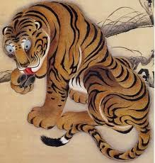
CONCLUSION OF A THING OF BEAUTY JOY FOR EVER
An Aunt Jennifer’s Tigers summarise the poet wants to represent the life of a woman who has to live under a constant fear from her husband. Also, she will only get freedom when she will die. The freedom represents to the tiger.

Slide 20
MORAL/MESSAGE OF THE POEM
“Aunt Jennifer’s Tigers” is a statement of conflict in women, specifically between the impulse to freedom and imagination.
Aunt Jennifer wants a life that she embroiders on the panel.
She wants a colour full vibrant life which every woman should have the power to create.

Slide 21
MAY I CHECK UP YOUR COMPREHENSION?
What is the theme of the poem?
What are the poetic devices used in the poem?
What is the poet’s mission in creating ‘tigers’?
Describe Jennifer’s tigers.
Why does the poet find difficulty to pull her ivory needles?
What does ‘uncle’s wedding band’ refer to?
Why does the poet say ‘her hands terrified’?
What shall be the consequence of the tigers, she has created following her demise?
Do you say the poet’s married life is remorseful and tiring? Give pieces of evidence from the poem.
Compare and contrast Aunt Jennifer and her tigers.

Slide 22
THANKING YOU
ODM EDUCATIONAL GROUP

