Slide 1
WELCOME TO ONLINE CLASS
CLASS-UKG
SUBJECT-MATHS
TOPIC- SMALLEST NUMBER
& SMALL TO BIG

Slide 2
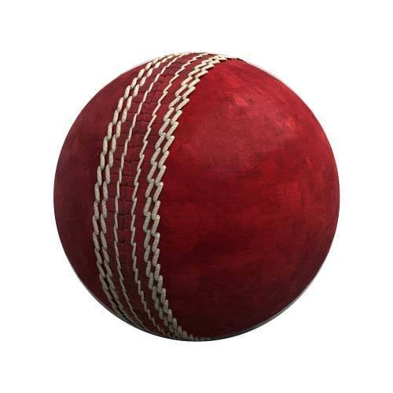
LET’S REVISE CAN YOU RECOGNISE THE SMALLEST BALL?
S
M
A
L
L
E
S
T

Slide 3
LET’S ARRANGE THE BALLS FROM SMALL TO BIG
SMALL
BIG

Slide 4
TODAY’S TOPIC
SMALLEST NUMBER &
ARRANGE NUMBERS FROM SMALL TO BIG

Slide 5
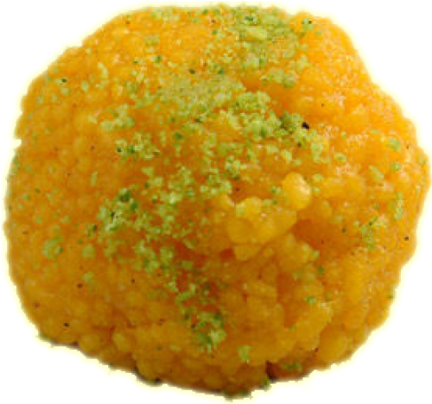
COUNT AND SAY THE PLATE HAVING LESS NUMBER OF LADOOS.
5
4
6
SMALLEST NUMBER

Slide 6
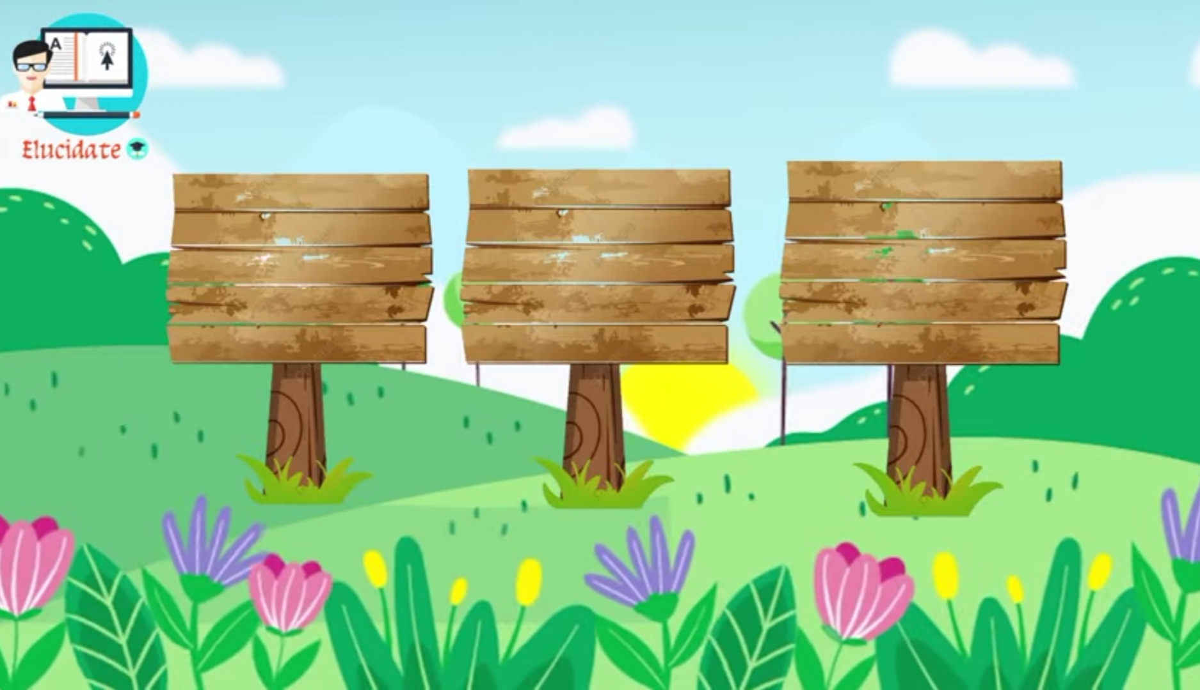
SAY THE SMALLEST NUMBER
15
18
12

Slide 7
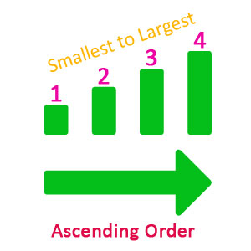
SMALL TO BIG
SMALLEST NUMBER
SMALL TO BIG

Slide 8
Let’s know rules for arranging numbers from small to big

Slide 9
Arrange numbers from small to big
T | O
2 | 5
T | O
2 | 8
T | O
2 | 3
23
25
28

Slide 10
LET’S ARRANGE NUMBERS FROM SMALL TO BIG
32
21
46
47
30
29

Slide 11
cw
14.9.21
COLOUR THE CIRCLE HAVING
SMALLEST NUMBER
43
21
18
62
54
76
55
49
93

Slide 12
WRITE NUMBERS FROM SMALL TO BIG
HW
14.9.21
43
41
48
23
36
20
32
39
30
43
46
49

Slide 13
THANKING YOU
ODM EDUCATIONAL GROUP

