Slide 1
CLASS : UKG
SUBJECT : ENGLISH
CHAPTER NUMBER : 7
CHAPTER NAME : “P – sound words”
TOPIC : USES OF He/She/It

Slide 2
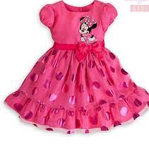
Dt. 17/11/2021
Uses of He/ She/ It
We use ‘He’ for boys.
We use ‘She’ for girls.
We use ‘It’ for objects /animals.
It
He
She

Slide 3
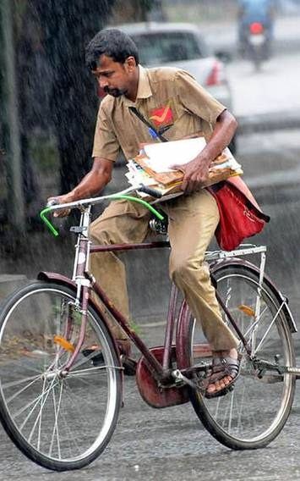
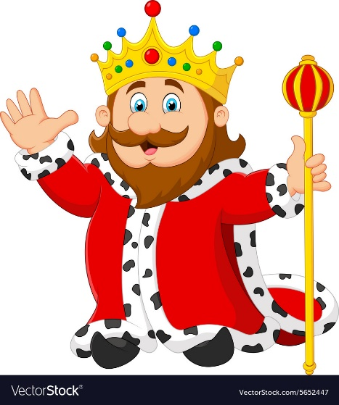
USES OF ‘He’
Policeman
Postman
King
Father

Slide 4
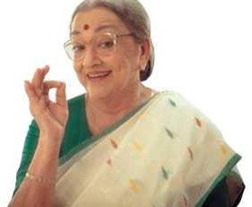
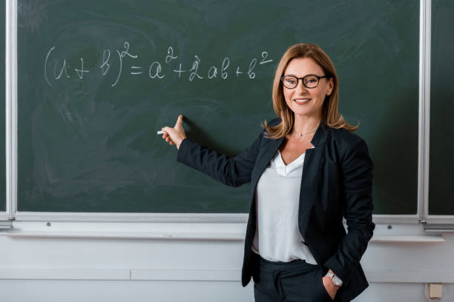
USES OF ‘SHE’
Teacher
Grandmother
Girl
Nurse

Slide 5
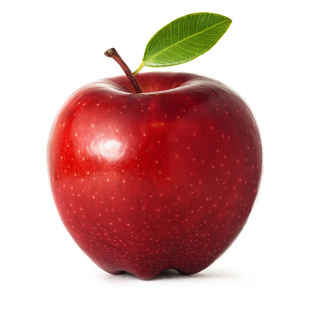
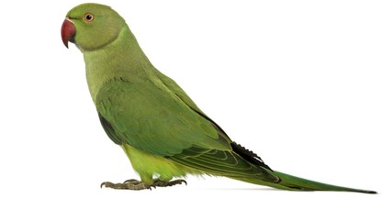
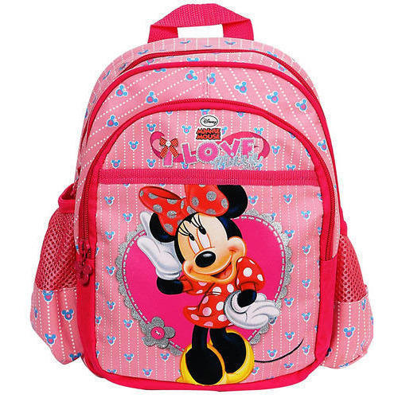
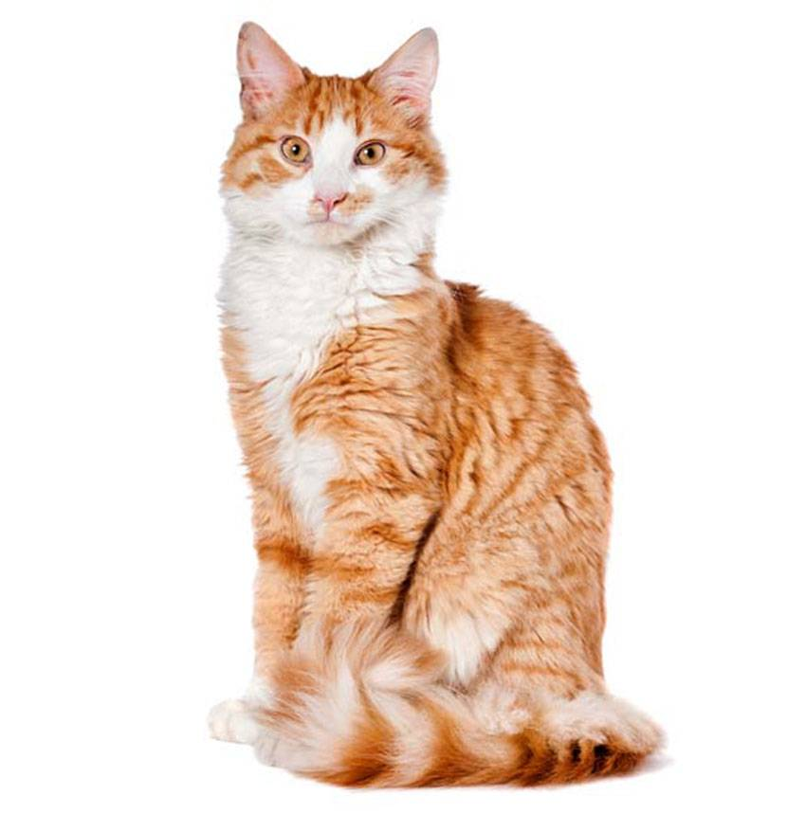
USES OF ‘IT’
Apple
Parrot
Cat
Bag

Slide 6
Dt. 17/11/2021
Class Assignment
Write the given words in the correct bag.
Mother, brother ,sister, fish, nurse, grandfather, football, king , boy, watch
He
She
It

Slide 7
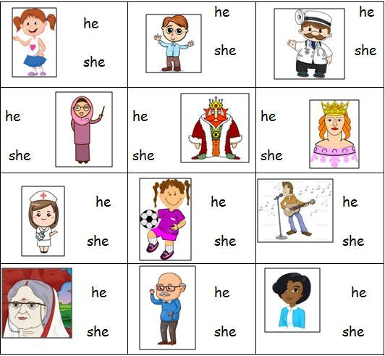
HOME ASSIGNMENT : Circle the correct word.

Slide 8
THANKING YOU
ODM EDUCATIONAL GROUP

