Slide 1
Digestive system
Period 1
SUBJECT : (Science )
CHAPTER NUMBER: 1
CHAPTER NAME :Digestive system

Slide 2
Large intestine
The long, tube-like organ that is connected to the small intestine at one end and the anus at the other.
It is 1.5 meter long.
The large intestine has three parts: cecum, colon, rectum.
It does not secretes any enzyme.
It mainly absorbs water from the undigested food.

Slide 3
assimilation
It is the utilization of the digested food or nutrients by the body cells.
Glucose-release energy for cell activities
Amino acid-used for growth, repairing worn out cells and tissues.
Fatty acids and glycerols- resorves of energy and are stored for further use.

Slide 4
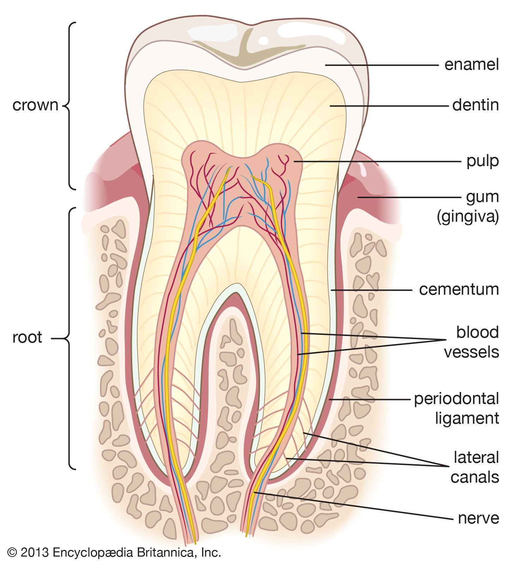
Structure of tooth

Slide 5
Crown- top portion of the teeth
Enamel- the white , hard layer which surrounds the crown
It is the hardest substance of the body.
Dentine –it is the bone like hard substance just below the enamel.
Pulp. Pulp is the innermost portion of the tooth. It’s made of tiny blood vessels and nerve tissue.

Slide 6
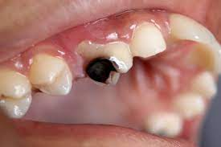
The aching tooth
Food along with bacteria stuck to the teeth’s surface form a yellow coloured film called plaque.
Acid produced by the bacteria slowly corrodes the enamel of the teeth and forms a cavities known as dental caries.

Slide 7
Care of the teeth
Brush your teeth twice a day with fluoride toothpaste.
Floss regularly.
Visit your dentist routinely for a checkup and cleaning. Tell the dentist about any medical conditions you have and medications you take.
Eat a well-balanced diet.
Quit smoking. Smoking increases your risk for gum disease.

Slide 8
THANKING YOU
ODM EDUCATIONAL GROUP

