Slide 1
Welcome to the Vertual Class
Social Science
SUBJECT : History CHAPTER NUMBER: 01
CHAPTER NAME : THE RISE OF IN
NATIONALISM IN EUROPE
PPT- 06

Slide 2
LEARNING OUTCOMES
Pupil will be able to:
Understand the causes of the revolt started by Liberals against Conservatives.
Realize the need for Revolution.
Familiarize with the condition of Europe during Revolution.

Slide 3
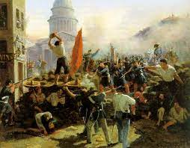

Slide 4
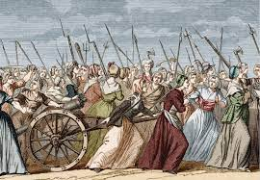
REVOLUTION IN 1848
Parallel to the revolts of the poor, unemployed and starving peasants and workers in many European countries in the year 1848, a revolution led by the educated middle class was under way.
It brought about the abdication of the monarch and a republic based on universal male suffrage had been

Slide 5
In other parts of Europe where independent nation-states did not yet exist – such as Germany, Italy, Poland, the Austro Hungarian Empire – men and women of the liberal middle classes combined their demands for constitutionalism with national unification.
They took advantage of the growing popular unrest to push their demands for the creation of a nation-state on parliamentary principles.
REVOLUTION IN 1848

Slide 6
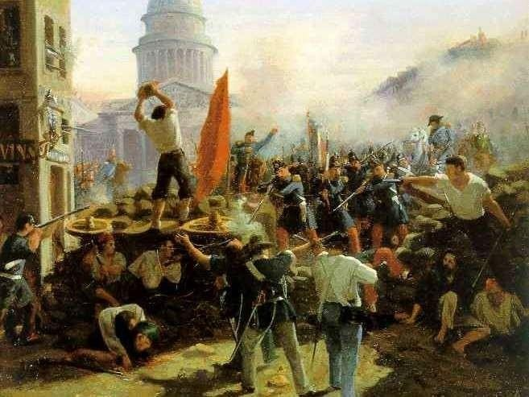
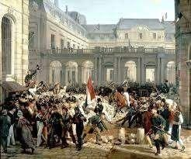
REVOLUTIONS IN 1848 AND 1830

Slide 7
HOME ASSIGNMENT
Worksheet Q. No: 18

Slide 8
THANKING YOU
ODM EDUCATIONAL GROUP

