Slide 1
WELCOME TO ONLINE CLASS
CLASS - UKG
SUBJECT – MATHS (COMPARISON)
REVISION

Slide 2
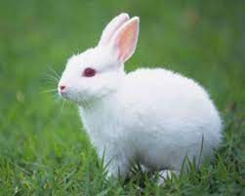
TICK THE BIG ONE AND COLOUR THE SMALL ONE:

Slide 3
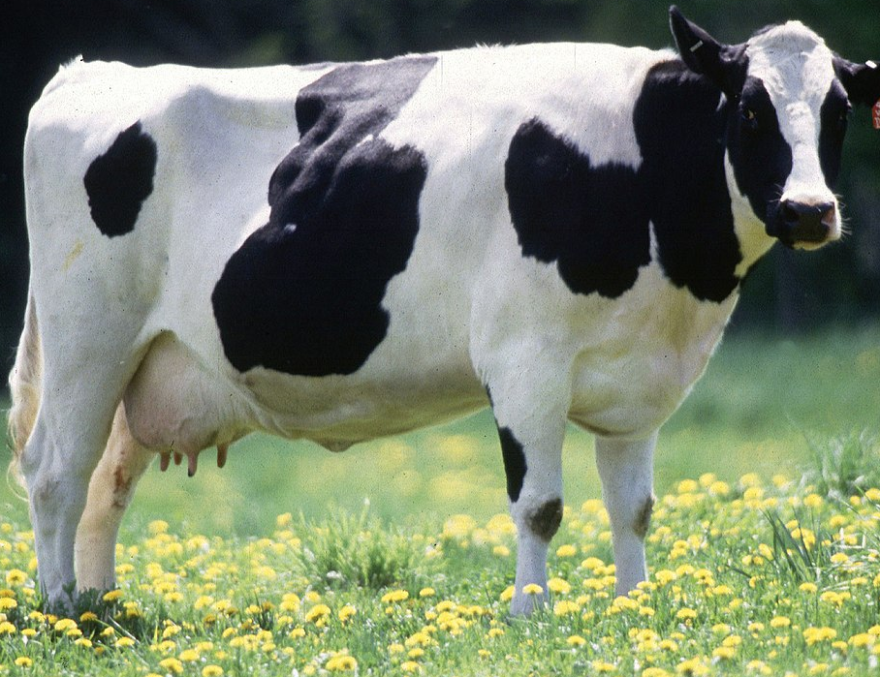
Arrange the pictures in the given order:
Rhinoceros
Elephant
Cow
BIG
BIGGER
BIGGEST

Slide 4
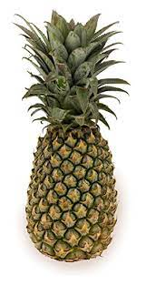
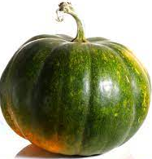
Arrange the pictures in the given order:
PUMPKIN
PINEAPPLE
WATERMELON
BIG
BIGGER
BIGGEST

Slide 5
Arrange the pictures in the given order:
TALL
TALLER
TALLEST

Slide 6
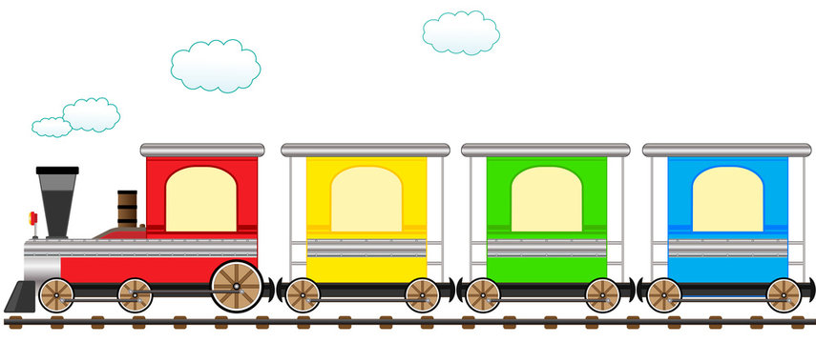
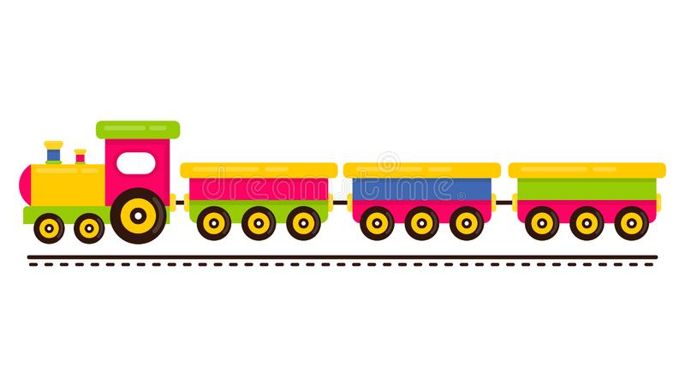
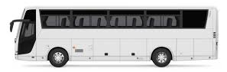
Arrange the pictures in the given order:
LONG
LONGER
LONGEST

Slide 7
C.W.
DATE:21.09.21
DRAW THE BIGGER ONE:
DRAW THE LONGEST ONE:

Slide 8
HW.
DATE:21.09.21
DRAW AND COLOUR A SMALL ONE:
DRAW A TALLER ONE:

Slide 9
THANKING YOU
ODM EDUCATIONAL GROUP

