Slide 1
CELL: THE UNIT OF LIFE
RIBOSOME, CYTOSKELETON, CILIA AND FLAGELLA, CENTROSOME –CENTRIOLE, MICROBODIES
SUBJECT :BIOLOGY
CHAPTER NUMBER:08
CHAPTER NAME :CELL :THE UNIT OF LIFE

Slide 2
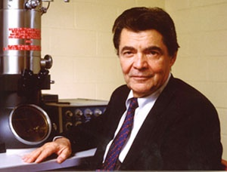
RIBOSOMES
Ribosomes are the granular structures first observed under the electron microscope as dense particles by George Palade (1953).
George Emil Palade

Slide 3
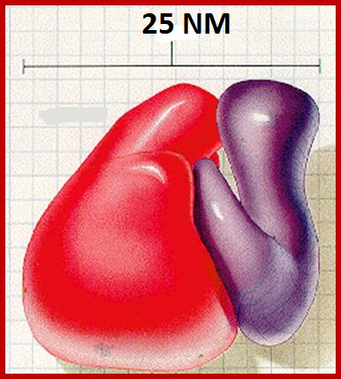
RIBOSOMES
They are composed of ribonucleic acid (RNA) and proteins and are not surrounded by any membrane.
The eukaryotic ribosomes are 80S while the prokaryotic ribosomes are 70S.
Each ribosome has two subunits, larger and smaller subunits.
RIBOSOME-SIZE
Prokaryotic ribosomes are around 20 nm (200 Å) in diameter.
Eukaryotic ribosomes are between 25 and 30 nm (250–300 Å) in diameter.
EUKARYOTIC RIBOSOMES
PROKARYOTIC RIBOSOMES

Slide 4
SVEDBERG COEFFICIENT
A Svedberg unit (symbol S/Sv) is a unit for sedimentation coefficient.
The Svedberg is a measure of time, defined as exactly 10⁻¹³ seconds.
For biological molecules, sedimentation rate is typically measured as the rate of travel in a centrifuge tube subjected to high g-force.
Here ‘S’ (Svedberg’s Unit) stands for the sedimentation coefficient; it is indirectly a measure of density and size.

Slide 5
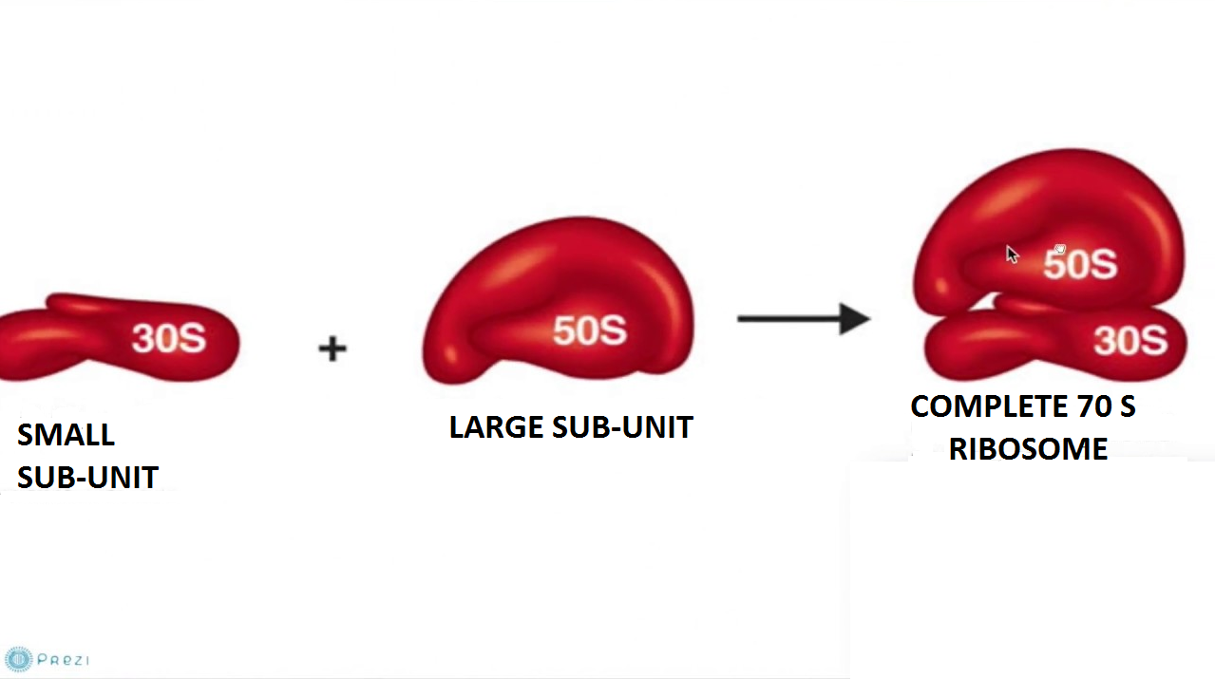
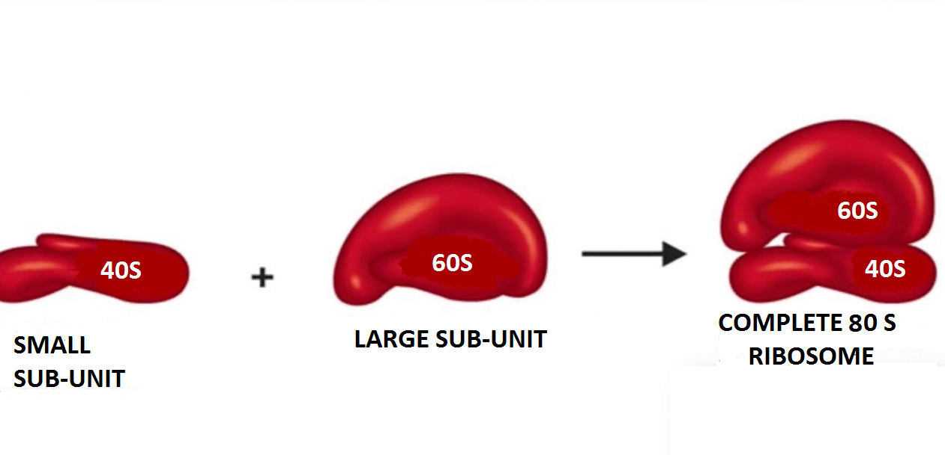
RIBOSOME - STRUCTURE
PROKARYOTIC RIBOSOME
EUKARYOTIC RIBOSOME

Slide 6
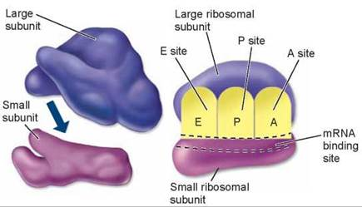
LARGE RIBOSOMAL SUB-UNIT
POLYRIBOSOME

Slide 7
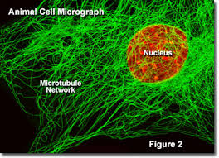
CYTOSKELETON
An elaborate network of filamentous proteinaceous structures consisting of microtubules, microfilaments and intermediate filaments present in the cytoplasm is collectively referred to as the cytoskeleton.
The cytoskeleton in a cell are involved in many functions such as mechanical support, motility, maintenance of the shape of the cell.

Slide 8
CILIA AND FLAGELLA
Cilia (sing.: cilium) and flagella (sing.: flagellum) are hair-like outgrowths of the cell membrane.
Cilia are small structures which work like oars, causing the movement of either the cell or the surrounding fluid.
Flagella are comparatively longer and responsible for cell movement.
The prokaryotic bacteria also possess flagella but these are structurally different from that of the eukaryotic flagella.
The electron microscopic study of a cilium or the flagellum show that they are covered with plasma membrane.
Their core called the axoneme, possesses a number of microtubules running parallel to the long axis.
The axoneme usually has nine doublets of radially arranged peripheral microtubules, and a pair of centrally located microtubules

Slide 9
CILIA AND FLAGELLA
Such an arrangement of axonemal microtubules is referred to as the 9+2 array.
The central tubules are connected by bridges and is also enclosed by a central sheath, which is connected to one of the tubules of each peripheral doublets by a radial spoke.
Thus, there are nine radial spokes.
The peripheral doublets are also interconnected by linkers. Both the cilium and flagellum emerge from the basal bodies.

Slide 10
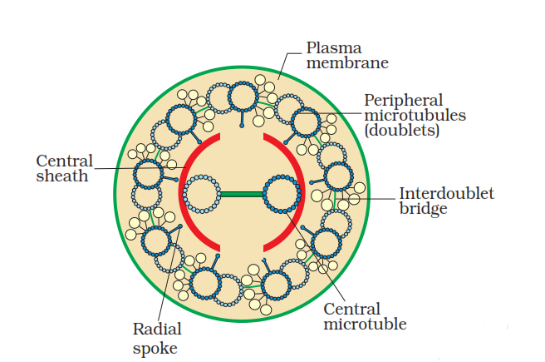

Slide 11
Difference Between Cilia And Flagella
Cilia | Flagella
The number of cilia is comparatively more (typically ranges in the thousands) | The number of flagella is comparatively less (usually ranges from 1 to 8)
Cilia is usually shorter in length | Flagella is comparatively longer in length
Beating pattern of cilia is very complicated – Can move in a wide range of motions | Beating pattern of Flagella involves circular, wave-like or propeller-like motion
Found in Eukaryotic cells | Found in prokaryotic cells and eukaryotic cells
Cilia are of two types: Non-motile cilia and Motile cilia | Flagella are of three types: Bacterial flagella, Archaeal flagella and Eukaryotic flagella

Slide 12
Centrosomes and Centrioles
Centrosome is an organelle that generally have two cylindrical structures known as centrioles.
They are basically surrounded by an amorphous pericentriolar materials.
Both the centrioles in a centrosome lie perpendicular to each other in which each has an organisation like the cartwheel.
They are usually made up of nine evenly spaced peripheral fibrils (triplet in nature) of tubulin protein. With which adjacent triplets are also being linked.
The centre part of the proximal region of the centriole possess rod-shaped proteinaceous mass known as hub, which is connected with tubules of the peripheral triplets fibrils known as radial spokes (made up of protein).
From the basal body of cilia or flagella the centrioles and spindle fibres give rise to spindle apparatus during cell division in animal cells.

Slide 13
CENTRIOLE
“Centriole is an organelle, cylindrical in shape, that is composed of a protein called tubulin.”
All animal cells have two centrioles. They help the cell during cell division. They work during the process of mitosis and meiosis.
They could be found in some lower plants such as chlamydomonas, although they are not present in many of the fungi, angiosperms (flowering plants) and pinophyta (conifers).
They are usually present near the nucleus but are not visible when the cell is not dividing.

Slide 14
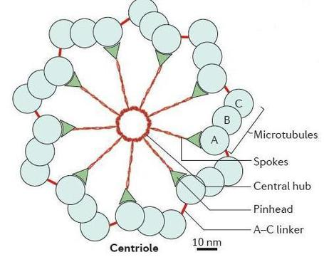

Slide 15
Functions
Centrosomes and centrioles possess the following functions
These forms spindle fibres and move to the poles, at the time of cell division, which thus, help in the movement of chromatids in daughter cells.
(ii) Help in the formation of cilia and flagella of the cells.

Slide 16
MICROBODIES
These are the membrane bound cytoplasmic elements that are composed of enzymes and other substances.
These are minute vesicles found in both plant cells and animal cells, e.g., In the liver, kidney, Protozoa, yeast and many other types of cells.
Their shape can be ovoid, spherical, granular,etc.
Peroxisomes and glyoxysomes are the types of microbodies being found in plant cell and animal cell respectively

Slide 17
Peroxisomes are single membrane-bound organelles that contain enzymes.
Peroxisomes have two functions: break down fatty acids to be used for forming membranes and as fuel for respiration; and transfer hydrogen from compounds to oxygen to create hydrogen peroxide and then convert hydrogen peroxide into water.
Glyoxysomes are specialized peroxisomes found in plants (particularly in the fat storage tissues of germinating seeds) and also in filamentous fungi.
The seedling uses these sugars synthesized from fats until it is mature enough to produce them by photosynthesis.
A melanosome is an organelle found in animal cells and is the site for synthesis, storage and transport of melanin, the most common light-absorbing pigment found in the animal kingdom.
Melanosomes are responsible for color and photoprotection in animal cells and tissues.

Slide 18
THANKING YOU
ODM EDUCATIONAL GROUP

