Slide 1
THE STRUCTURE OF ATOM
SUBJECT-CHEMISTRY
CHAPTER-03
THOMSON’S ATOMIC MODEL DRAWBACKS OF THOMSON’S ATOMIC MODEL PERIOD-3

Slide 2
LEARNING OBJECTIVE
STUDENTS WILL BE ABLE TO UNDERSTAND :-
THE POSTULATES OF THEVDALTON’S ATOMIC THEORY.
FAMILARIZE THEMSELVES WITH THE DRAWBACKS OF THE DALTON’S ATOMIC THEORY.

Slide 3
WARM UP QUESTIONS
WHICH IS THE FIRST MODEL OF ATOM?
WHAT IS THE BASIS OF THE MODEL OF AN ATOM?
WHO PROPOSED THE FIRST MODEL OF AN ATOM?

Slide 4
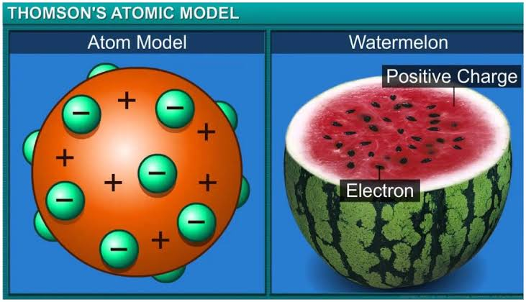
THOMSON’S MODEL OF ATOM
THOMSON’S MODEL OF ATOM WAS PROPOSED BY J.J. THOMSON IN THE YEAR IN 1904.
HE PROPOSED THAT AN ATOM CONSISTS OF A POSITIVE SPHERE IN WHICH NEGATIVE ELECTRONS ARE EMBEDDED JUST LIKE PLUM IN A PUDDING.
THIS MODEL IS ALSO KNOWN AS WATER MELON MODEL OR CHRISTMAS PUDDING MODEL.
THOMSON CONCLUDED THAT AN ATOM IS ELECTRICALLY NEUTRAL.
THE NUMBER OF NEGATIVE PARTICLE IS EQUAL TO THE NUMBER OF POSITIVE PARTICLES IN AN ATOM

Slide 5
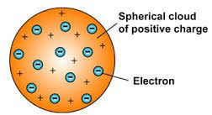
DRAWBACKS OF THOMSON’S ATOMIC MODEL
IT COULD NOT EXPLAIN THE RESULTS OF THE SCATTERING EXPERIMENT CARRIED OUT BY RUTHERFORD.
IT COULD EXPLAIN OF THE EXACT POSITION OF THE ELECTRONS.

Slide 6
HOME ASSIGNMENT
EXPLAIN THE POSTULATES OF THE DALTON’S ATOMIC THEORY.
MENTION THE DRAWBACKS OF THE DALTON’S ATOMIC THEORY.

Slide 7
WATCH A VIDEO
https://youtu.be/kJ-6Qy05u_Q

Slide 8
THANKING YOU
ODM EDUCATIONAL GROUP

