Slide 1
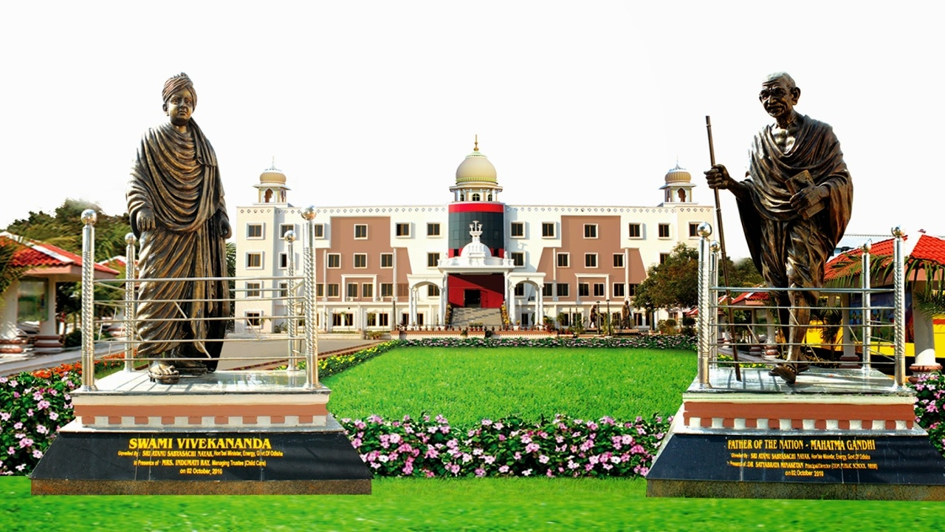
CLASS : NURSERY
DATE : 12/08/21
SUBJECT :CONVERSATION
CHAPTER NUMBER-3
SUB-TOPIC : MY MOTHER

Slide 2
MOTHER

Slide 3
MY mother’s name is…….

Slide 4
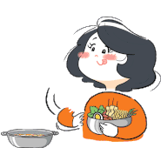
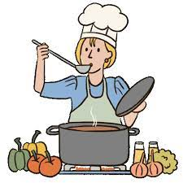
She cooks tasty food for me.

Slide 5
She is very beautiful.
I love my mother very much.

Slide 6
HOME ASSIGNMENT
LEARN FOUR SENTENCES ABOUT
‘MY MOTHER.

Slide 7
THANKING YOU
ODM EDUCATIONAL GROUP

