Slide 1

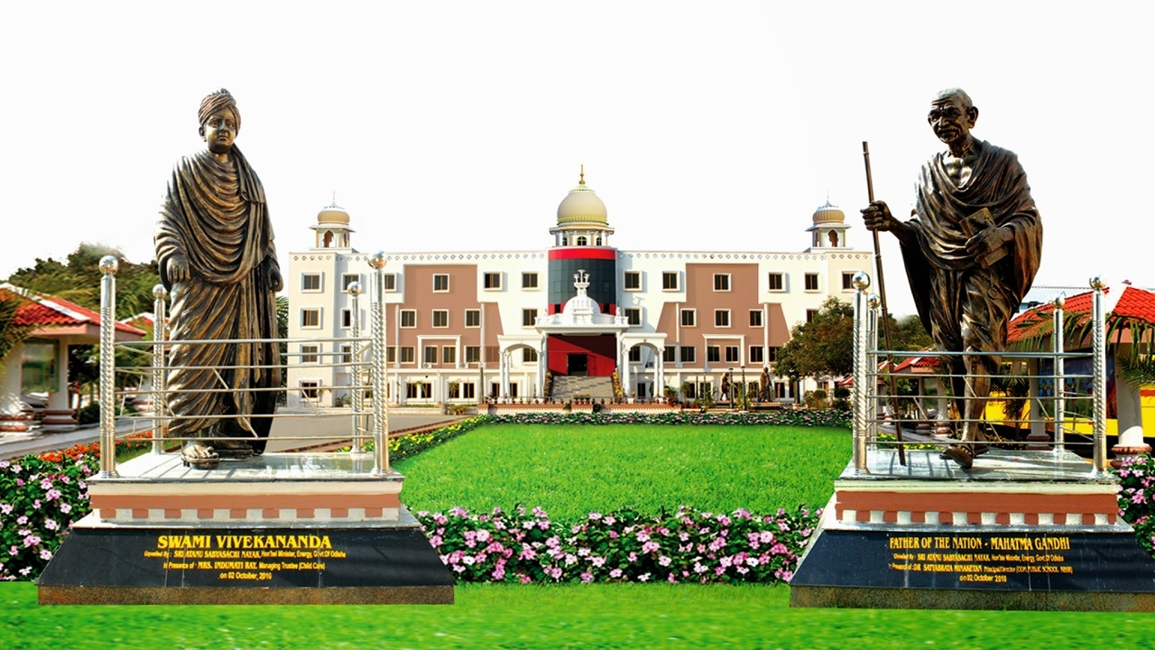
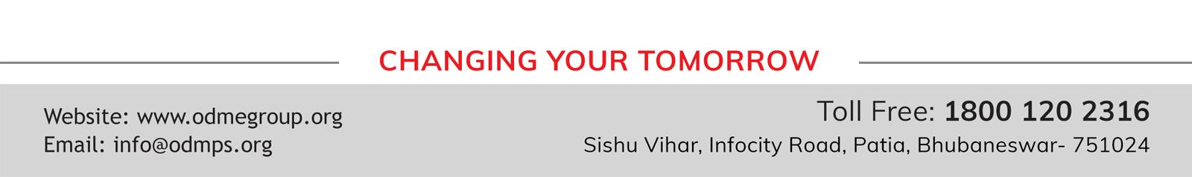
CLASS : NURSERY
DATE : 13/09/21
SUBJECT :CONVERSATION
CHAPTER NUMBER-1
SUB-TOPIC : MY SELF

Slide 2


Give me self introduction
Tell me about yourself
Notes:
RIYA

Slide 3

Self Introduction as a boy or girl
  1.My name is …………..
  2. I am a ………….
  3. I am ……….years old.
  4. I study in………
  5. The name of my school is ……………..
  6.I like to eat …………..

Slide 4
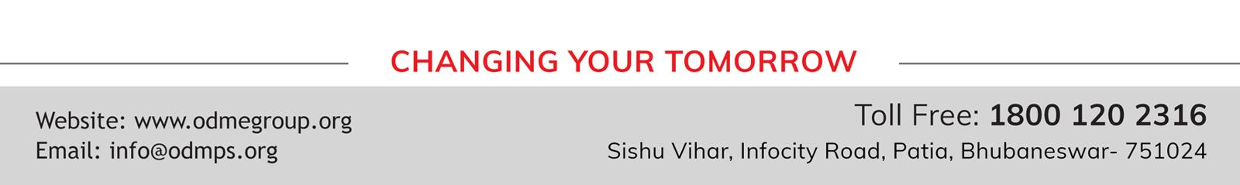
THANKING YOU
ODM EDUCATIONAL GROUP

