Slide 1
PERIOD 3
MATHEMATICS
CHAPTER NUMBER :~ 3
CHAPTER NAME :~ COORDINATE GEOMETRY
SUB TOPIC :~ PLOTTING POINTS IN THE CARTESIAN PLANE WHEN POINTS ARE GIVEN

Slide 2
PREVIOUS KNOWLEDGE TEST
1. Explain the key words of Cartesian system-
(a) origin
(b) quadrant
2. A point lies on x-axis at a distance of 9 units from y-axis . What are its co-ordinates ? What will be it’s coordinate if it lies on y-axis at a distance of ––9units from x-axis ?

Slide 3
LEARNING OUTCOME:-
Students will learn to
Plot points in the Cartesian Plane when coordinates are given.

Slide 4
https://www.youtube.com/watch?v=s7NKLWXkEEE
“Coordinate geometry is the branch of mathematics which is a fusion of algebra and geometry. In the honour of Descartes, the subject is called cartesian geometry.…”
- Rene Descartes …

Slide 5
Different Examples Of Plotting Points On Cartesian Plane-
(0,0); (1,4); (9,0); (0,9); (–5,9); (–2,–9)

Slide 6
Evaluation:-
Locate the points
(2,–3); (3,2); (2,2); (0,2); (2,0) on the Cartesian plane.

Slide 7
Homework:-
Exercise – 3.3

Slide 8
Question 1
In which quadrant or on which axis do each of the points (-2, 4),(3, -1), (-1, 0),(1, 2) and (-3, -5) lie? Verify your answer by locating them on the Cartesian plane.
Solution:
The point (-2, 4) is having negative abscissa and positive ordinate. ∴ (-2,4) lies in the 2nd quadrant. The point (3, -1) is having positive abscissa and negative ordinate. ∴ (3, -1) lies in the 4th quadrant.

Slide 9
The point (-1, 0) is having negative abscissa and zero ordinate. ∴ The point (-1, 0) lies on the negative x-axis.
The point (1, 2) is having the abscissa as well as ordinate positive. ∴ Point (1,2) lies in the 1st quadrant.
The point (-3, -5) is having the abscissa as well as ordinate negative. ∴ Point (-3, -5) lies in the 3rd quadrant.
These points are plotted in the Cartesian plane as shown in the following figure as A(-2, 4); B(3, -1); C(-l, 0); D(l, 2) and E (-3, -5).

Slide 10
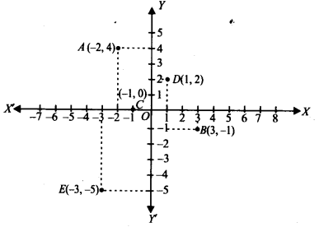

Slide 11
Question 2
Plot the points (x, y) given in the following table on the plane, choosing suitable units of distance on the axis.

Slide 12
Solution: The given points are (-2, 8), (-1, 7), (0, -1.25), (1,3) and (3, -1). To plot these points:
(i) We draw X’OX and YOY’ as axes.
(ii) We choose suitable units of distance on the axes.
(iii) To plot (-2,8), we start from O, take (-2) units on x-axis and then (+8) units on y – axis. We mark the point as A (-2, 8).

Slide 13
(iv) To plot (-1,7), we start from O, take (-1) units on x-axis and then (+7) units on the y – axis. We mark the point as B(-1, 7).
(v) To plot (0, -1.25), we move along 1.25 units below the x-axis on the y – axis and mark the point as C(0, -1.25).
(vi) To plot (1, 3), we take (+1) unit on the x-axis and then (+3) units on the y – axis. We mark the point as D(1, 3).
(vii) To plot (3, -1), we take (+3) units on the x-axis and then (-1) unit on the y – axis. We mark the point E(3, -1).

Slide 14
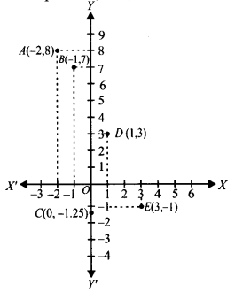

Slide 15
AHA:-
A) Taking 0.5cm 1unit, plot the following points on the graph paper.
B) Plot the points (x,y) given by the following table. Using scale 1cm = 0.25unit.

Slide 16
THANKING YOU
ODM EDUCATIONAL GROUP

