Slide 1
Ideas and ideals the Indian Constitution
SUBJECT : CIVICS CHAPTER NUMBER:2
CHAPTER NAME :Ideas and ideals the Indian Constitution

Slide 2
1. General Objective of the Chapter | The purpose of this chapter is to make the students understand about The key features of Indian Constitution –the adjectives used to describe India and the meaning of the adjectives. The Preamble- What is the meaning of the term Preamble. The directive principles of state policy—the meaning of directive principles
2. Learning Outcome of the Chapter | After studying the chapter, the students should understand India is a Sovereign state and it is no more under the control of the control any external force. India is a secular state—Here all religions are treated equally and no discrimination on the basis of religion, India is a Democratic country- --The people of India govern themselves through their elected representatives. India is a Republic Country – The head of the state – the president is an elected one and not a hereditary one. India is a socialist country-Here every one is given equal opportunities to make use of the resources of the country. In India every Government which comes to power is expected to be guided by some principles which came to known as Directive Principles of State Policy

Slide 3
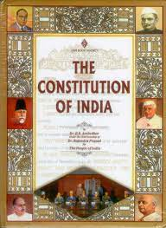
Key Features of Indian Constitution

Slide 4
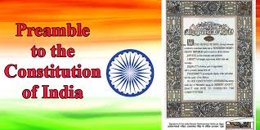
Our Constitution begins with a introduction came to known as Preamble. It highlights the goals and aspirations of the Indian people, and it describes India as Sovereign, socialist, secular, democratic, republic country.

Slide 5
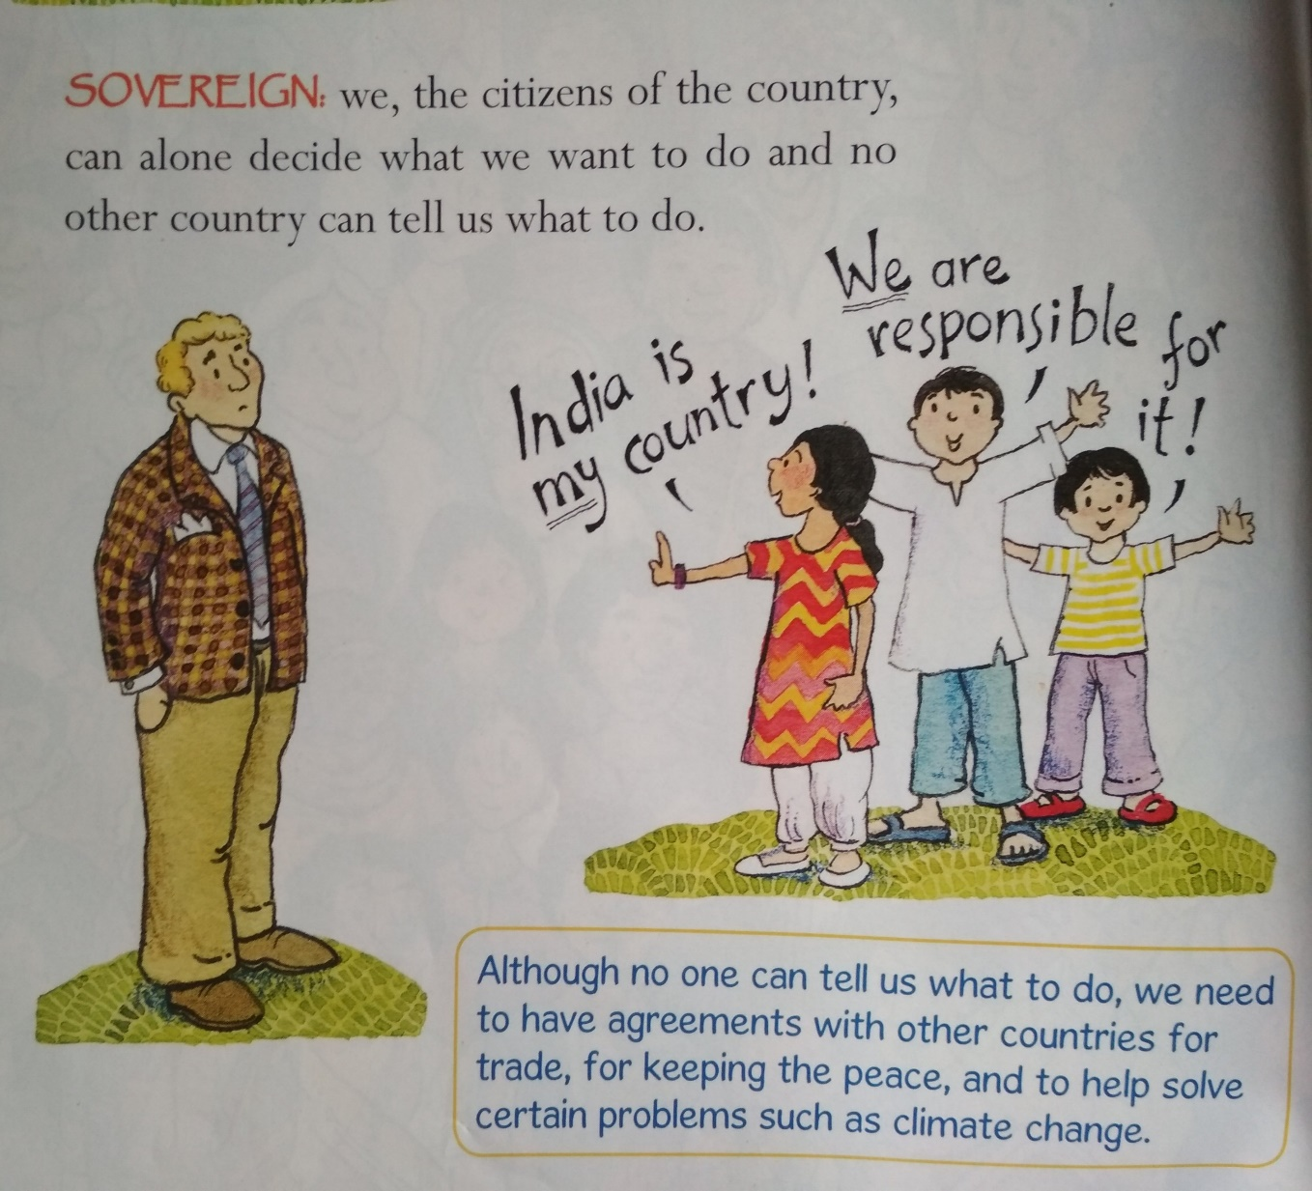
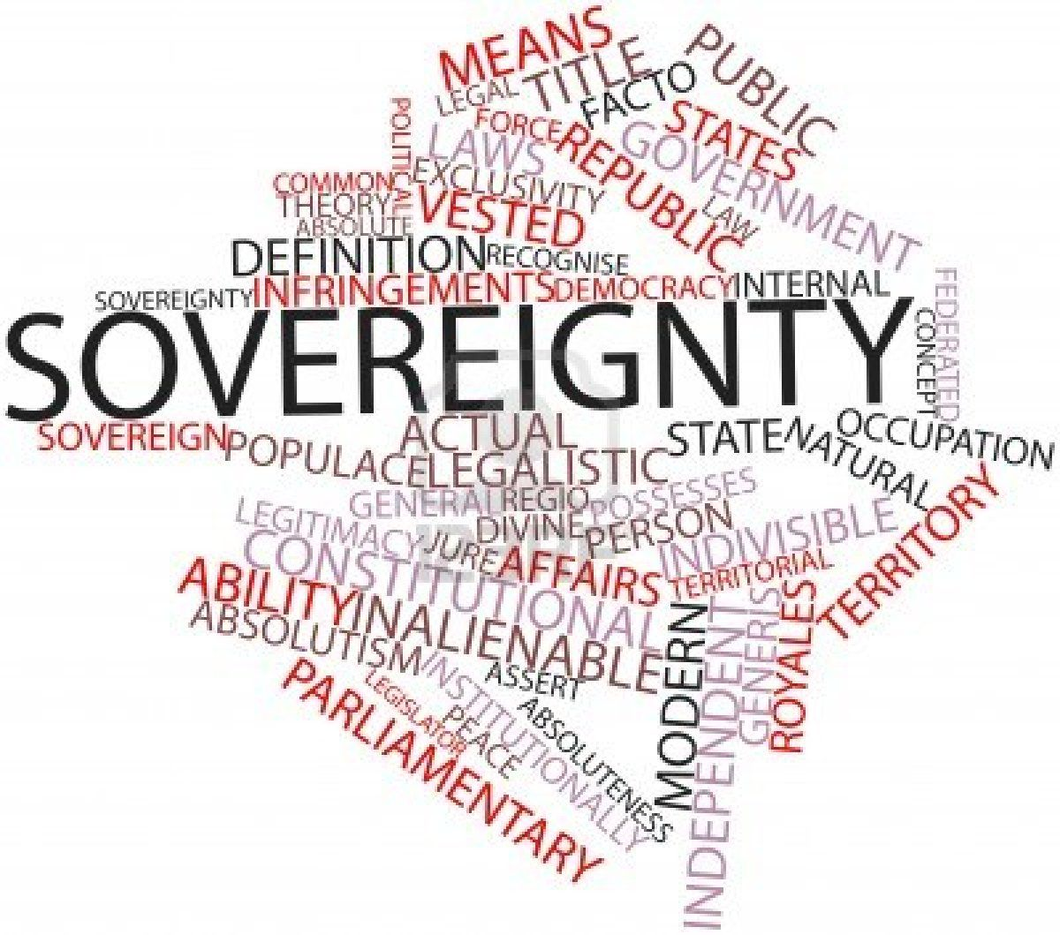

Slide 6
Socialist Country
Everyone is given equal opportunities to make use of the resources of the country.

Slide 7
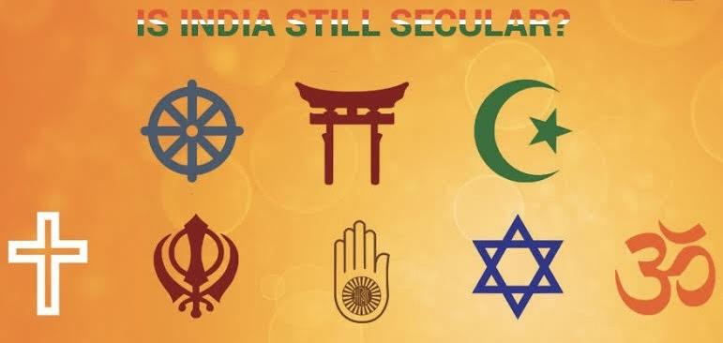
Secular Country
Every citizen has the freedom to profess, practice, and propagate the religion of his liking and no discrimination on the basis of religion.

Slide 8
D e m o c r a t i c C o u n t r y
The country which is governed by elected representatives. Election is conducted at fixed intervals.

Slide 9
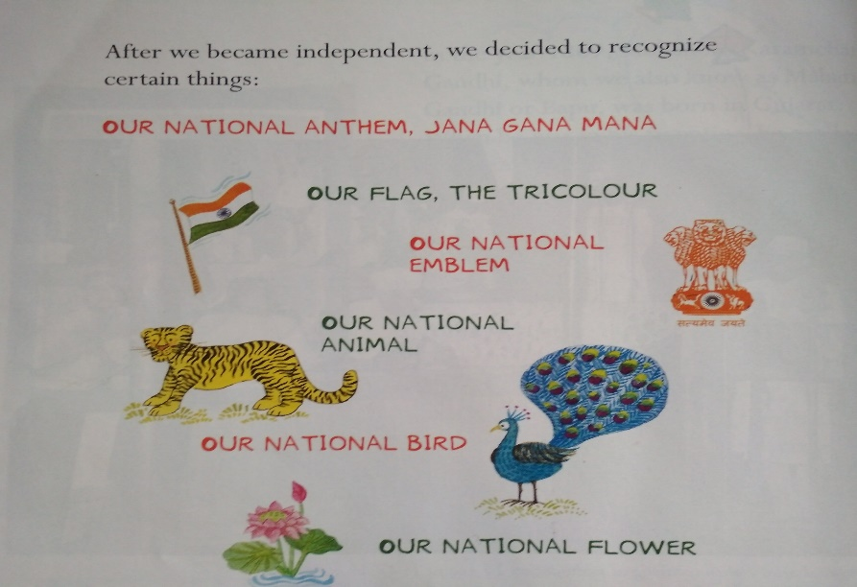
R e p u b l i c C o u n t r y
India is a Republic country because our head of the state –president is an elected person not a hereditary one. He is elected for 5 years which is a fixed term of office.

Slide 10
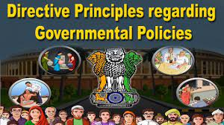
D i r e c t i v e P r i n c i p l e s o f S t a t e P o l i c y
Every Govt. which comes to power is expected to be guided by some
principles when making policies and laws. These principles are called Directive Principles.

Slide 11
Home Assignment
Define the term Preamble?
What do you mean by sovereign state?
India is a republic country. What does it mean?
India is secular country. What does it mean?

Slide 12
THANKING YOU
ODM EDUCATIONAL GROUP

