Slide 1
SESSION NO.: 3
CLASS: 5
SUBJECT: SCIENCE
CHAPTER NUMBER: 11
CHAPTER NAME: FORCE AND ENERGY
SUB TOPIC: SIMPLE MACHINES- THE INCLINED PLANE, THE PULLEY
Notes:
Simple machine- the wheel and axle, the screw
Learn Ch- 9
Revision-1
Choose the correct answer
Answer the following questions
Learn Ch- 10
Revision-2
Do as directed
Answer the following questions
Learn Ch- 9 & 10
Energy
Different forms of energy- mechanical energy, solar energy, geothermal energy
Do the oral Q& A of page no. 103
Different forms of energy- wind energy, hydro power, heat energy
Do the questions A, B & C in your notebook

Slide 2
LEARNING OBJECTIVE
To enable the learner to:
understand about machines.
identify the types of simple machines commonly used.
understand the importance of machines in real life.
Notes:
Introduction
The brain
Write the difficult words
The spinal cord
Nerves
Kinds of nerves
Draw a labelled diagram of human brain
Sense organs- the eyes
Do the oral Q& A of page no. 93,
Do the questions A, B & C in your notebook
Sense organs- the ears, the nose, the tongue, the skin
Draw a labelled diagram of human eye
Long Q & A
Learn the Q & A
Activity
Class test

Slide 3
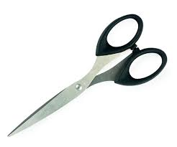
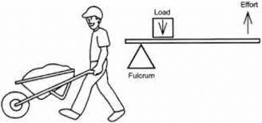
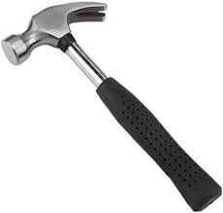
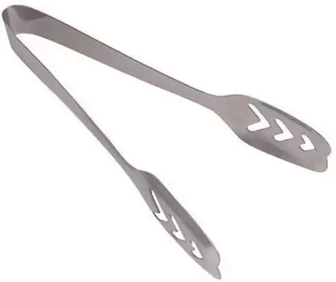
LET’S RECAP
Identify the type of lever shown in the pictures below:

Slide 4
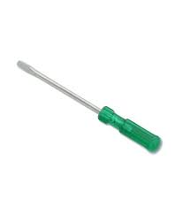
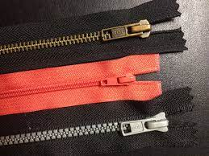
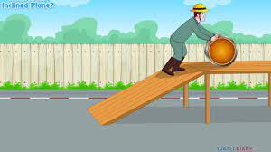
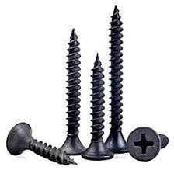
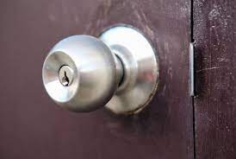
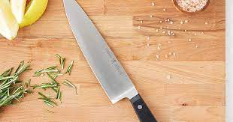
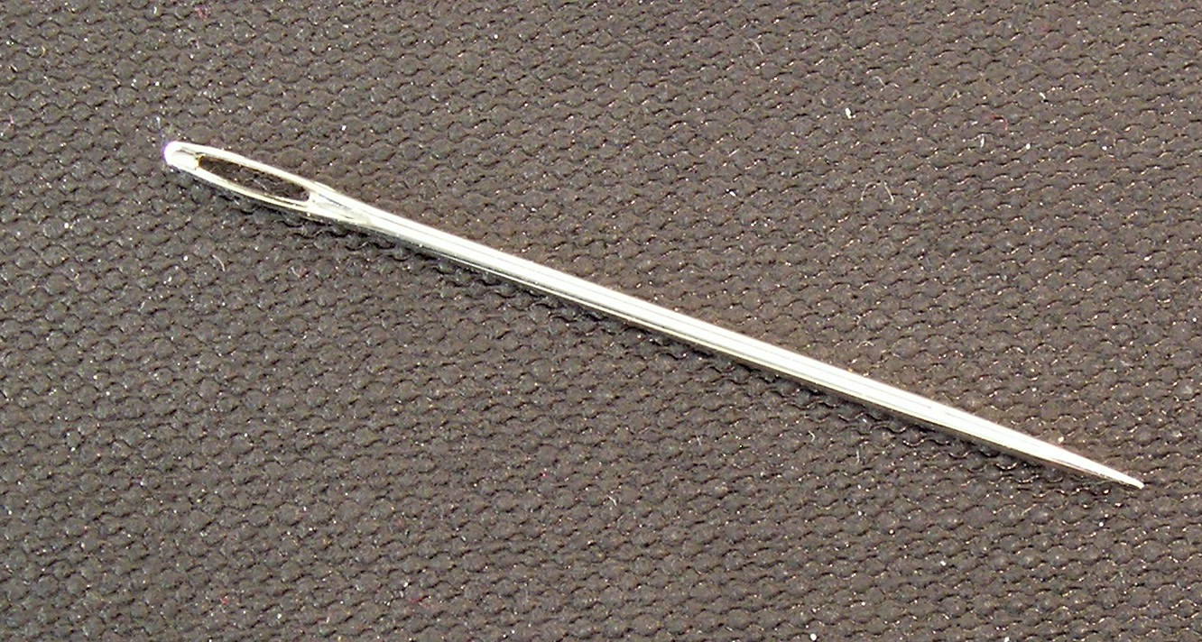
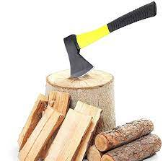
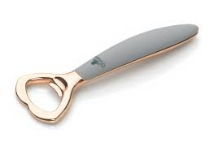
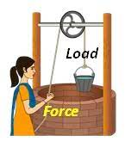
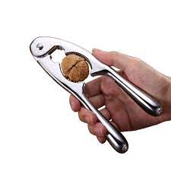
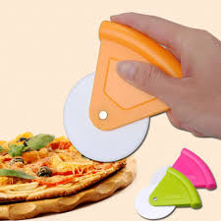
SIMPLE MACHINES
Tools which make our work easier and faster are called machines.
Simple machines help us to do work by applying force at a convenient point which either changes the direction of force or increases the force applied.

Slide 5
TYPES OF SIMPLE MACHINES
Inclined Plane
Pulley
Lever
Wheel and axle
Wedge
Screw

Slide 6
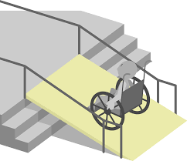
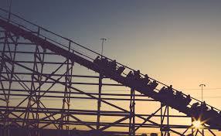
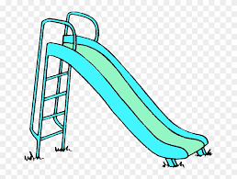
INCLINED PLANE
An inclined plane is a slope which makes work easier.
E.g.: workers can easily load or unload on a truck using a plank of wood.
In hospitals and some other buildings inclined planes called ramps are provided next to stairs which helps them in pushing up wheelchairs.

Slide 7
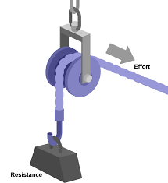
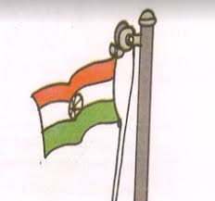
PULLEY
A pulley is a small wheel with a groove around its outer edge that can hold a rope in position.
A pulley together with a chain or a rope is used to lift heavy objects.

Slide 8
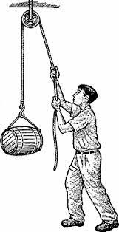
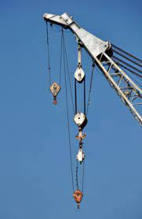
TYPES OF PULLEY
Fixed pulley
Movable pulley

Slide 9
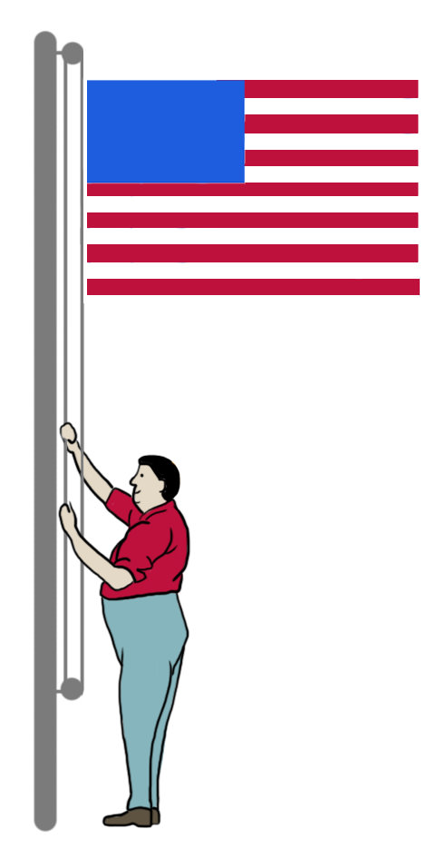
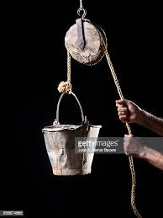
FIXED PULLEY
When pulley is fitted to some support and does not move, then it is called a fixed pulley.
It is used to change the direction of the force needed to lift a load.
A force is exerted downward in order to lift the load upward.

Slide 10
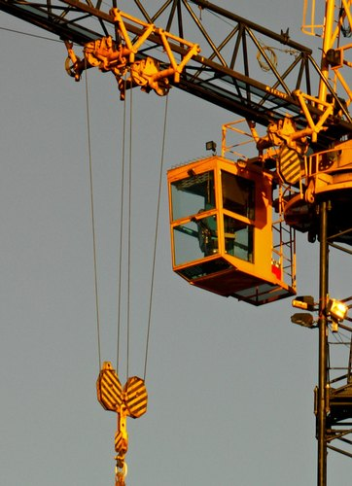
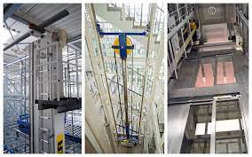
MOVABLE PULLEY
A movable pulley is a pulley that is attached to a support and can move such that its axis of rotation is not fixed.
It can move up and down.
E.g.: construction cranes, modern elevators etc.

Slide 11
SUMMARY
An inclined plane is a slope which makes work easier.
A pulley is a small wheel with a groove around its outer edge that can hold a rope in position.
When pulley is fitted to some support and does not move, then it is called a fixed pulley.
A movable pulley is a pulley that is attached to a support and can move such that its axis of rotation is not fixed.

Slide 13
Ramps are examples of ____________.
Ans: Inclined plane

Slide 14
2. A ________________ is a small wheel with a groove around its outer edge that can hold a rope in position.
Ans: Pulley

Slide 15
3. Which type of pulley is used to draw water from the well.
Ans: Fixed pulley

Slide 16
HOMEWORK
Mention the names of all the simple machines and write a use of each in our daily life.

Slide 17
LEARNING OUTCOME
The learner will be able to:
understand about machines.
identify the types of simple machines commonly used.
understand the importance of machines in real life.

Slide 18
THANKING YOU
ODM EDUCATIONAL GROUP

