Slide 1
CLASS : NURSERY
DATE : 10.11.2021
SUBJECT : ENGLISH
TOPIC- : BK PG NO-50.51
SUBTOPIC: LETTER N

Slide 3
IDENTIFICATION OF LETTER M

Slide 4
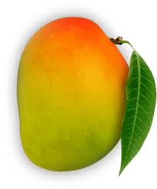
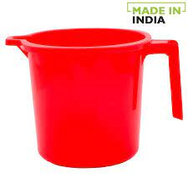
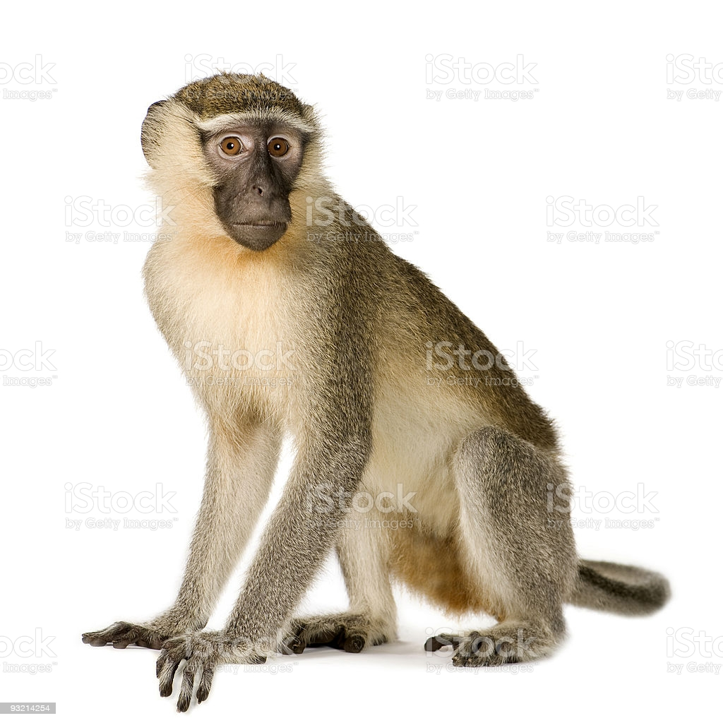
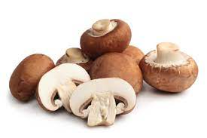
Picture related to letter-M

Slide 5
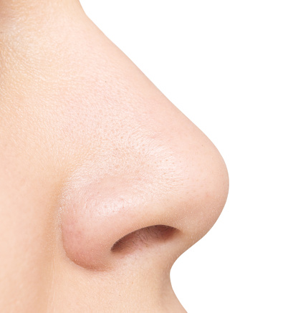
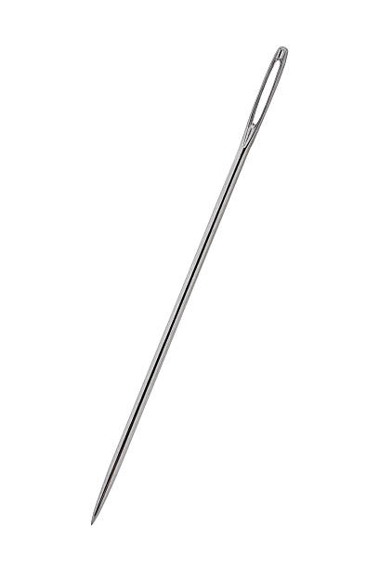
Identify the given pictures

Slide 7
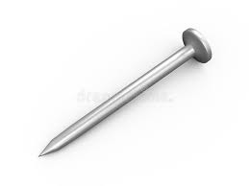
Picture related to letter-N
NURSE
NEST
NET
NAIL
Notes:
NAIL

Slide 8
Letter N in book pg no-51
Notes:
Note book work

Slide 9
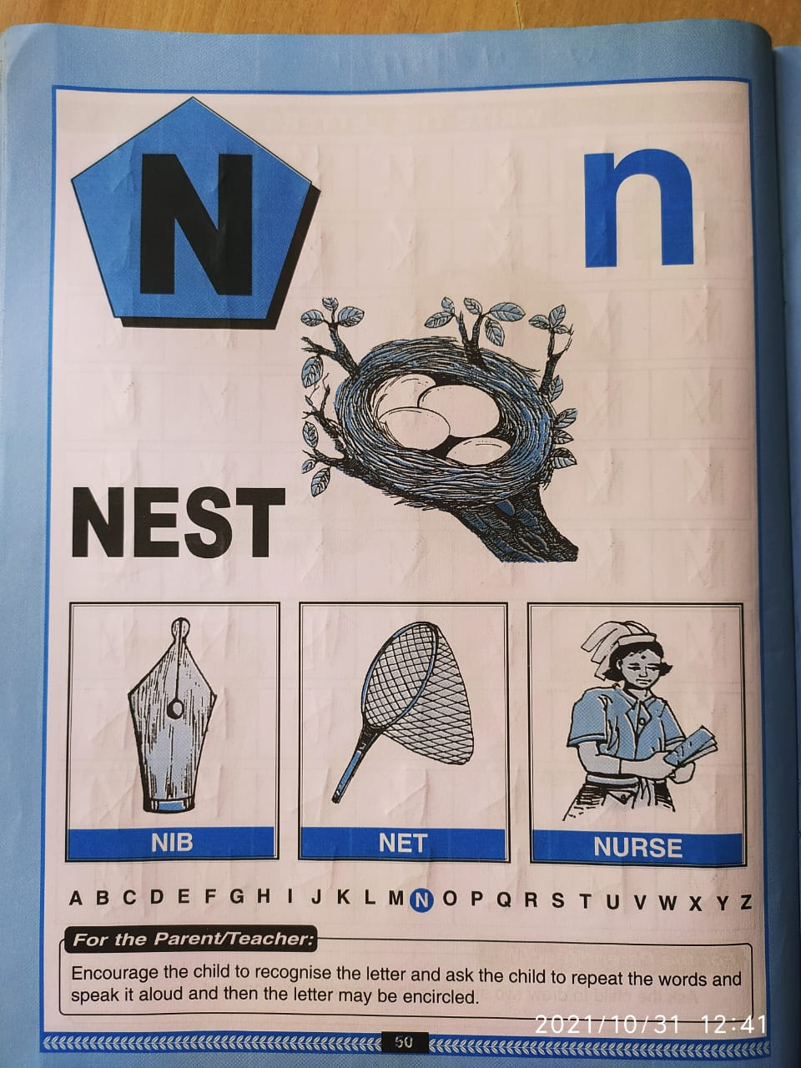

Slide 10
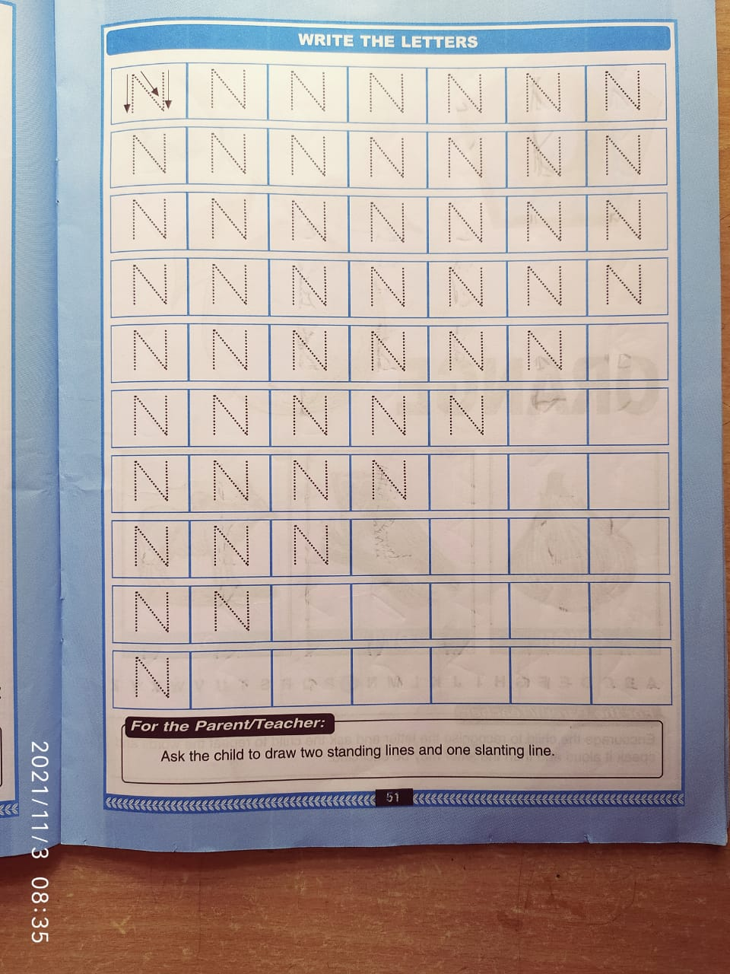
Trce and write
CW
10/11/21
Notes:
`10/11/21

Slide 11
Identify and circle letter-N
HW
F
H
A
M
N
T
N
M
N
H
N
N
K
M
H
A
N
E

Slide 12
11/11/21
ASSIGNMENT
Complete bk pg no 50
1.
2.Practice phonetic sound of letter-N
Notes:
Practice phonetic sound of letter-M

Slide 13
THANKING YOU
ODM EDUCATIONAL GROUP

