Slide 1
CLASS : NURSERY
DATE : 15.09.2021
SUBJECT : ENGLISH
TOPIC- :ALPHABETS
SUBTOPIC:REVISION-3 IN NOTE BK

Slide 2
READING

Slide 3
Note book work
Notes:
Note book work

Slide 4
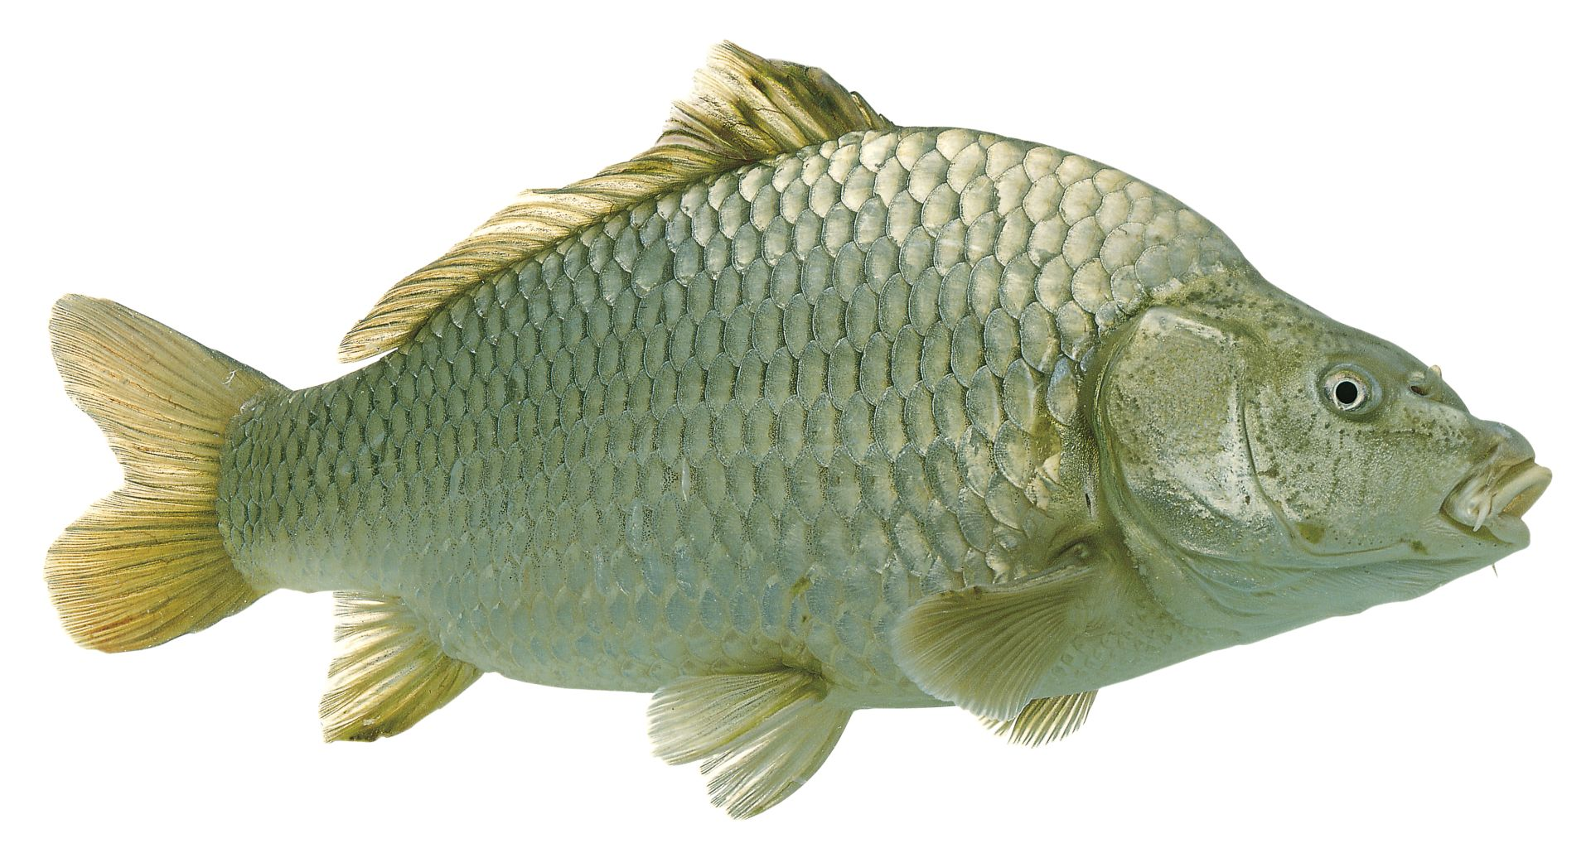
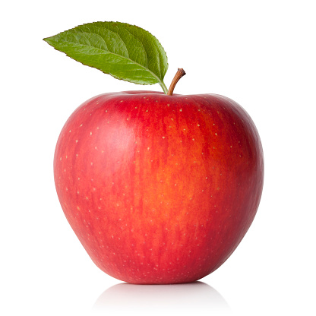
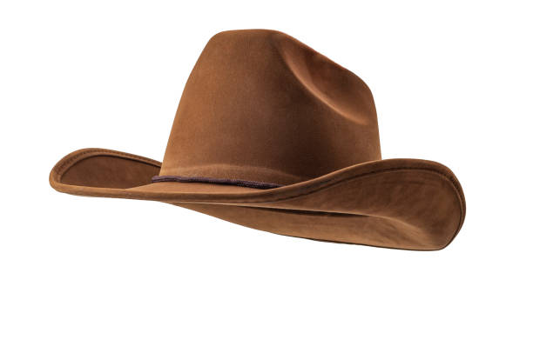
Revision-3
1. Write the initial letter of the given picture
F
A
H
I
Notes:
I

Slide 5
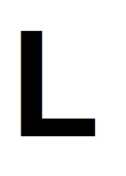
Say and write
HW
15/09/21
Notes:
14/09/21

Slide 6
15/09/21
ASSIGNMENT
PRACTICE THE REVISION WORK
1.

Slide 7
THANKING YOU
ODM EDUCATIONAL GROUP

