Slide 1
CLASS : NURSERY
DATE : 24.08.2021
SUBJECT : ENGLISH
TOPIC-BK PG NO-31,32
SUB-TOPIC-LETTER H (In nt bk)

Slide 2
Recapitulation
Notes:
CW

Slide 3
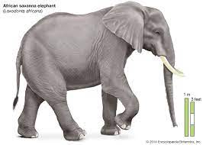
Pictures related to letter-E

Slide 4
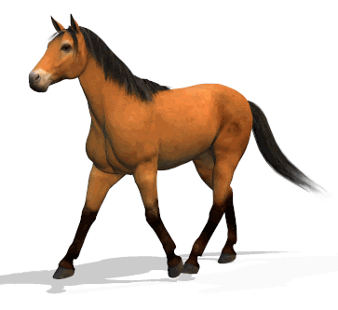

Slide 6
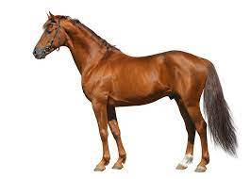
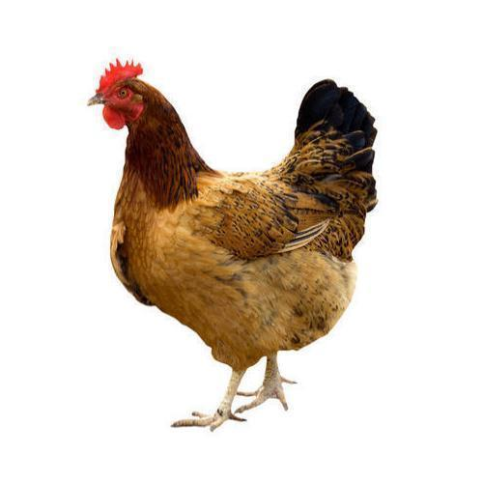
Pictures related to letter-h
HAT
HOUSE
HEN
HORSE
Notes:
HORSE

Slide 7
BK PG NO-31
CW
24/08/21
READ IT 5 TIMES
Notes:
18/08/21

Slide 8
H stands for Hat
CW
24/08/21
Notes:
24/08/21

Slide 9
Trace and write letter H
CW
24/08/21
Notes:
H

Slide 10
Say and write(In note bk)
HW
Notes:
H W

Slide 11
ASSIGNMENT
24/08/21
1 .Practice phonic sound of letter H
2.
Complete the work given in note bk
3.PRACTICE TO READ BK PG NO-31 -LETTER H
Notes:
CW

Slide 12
THANKING YOU
ODM EDUCATIONAL GROUP

