Slide 1
HEAT STD-VII
SUBJECT-PHYSICS
CHAPTER NO-05

Slide 2
LEARNING OBJECTIVE
Students will be able to
Know modes of transfer of heat
Know construction thermos flask

Slide 3
CONDUCTION:
Conduction is a method of heat transfer in solid.
The heat energy is transferred as the heated molecules vibrate about their mean position and therefore transfer heat energy from one molecules to the other until the heat energy is transferred from one point to another.
It require a material medium for heat transfer.

Slide 4
CONVECTION: Convection is a method of heat transfer in liquid.
The heat energy is transferred from one place to another by the movement of the heated molecules.
The heated molecules move in a circular pattern. The movement of the heated molecules set up a convectional current.
It require a material medium for heat transfer.

Slide 5
RADIATION:.
Radiation is a method of heat transfer through space. The heat energy is transferred from one place to another without heating the intervening medium. Radiation does not require a material medium for heat transfer.
Heat energy from a hot surface reaches us by radiation.

Slide 6
LAND BREEZE: Land breeze is the breeze that blows from the land to the sea at night.
SEA BREEZE: Sea breeze is the breeze that blow from the sea to the land during the day.

Slide 7
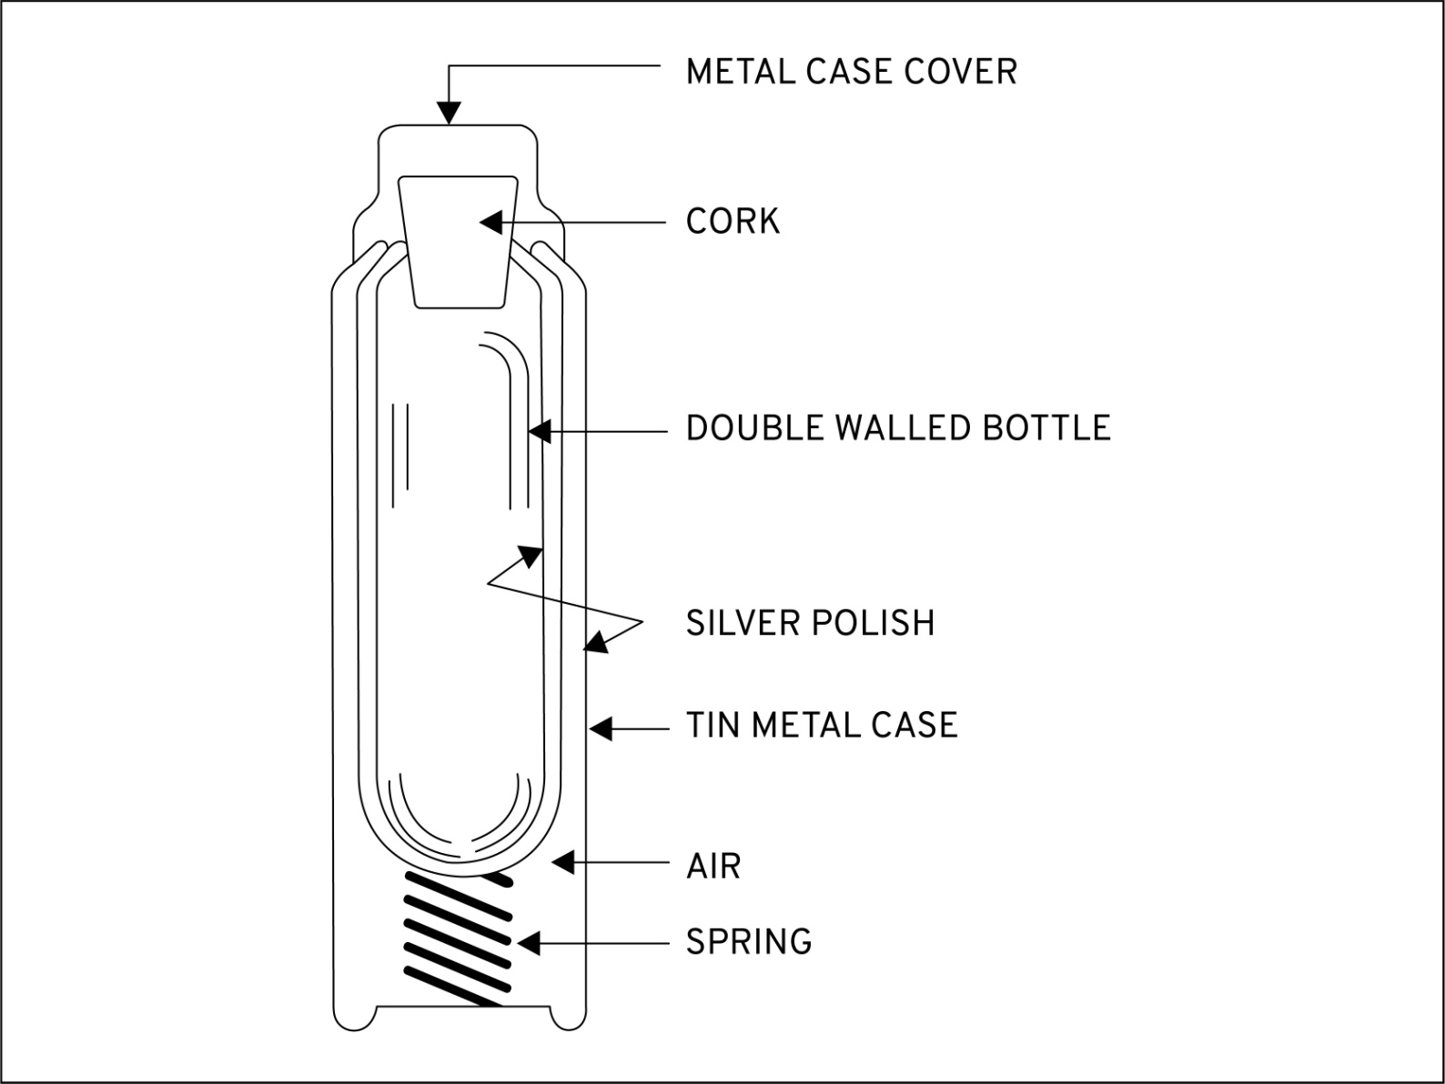
THERMOS FLASK

Slide 8
HOME ASSIGNMENT
Differentiate conduction convection and radiation
Explain the construction and working of thermos flask

Slide 9
THANKING YOU
ODM EDUCATIONAL GROUP

