Slide 1
IS MATTER AROUND US PURE
CLASS-IX
SUBJECT-CHEMISTRY
CHAPTER-02
NEED FOR THE SEPARATION OF MIXTURES, TRADITIONAL METHODS OF SEPARATION
PERIOD-2

Slide 2
LEARNING OBJECTIVE
Students will be able to
Understand the mixtures and the need to separate the mixtures.
Familiarize with various traditional methods of separation.
Sensitize different types of examples from the daily life

Slide 3
WARM UP QUESTION
Recapitulate the previous concept of the Classification of Matter.
Activate their minds with the pure and impure substances.
Ask them differentiate between compounds and mixtures

Slide 4
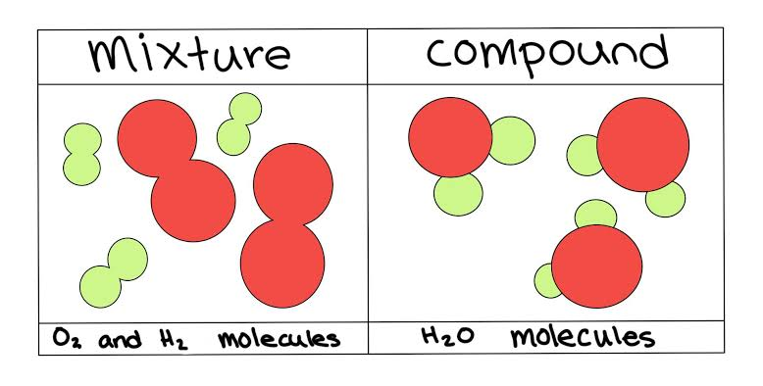
MIXTURE
Mixture
Any impure substances that are made up of two or more materials combined in any ratio.
The components of a mixture can be separated easily by physical methods.

Slide 5
VIDEO TIME
outu.be/dhttps://yW1Vn6cbTRE

Slide 6
SEPARATION OF MIXTURES
NEED FOR THE SEPARATION OF THE COMPONENTS OF MIXTURES
To remove undesirable and harmful substances.
To get useful substances.
To get completely pure substances for preparing other useful substances

Slide 7
TRADITIONAL METHODS OF SEPARATION
Separation process:
The process of separating the constituent substances of a mixture by physical methods, taking advantage of the differences in their physical properties is called separation process.
Magnetic Separation
Winnowing
Sieving
Threshing
Filtration
Evaporation

Slide 8
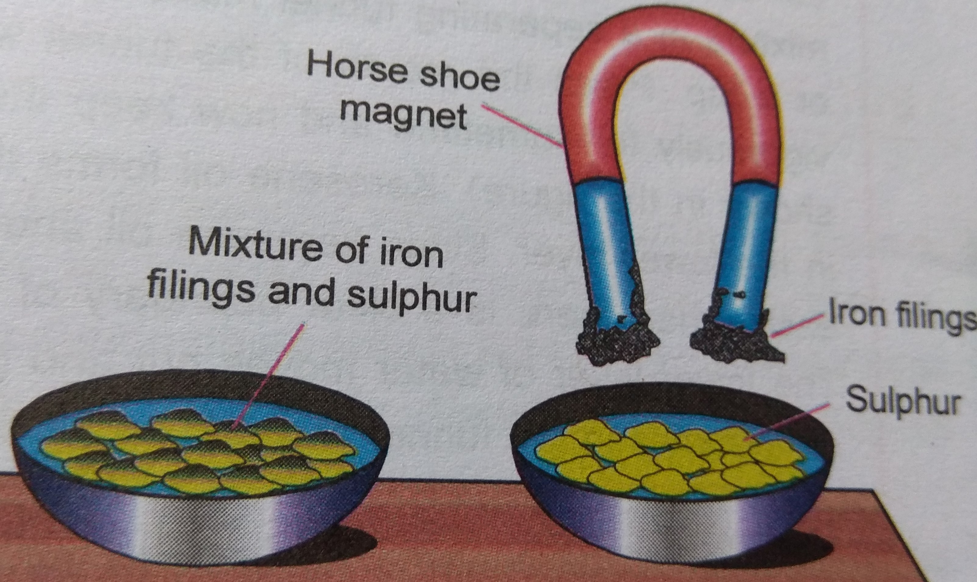
MAGNETIC SEPARATION
Magnetic Separation:
This method is used when one of the components is magnetic. Example: The mixture of iron filings and sulphur powder can be separated by using magnets.

Slide 9
WINNOWING, SIEVING AND THRESHING
Threshing: The process of separating grains from chaffs by biting on the ground. It can be done by a thresher. Winnowing: The method of separating the lighter chaff from the heavier grains by the help of air. Sieving: The method of separating solid-solid mixture by using a sieve. Pebbles are removed from the sand to make fine by the method of sieving.

Slide 10
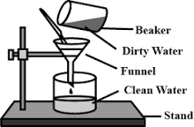
FILTRATION
Filtration is a process by which insoluble solids can be removed from a liquid by using a filter paper.
A filter paper is a special type of paper which has pores that are tiny enough to let only liquids pass through it. If you pass a solution through filter paper, any undissolved solid particles will get left behind on the paper whereas the liquid will filter through. The liquid that passes through is called the filtrate and the undissolved solid particles are called residue.
Example: A mixture of chalk powder and water can be separated by this method.

Slide 11
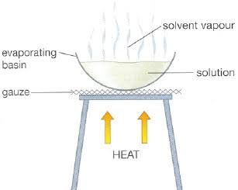
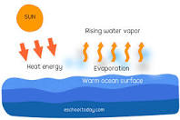
EVAPORATION
Evaporation is the process of vaporizing the solvent to obtain the solute. Evaporation is used to separate a mixture containing a non-volatile, soluble solid from its volatile, liquid solvent. We can separate salt from a solution by evaporating the water from the solution.

Slide 12
HOME ASSIGNMENT
Exercise Q5 to Q11
How can we separate saw dust, sand and iron fillings?
How can we obtain clean water from muddy water?

Slide 13
THANKING YOU
ODM EDUCATIONAL GROUP

