Slide 1
WORKING OF INSTITUTIONS
SUBJECT : SOCIAL SCIENCE
CHAPTER NUMBER:4 PERIOD:1
CHAPTER NAME : WORKING OF INSTITUTIONS

Slide 2
WORKING OF INSTITUTIONS
LEARNING OBJECTIVES
Students will be able to:- understand the need and working of political institutions.
Understand three important political institutions, Parliament, Prime Minister and Cabinet Ministers.
Gain a sense of the working of Indian Democracy, its institutions at local, state & union level.
Sensitise to the key role of the Parliament and its procedures.
Distinguish between nominal and real executive authorities and functions.
Understand the Parliamentary System of executive’s accountability to the legislature.

Slide 3
WORKING OF INSTITUTIONS
OFFICE MEMORANDUM
A communication issued by an appropriate authority stating the policy or decision of the government.
The government issues hundred of orders every day on different matters.
A Office memorandum was the culmination of a long chain of events.
MANDAL COMMISSION
The government of India had appointed the Second Backward Classes Commission in 1979.
It was headed by B.P. Mandal, so it is popularly called the Mandal Commission.
It was asked to determine the criteria to identify the socially and educationally backward classes in India and recommended steps to be taken for their advancement
The commission gave its report in 1980 and made many recommendations.
One of these was 27% of government jobs be reserved for the socially and economically backward classes.

Slide 4
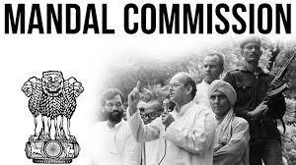
WORKING OF INSTITUTIONS
MANDAL COMMISSION
The benefit of job reservation extended from SC to ST to a third category called SEBC introduced
These reports and recommendations were discussed in the parliament
Many parties and parliamentarians kept demanding for the implementation of the demands.
1989, Lok Sabha election, the Janata Dal party promised that if they will get a chance to form the government they would implement the demands.
Janata Dal formed the government and its leader V.P. Singh became the prime minister and took different measures for to implement the commission report.
Finally, it was implemented official memorandum- O.M.No. 36012/31/90 was born on April 13, 1990

Slide 5
WORKING OF INSTITUTIONS
HOME ASSIGNMENT
1. What is SEBC?
2. What do you know about Mandal Commission?
3. Who agreed to the recommendation of Mandal commission?
4. What is ‘Office Memorandum’?
5. When did the Mandal Commission give its report?
.6. What are the various activities needed to govern the country?

Slide 6
THANKING YOU
ODM EDUCATIONAL GROUP

Slide 7
WORKING OF INSTITUTIONS
SUBJECT : SOCIAL SCIENCE
CHAPTER NUMBER:4 PERIOD:2
CHAPTER NAME : WORKING OF INSTITUTIONS

Slide 8
WORKING OF INSTITUTIONS
DECISION MAKERS
Decisions are made by government.
President of India is The Head of states and all decisions are taken in his name.
Prime minister is The Head of Government and actually exercises government power.
Decision are taken in cabinet meetings.
Parliament consists of two Houses:
Lok Sabha and Rajya Sabha .
Prime minister must have majority in Lok Sabha.

Slide 9
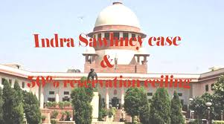
WORKING OF INSTITUTIONS
OPPOSITIONS AGAINST THE MANDAL COMMISSION
Some people felt that reservation was against the principle of equality.
Newspapers and Magazines were full of different views and opinions related with this issue.
It affected the thousands of job opportunities.
Some persons and associations opposed this and filed the case in the courts.
The supreme court of India bunched all these case together.
This case was known as “ Indira Sawhney and others Vs Union of India case.
Eleven judges of Supreme Court heard the arguments of both side.

Slide 10
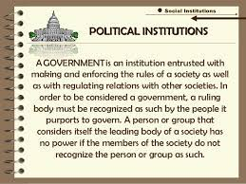
WORKING OF INSTITUTIONS
NEED FOR POLITICAL INSTITUTIONS
In India the political institutions are arranging and carrying all the tasks of the country. In modern democracy these arrangements are known as Institutions.
Working with institutions are not easy, it has lot of rules and regulations. It leads to delays also.
We need political institutions to frame implement and regulate rules for the country.
However, no work can be done without the institutions in a democracy.

Slide 12
WORKING OF INSTITUTIONS
HOME ASSIGNMENT
1. What is the role of government in a citizen’s life?
2. Why do we need political institutions in a democratic country?
3. Name any three institutions responsible to run the democratic government in India.
4. Why democratic governments insist on institutions?
5. Which case was called as ‘Indira Sawhney’’ case?

Slide 13
THANKING YOU
ODM EDUCATIONAL GROUP

Slide 14
WORKING OF INSTITUTIONS
SUBJECT : SOCIAL SCIENCE
CHAPTER NUMBER:4 PERIOD: 3
CHAPTER NAME : WORKING OF INSTITUTIONS

Slide 15
WORKING OF INSTITUTIONS
CONSTITUTION
PARLIAMENT/ LEGISLATIVE
The prime minister and the cabinet ministers that take all important policy decisions
EXECUTIVE
The Civil Servants, working together, are responsible for taking steps to implement the minister's decision.
JUDICIARY
Supreme Court is an institution where disputes between citizens and the government are finally settled.

Slide 16
WORKING OF INSTITUTIONS
SEPARATION OF POWERS

Slide 17
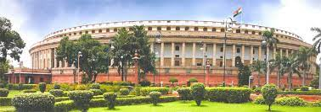
WORKING OF INSTITUTIONS
WHY DO WE NEED A PARLIAMENT
The parliament exercises political authority on behalf of the people in many ways:
Parliament is the final authority for making law in any country. It can also change existing laws or abolish existing laws and make new ones in their place.
Parliament exercises control over those who run the government. No decision can be taken without the support of the parliament
Parliament also control the money matters.
Parliament is the highest forum of discussion and debate on public issues and national policy in any country. It can seek information about any matter.

Slide 18
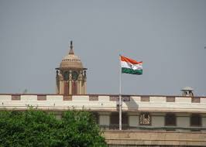
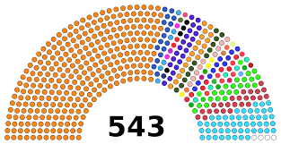
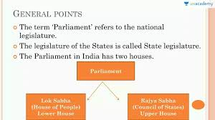
WORKING OF INSTITUTIONS
PARLIAMENT & LEGISLATURE
PARLIAMENT In all democracies, an assembly of elected representatives exercise supreme political authority on behalf of people. In India such as such as national assembly called Parliament
LEGISLATURE The body of elected representatives at the state level is called Legislature or Legislative assembly.

Slide 19
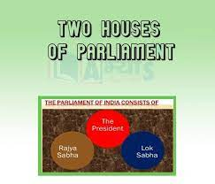
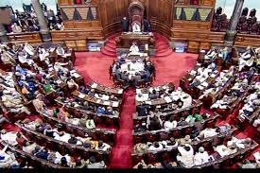
WORKING OF INSTITUTIONS
TWO HOUSES OF PARLIAMENT
Parliament plays a central role in democracies
The large countries divide the role and powers of the parliament in two parts.
They are called Chambers or Houses
One house is usually directly elected by the people and exercises the real power.
The second house , elected indirectly and perform some special functions. They were looking the interest of various states, regions and federal units.
Our Parliament has two houses: Lower House is called Lok Sabha or House of People and Upper House is called Rajya Sabha or Council of States.

Slide 20
WORKING OF INSTITUTIONS
LOK SABHA AND RAJYA SABHA
It is directly elected by the people and exercises the real power.
The maximum strength of the house is 552 of 530 members are elected from the states and 20 members from the Union Territories. Two members are nominated by the president of India from the Anglo- Indian community.
The present membership of Lok Sabha is 545.
Is usually elected indirectly and performs some special functions
The most common work for the second House is to look after the interests of various states, regions or federal units.
It has not more than 250 members
Twelve of Rajya Sabha members are nominated by the president from persons who have earned distinction in the field of literature, art, science service.
Rajya Sabha is a permanent body.
One third of the members retire every two years.
At present 245 members in Rajya Sabha, distributed among different states and union territories

Slide 21
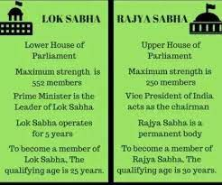
WORKING OF INSTITUTIONS
FUNCTIONS OF PARLIAMENT
On ordinary bills both Houses have equal power. In case of a deadlock a joint sitting of both Houses is called where Lok Sabha has numerical majority.
On many matters, Lok Sabha enjoys more power than Rajya Sabha . Rajya Sabha can delay it only by 14 days.
Lok Sabha controls Council of Ministers through no confidence motion . Rajya Sabha does not have this power.

Slide 22
WORKING OF INSTITUTIONS
HOME ASSIGNMENT
1. What is the role of Parliament in law making?
2. How does Lok Sabha exercise money powers?
3. How does Lok Sabha exercise control over the Council of Ministers?
4. The Lok Sabha exercises Supreme power.’ Justify your statement.
5. Why do we need a Parliament?

Slide 23
THANKING YOU
ODM EDUCATIONAL GROUP

Slide 24
WORKING OF INSTITUTIONS
SUBJECT : SOCIAL SCIENCE
CHAPTER NUMBER:4 PERIOD: 4
CHAPTER NAME : WORKING OF INSTITUTIONS

Slide 25
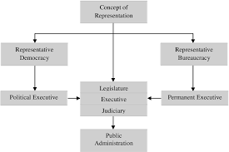
WORKING OF INSTITUTIONS
POLITICAL AND PERMANENT EXECUTIVE
The one which is elected by the people for only a specific period of time is called the Political Executive.
It signifies the government of a country.
The one where people are appointed on a long-term basis is called the Permanent Executive or the Civil Services.
People working for the civil services are called the civil servants.

Slide 26
Political executive
WORKING OF INSTITUTIONS
DIFFERENCE BETWEEN POLITICAL AND PERMANENT EXECUTIVE
Permanent executive
Executives who are elected by the people for a specific period are called Political Executives.
Example- Political leaders like the Prime minister, Council of Ministers
They remain in office only so long as they command the confidence of the majority members of the parliament
They are answerable to people for all the consequences of their decisions
They are more powerful. They take all the final decision
The permanent executives are salaried with civil servants who are appointed on a long term.
Persons working in civil services. Example: IAS, IPS and IFS
They remain in office even when the ruling party changes. Their tenure of the office is fixed.
They are not answerable to the people.
They are less powerful. They do not take decisions. Instead they assist political executives in carrying out day- to- day administration.

Slide 27
WORKING OF INSTITUTIONS
PRIME MINISTER
The prime minister is the most important political institution in the country.
The President appoints the Prime Minister. The prime minister does not have a fixed tenure. He continues in power so long as remains the leader of the majority party or coalition. The currently prime minister of India is Narender Modi.
He chairs Cabinet meetings
He coordinate the work of different department
His decision are final in case disagreements arise between departments.
He exercises general supervision of different ministries
All ministers work under his leadership
The prime minister distributes and redistributes work to the ministers.
He has the power to dismiss ministers.
When the Prime Minister quits, the entire ministry quits. Thus, if the cabinet is the most powerful institution in India, within the cabinet it is the Prime Minister who is the most powerful

Slide 28
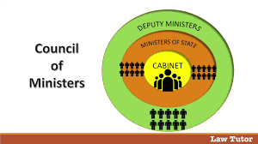
1. Council of ministers is the official name for the body that includes all the Ministers. It usually has 60 to 80 Ministers of different tasks Usually top level leaders of the ruling party, who are in charge of the major ministries. Usually the Cabinet Ministers meet to take decisions in the name of the council of Ministers. Cabinet is thus the inner ring of the Council of Ministers. It comprises about 20 ministers.
WORKING OF INSTITUTIONS
CABINET MINISTERS

Slide 29
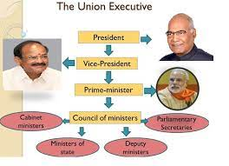
WORKING OF INSTITUTIONS
MINISTERS
2. MINISTERS OF STATE WITH INDEPENDENT CHARGE: are usually in charge of smaller ministries. They participate in the cabinet meetings only when specially invited.
3. MINISTERS OF STATE: Are attached to and required to assist cabinet Ministers.
The cabinet work as a team. No minister can openly criticise any decision of the government, even if it is about another ministry or Department.
Every Ministries has secretaries, who are Civil Servants.
The secretaries provide the necessary background information to the ministers to take decisions.

Slide 30
WORKING OF INSTITUTIONS
HOME ASSIGNMENT
1. Who is an Executive?
2. Why are they called as the Executive?
3. What do you understand by the term ‘political Executive’?
4.Who is called ‘Permanent Executive’?
5. Why does political executive have more power than the non-political executive?
6. How is the Prime Minister appointed?
7. Who are the Cabinet Ministers?

Slide 31
THANKING YOU
ODM EDUCATIONAL GROUP

Slide 32
WORKING OF INSTITUTIONS
SUBJECT : SOCIAL SCIENCE
CHAPTER NUMBER:4 PERIOD: 5
CHAPTER NAME : WORKING OF INSTITUTIONS

Slide 33
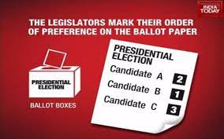
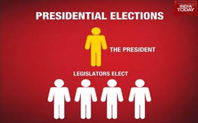
WORKING OF INSTITUTIONS
ELECTION PROCEDURE OF PRESIDENT OF INDIA
The president of India not elected directly by the people.
All the members of Parliament (MP) and members of Assemblies (MLA) elect him.
A candidate standing for the post of President has to get majority of votes to win the election.
This ensures that the President of India can be seen to represent the entire nation .

Slide 34
WORKING OF INSTITUTIONS
POWER OF PRESIDENT OF INDIA
The President of India is the head of the State.
He exercises only nominal powers. He is like the queen of Britain whose functions are to a large extent ceremonial.
The President supervises the overall functioning of all the political institutions.
All government activities take place in the name of the President
All laws and major policy decision of the government are issued in his/her name
All major appointments are made in the name of the President. These includes the appointment of the Chief Justice of India, the Judges of the Supreme Court and the High Courts, the Governors of the States, the Election Commissioners, ambassadors to other countries etc..
All international treaties and agreements are made in the name of the president.
The President is the Supreme Commander of the defence force of India

Slide 35
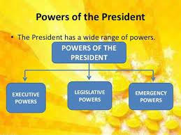
WORKING OF INSTITUTIONS
LIMITATION OF PRESIDENT
The President is the head of the State and not the head of the government. Therefore, he exercises only nominal powers and that too on the advice of the council of ministers.
The President can ask the Council of Ministers to reconsider its advice. But if the same advice is given again, he/she is bound to act according to it.
A bill passed by the Parliament becomes a law only after the President gives assent to it. If the President wants, he/she can delay this for some time and send the bill back to the Parliament for reconsideration. But if the Parliament passes the bill again, he/ she to sign it

Slide 36
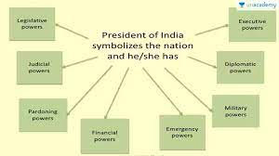
WORKING OF INSTITUTIONS
APPOINTMENTS MADE BY PRESIDENT OF INDIA
She/he appoints the Chief Justice of India, the judges of the Supreme Court and the High Courts of the states.
He appoints the Prime Minister of India and other ministers on the advice of the Prime Minister. He appoints the Governors of the States.
He appoints the Election Commissioners and Ambassadors to other countries

Slide 37
WORKING OF INSTITUTIONS
WHEN AND HOW DOES THE PRESIDENT EXERCISE HIS DISCRETION
When a party or coalition of parties gets a clear majority in the elections, the President has to appoint the leader of the majority party or the coalition that enjoys majority support in the Lok Sabha
When no party or Coalition gets a majority in the Lok sabha, the President exercise his discretion
The President appoints a leader who in his opinion can muster majority support in the Lok Sabha.
In such case, the President can ask the newly appointed to prove majority in the Lok Sabha within a specified time

Slide 38
WORKING OF INSTITUTIONS
HOME ASSIGNMENT
1. How does the President of India is elected?
2.How does the President act as the Executive head?
3.How does President give his assent to a bill?
4.Explain the discretionary powers of the President.
5.Who appoints the Chief Justice of India and the other judges?

Slide 39
THANKING YOU
ODM EDUCATIONAL GROUP

Slide 40
WORKING OF INSTITUTIONS
SUBJECT : SOCIAL SCIENCE
CHAPTER NUMBER:4 PERIOD: 6
CHAPTER NAME : WORKING OF INSTITUTIONS

Slide 41
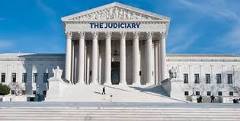
WORKING OF INSTITUTIONS
MEANING OF JUDICIARY
All the courts at different levels in the Country are collectively called the Judiciary.
It is independent and powerful institution and is considered essential for democracies.
The Indian Judiciary consists of a Supreme Court for the entire nation, High Court in the States, District Courts and the Courts at local level
The judiciary in India is also one of the most powerful in the World.

Slide 42
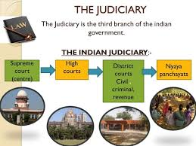
WORKING OF INSTITUTIONS
POWERS OF JUDICIARY
The Judiciary in India is one of the most powerful judiciary in the World. India has an integrated Judiciary. It means the Supreme Court controls the judicial administration in the country.
1. SETTLE THE DISPUTES
Between the Citizens
Between citizen and government
Between two or more state
Between government at the union and state level
2. FREE FORM LEGISLATURE AND JUDICIARY
The judges do not act on the direction of the government or according to the wishes of the party in power.
That is why all the modern democracies have courts that are independent of the legislature and the executive

Slide 43
WORKING OF INSTITUTIONS
POWERS OF JUDICIARY
INTERPRET THE CONSTITUTION OF THE COUNTRY
The Supreme court and the High court have the power to
interpret the Constitution of the country
JUDICIAL REVIEW
They can declare invalid any law of the legislature or the actions of the executive, whether at the Union level or at the State level, if they find such a law or action is against the Constitution. Thus they can determine the Constitutional validity of any legislation or action of the executive in the country, when it is challenged before them. This is known as Judicial review. If the court finds that a law or an order of the executive disobeys the provisions of the constitution, it declares such law or order null and void.

Slide 44
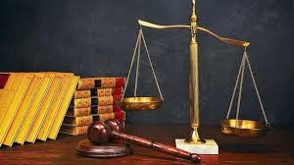
WORKING OF INSTITUTIONS
POWERS OF JUDICIARY
GUARDIAN OF FUNDAMENTAL RIGHTS
The powers and the independence of the Indian judiciary allow it to act as the guardian of the Fundamental rights. That is why, the judiciary enjoys a high level of confidence among the people.
PUBLIC INTEREST LITIGATION
Any one can approach the courts if public interest is hurt by the actions of the government.
PREVENT THE MISUSE OF GOVERNMENT POWER
The courts intervene to prevent the misuse of the government’s power to make decisions. They check malpractices on the part of the public officials. That’s why the judiciary enjoys a high level of confidence among the people.

Slide 45
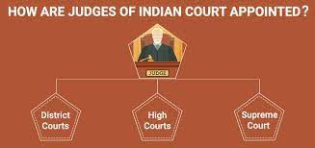
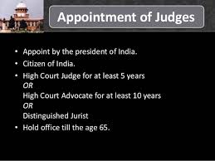
WORKING OF INSTITUTIONS
APPOINTMENT AND REMOVAL OF JUDGES
The judges of the S C and HC are appointed by the President on the advice of the Prime Minister and in consultation with the Chief Justice of the Supreme Court.
The Senior most judge of the Supreme Court is usually appointed the Chief Justice
Once a person is appointed as judge of the S C or H C it is nearly impossible to remove him or her from that position
A judge can be removed only by an impeachment motion passed separately by two thirds members of the two houses of the parliament
It has never happened in the history of Indian democracy.

Slide 47
WORKING OF INSTITUTIONS
HOME ASSIGNMENT
1.What does ‘independence of Judiciary ‘mean?
2. What does ‘Integration of Judiciary’ mean?
3. What do you understand by Public Interest Litigation (PIL)?
4. Define the term “Judicial Review”.
5. How can you say that the judiciary in India is the most powerful?

Slide 48
THANKING YOU
ODM EDUCATIONAL GROUP

