Slide 1
ORGANIC CHEMISTRY
Chemical Reactions of Haloarenes, Nucleophilic Substritution Reactions, Electrophilic Substitution Reactions, Reaction with Metals
SUBJECT : CHEMISTRY
CHAPTER NUMBER: 10
CHAPTER NAME : HALOALKANES AND HALOARENES

Slide 2
Learning Outcome
Students will be able to Recognize the various Chemical Reactions of Haloarenes
. Students will be able to relate Nucleophilic Substritution Reactions in Haloarenes
They will understand how Electrophilic Substitution Reactions occurs Aryl Halides
They will understand about Reaction of Aryl Halides with Metals

Slide 3
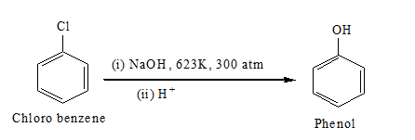
Lecture-07
Chemical Reactions of Haloarenes, Nucleophilic Substritution Reactions, Electrophilic Substitution Reactions, Reaction with Metals
Reactions of Haloarenes:
Nucleophilic substitution: Aryl halides are extremely less reactive towards nucleophilic substitution reactions due to:
Resonance effect:
carbon atom attached to halogen is sp2-hybridized
Instability of phenyl cation
Replacement by hydroxyl group:

Slide 4
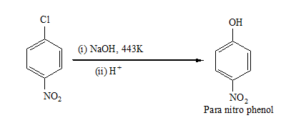
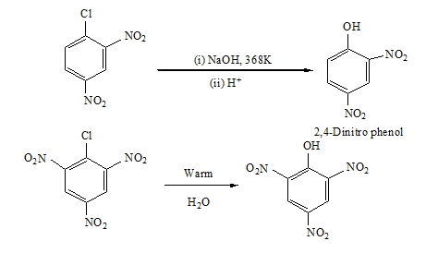
The presence of an electron-withdrawing group (-NO2) at the ortho- and para-positions increases the reactivity of haloarenes.
The effect is pronounced when (-NO2) group is introduced at ortho and para- positions

Slide 5
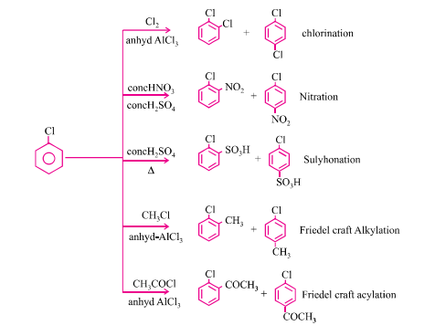
. Electrophilic Substitution Reaction of Haloarenes :

Slide 6
Reaction with metals:
Wurtz-Fittig reaction: A mixture of an alkyl halide and aryl halide gives an alkylarene when treated with sodium in dry ether and is called the Wurtz-Fittig reaction.
Fittig reaction: Aryl halides also give analogous compounds when treated with sodium in dry ether, in which two aryl groups are joined together. It is called the Fittig reaction

Slide 7
Answer the following questions:
1.Although chlorine is an electron withdrawing group, yet it is ortho-, para- directing in electrophilic aromatic substitution reactions. Why?
2.Can you think why does NO2 group show its effect only at ortho- and para- positions and not at meta- position?
3.Convert (i) Benzene to diphenyl (ii) Chlorobenzene to p-nitrophenol
4. What happens when bromo benzene is treated with Mg in the presence of dry ether?

Slide 8
THANKING YOU
ODM EDUCATIONAL GROUP

