Slide 1
MICRO NUTRIENTS
SUBJECT : PHYSICAL EDUCATION
CHAPTER NUMBER: 2
CHAPTER NAME : SPORTS AND NUTRITION

Slide 2
WHAT WE EXPECT TO LEARN?
We will be able to know about the ‘MICRO NUTRIENTS.
We will be familiar with the various types of macro & micro nutrition.

Slide 3
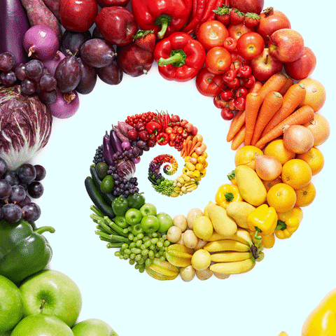
4% of body weight is made up of minerals.
Required for healthy teeth, bones, muscles.
Transmission of nerve impulses.
Formation of hormones.
Maintenance of heartbeats.
0.1gm of MACRO-MINERALS required/day.
0.01gm of MICRO-MINERALS required/day.
MINERALS

Slide 4
TYPES OF MINERALS
MACRO-MINERALS
P
C
M
P
S
POTASSIUM
I
C
I
C
C
IODINE
CALCIUM
COPPER
MICRO-MINERALS
MAGNESIUM
IRON
PHOSPHOROUS
CHROMIUM
SODIUM
COBALT

Slide 5
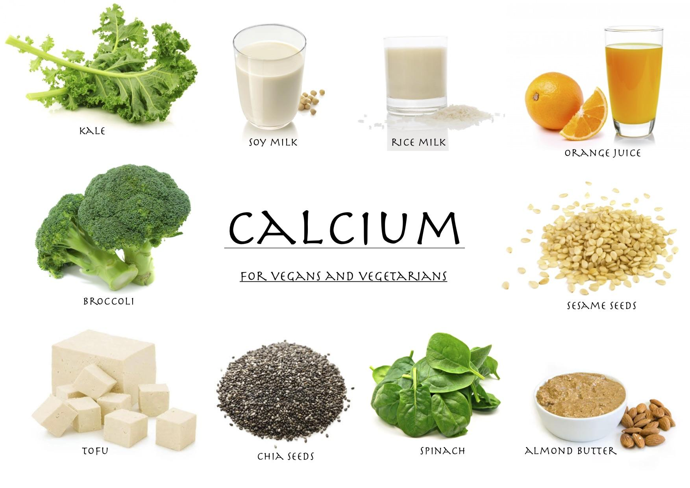
CALCIUM :-
It’s help of growth and development of our bones and teeth.
It’s help in blood clotting.
It’s deficiency may cause rickets.
Sources :- cheese, milk, orange juice, eggs, yogurt, green leafy vegetables, etc.
POTASSIUM :-
It’s helpful in keeping the nervous system and muscular system fit and active all the time.
It helps in maintaining the amount of water in blood and tissues.
Its deficiency may cause weak muscles, lethargic and contract Addison’s disease (damage adrenal glands).
Sources :- banana, tomatoes, green leafy vegetables, etc.
MACRO MINERALS

Slide 6
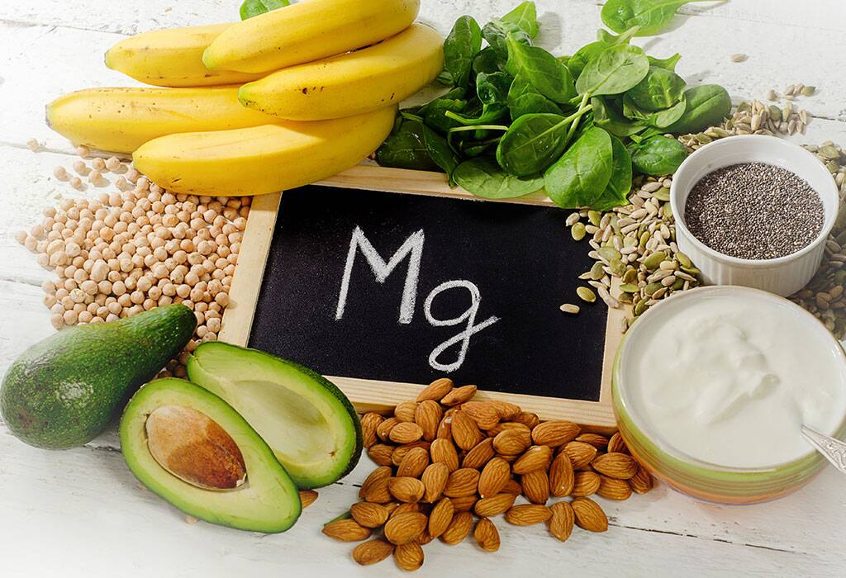
SODIUM :-
It helps in muscular activities.
It maintains the balance of acid & base.
It also helps in the transmission of nerve impulses.
Sources :- salt, pickles, butter, etc.
MAGNESIUM :-
It repairs and maintains body cells.
Sources :- meat, brown rice, beans, whole grains, etc.
PHOSPHORUS :-
It helps in the formation of bones and teeth.
Sources :- egg, fish, cod liver, milk, unpolished rice, etc.
MACRO MINERALS

Slide 7
SOURCES OF MACRO MINERALS
CALCIUM
milk, eggs, green leafy vegetables
POTASSIUM
banana, tomatoes, green leafy vegetables
SODIUM
salt, pickles, butter
MAGNESIUM
meat, brown rice, whole grains
PHOSPHORUS
egg, fish, milk, unpolished rice

Slide 8
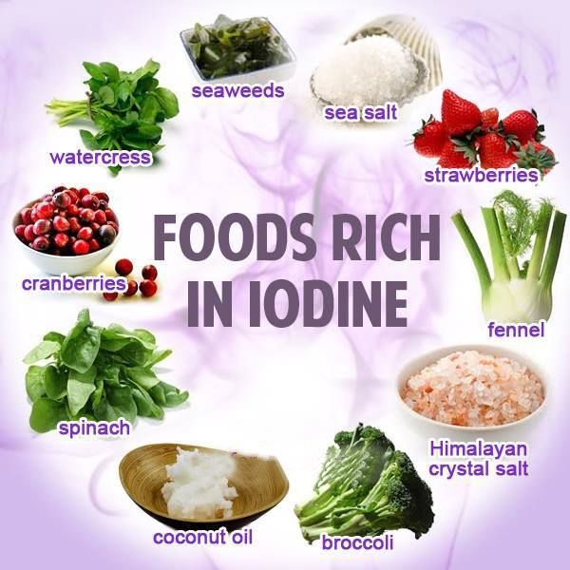
IODINE :-
It helps in the production of hormones in the thyroid gland.
It is also significant for the proper growth and development of the body.
Lack of iodine can cause GOITRE(swollen thyroid gland).
Sources :- salt, fish, and seafood.
IRON :-
It helps in the production of haemoglobin.
It’s deficiency causes anaemia.
Sources :- liver, meat, egg, dry fruits, banana, etc.
MICRO MINERALS

Slide 9
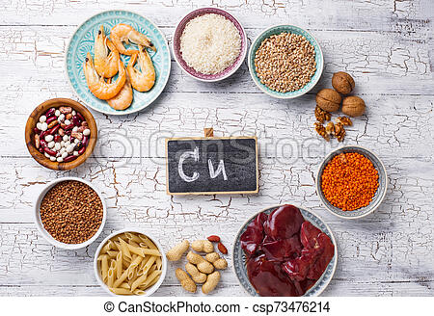
CHROMIUM :-
It helps in stimulates insulin activity.
Its deficiency may cause diabetes.
Sources :- soybean, carrot, tomato, bajra, etc.
COPPER :-
It helps iron in the formation of haemoglobin.
Sources :- egg, pulses, and green leafy vegetables, etc.
COBALT :-
It protects us from anaemia.
Sources :- milk, meat, green leafy vegetables, etc.
MICRO MINERALS

Slide 10
SOURCES OF MICRO MINERALS
IODINE
salt, fish, and sea food
IRON
meat, egg, dry fruits, banana
CHROMIUM
soybean, carrot, tomato
COPPER
egg, green leafy vegetables
COBALT
milk, meat, green leafy vegetables

Slide 11
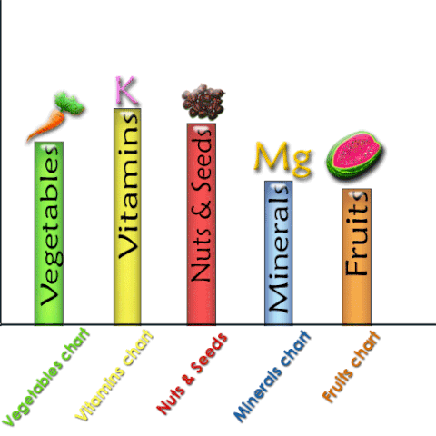
VITAMINS
Vitamins are chemicals, it is required in a very small amount.
The absence of vitamin in the diet causes deficiency disease.
Fat-soluble vitamins are composed of Carbon, Hydrogen and Oxygen.
Water-soluble vitamins contain Nitrogen & Sulphur.

Slide 12
1. Which one is macro nutrients as well as non-nutritive components of diet?
CARBOHYDRATES
PROTEINS
FATS
WATER
2. Which one is insoluble in water?
CELLULOSE
GALACTOSE
LACTOSE
GLUCOSE
3. How many amino acids are there in Proteins?
9
21
22
23
4. What is the ratio of hydrogen atoms to oxygen atoms?
1 : 2
1 : 1
2 : 1
2 : 2

Slide 13
THANKING YOU
ODM EDUCATIONAL GROUP

