Slide 1
LIGHT ENERGY
SUBJECT-PHYSICS CHAPTER NUMBER-5

Slide 2
LEARNING OBJECTIVE
Students will be able to :
state the laws of reflection.
Draw ray diagram to illustrate formation of image by a plane mirror.
apply the law of reflection to predict the position of images formed by objects in front of a plane mirror.
Identify different types of mirrors.

Slide 3
Recapitulation
https://youtu.be/v5SuSB_93FM

Slide 4
Refraction of light.

Slide 5
Refraction of light. When light travels from rarer to denser medium

Slide 6
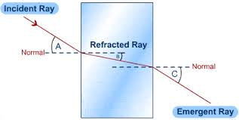
Refraction of light. When light ray travels from denser to rarer medium

Slide 7
Refraction of light. Through a glass slab
https://youtu.be/OdcHCRF00jM
https://youtu.be/F8UAwyW8yBs

Slide 8
Speed of light in different media
Speed of light in air: 3×10⁸ m/s.
Speed of light in water: 2.25×10⁸ m/s.
Speed of light in glass : 2×10⁸ m/s.
Glass is optically denser than air or air is optically rarer than glass.

Slide 9
Refraction of light
The change in the direction of path of light when it passes from one optical medium to another optical medium is called refraction of light.
When a light ray travels from rarer to denser medium:
When a light ray travels from a denser to rarer medium:
When a light ray is incident normally on surface separating two media:

Slide 10
When a light ray travels from rarer to denser medium:

Slide 11
When a light ray travels from a denser to rarer medium:

Slide 12
When a light ray is incident normally on surface separating two media:

Slide 13
THANKING YOU
ODM EDUCATIONAL GROUP

