Slide 1
CLASS : NURSERY
DATE : 01.09.2021
SUBJECT :
MATHS
CHAPTER NUMBER- BK PG NO -48,49
SUB-TOPIC :
NUMBER-6

Slide 2
IDENTIFY THE GIVEN NUMBERS

Slide 3
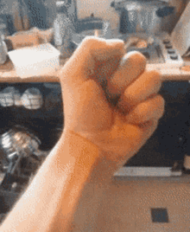
Identification of number-5

Slide 5
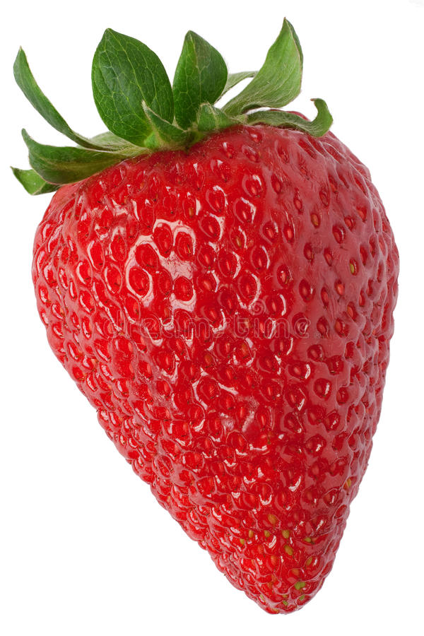
Identify and count the given pictures

Slide 6
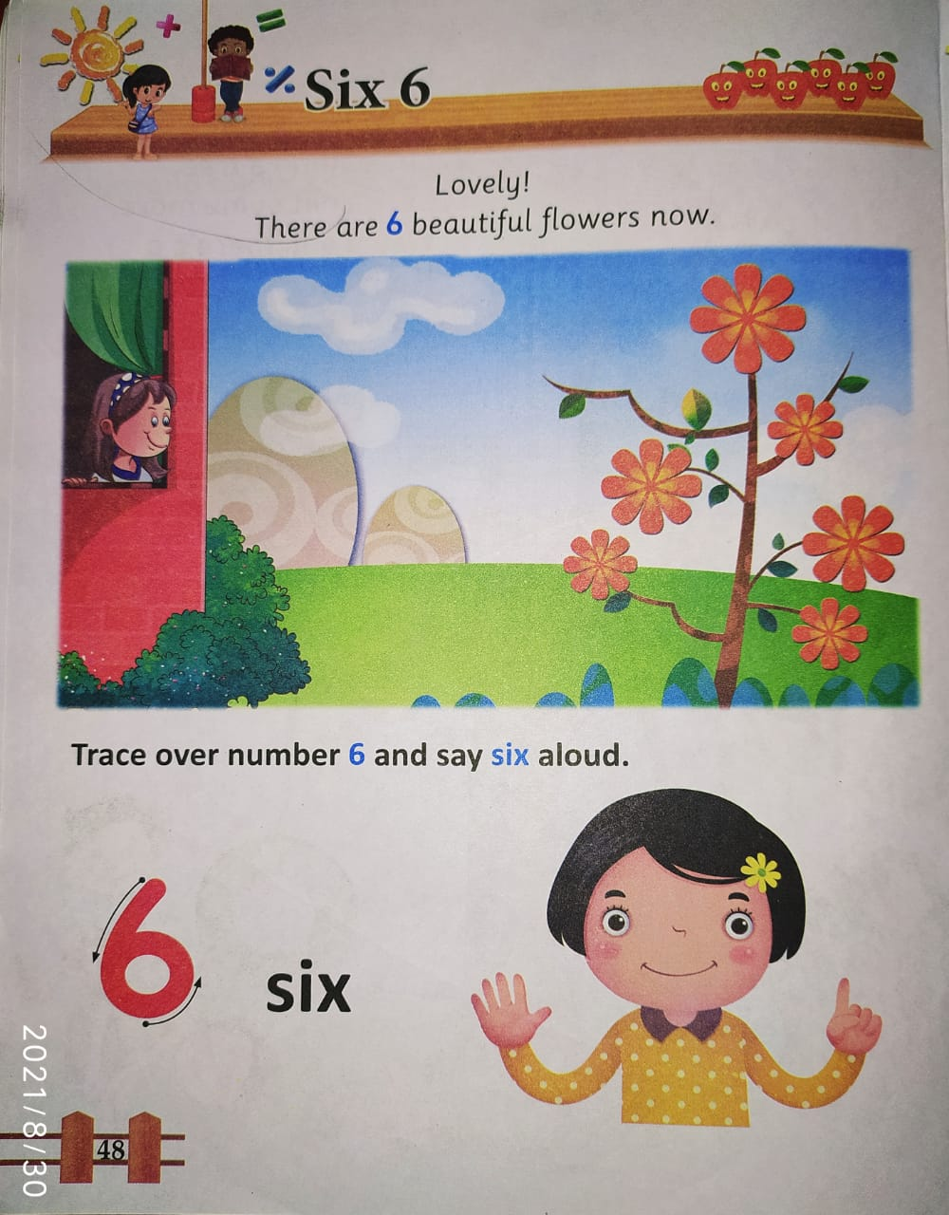

Slide 7
COUNTING IN FINGERS

Slide 10
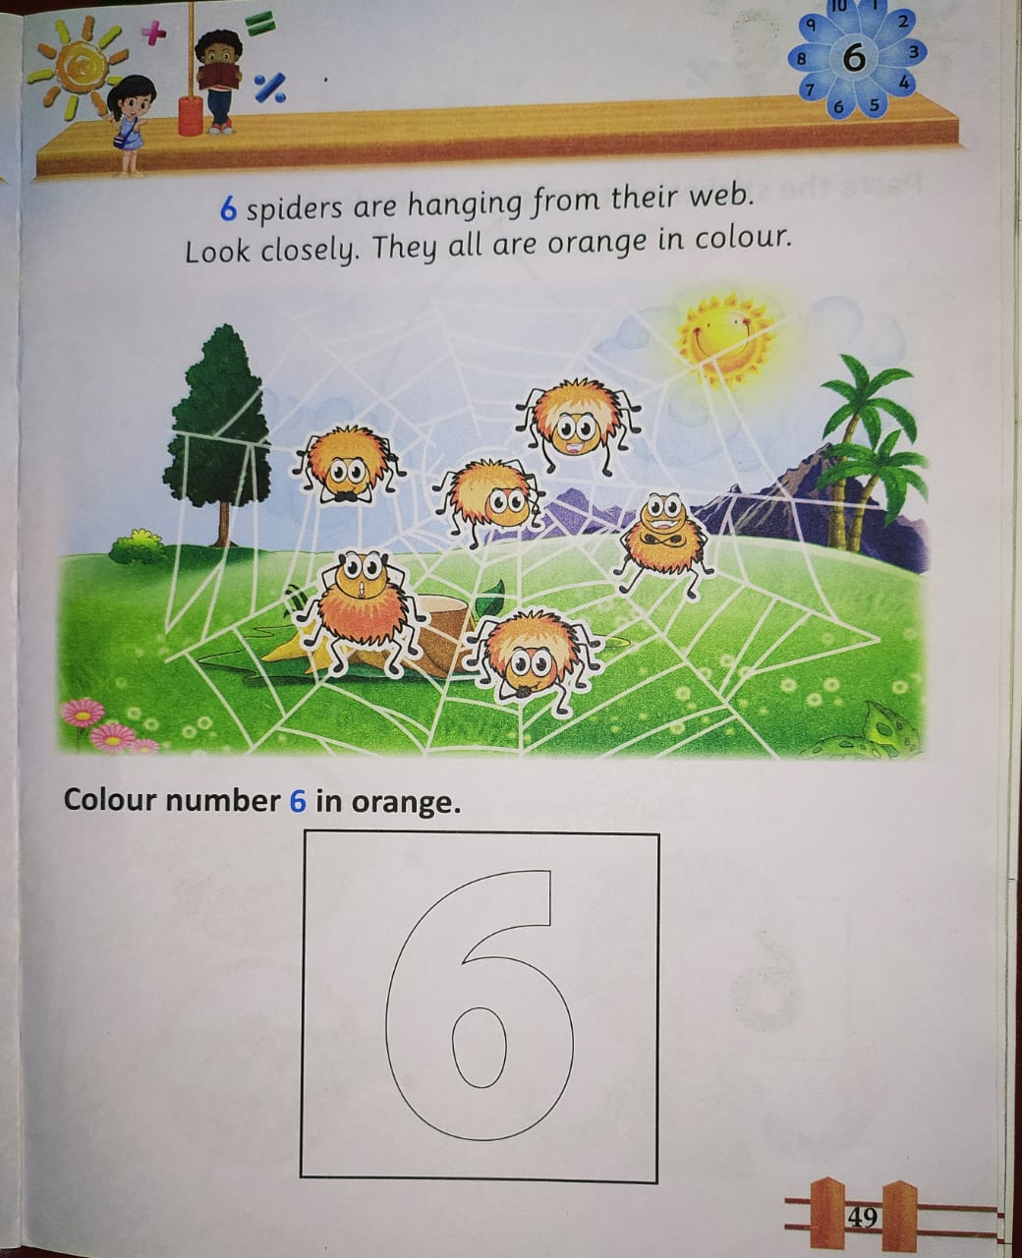

Slide 11
1 .Practice counting 1-5
ASSIGNMENT
01/09//21
1.Practice counting 1 to10
2.Do bk pg no-45,46
Notes:
2.practice the activity done today

Slide 12
THANKING YOU
ODM EDUCATIONAL GROUP

