Slide 1
CLASS : NURSERY
DATE : 03.01.2022
SUBJECT :
MATHS
TOPIC :
:NUMBER-16 IN NT BK

Slide 2
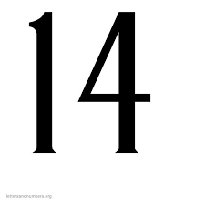
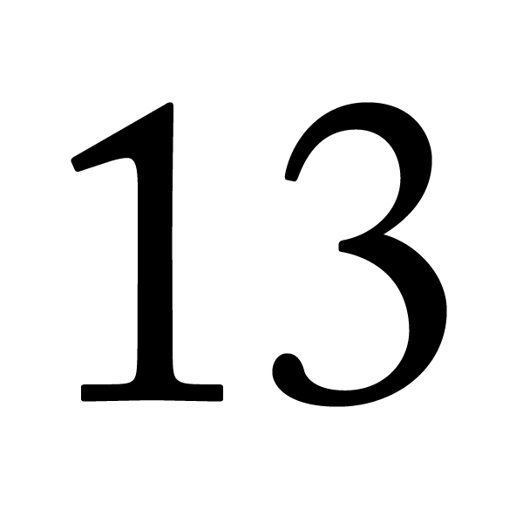
Identify the given number

Slide 4
Identify and count the objects

Slide 5
Identification of number -16

Slide 6
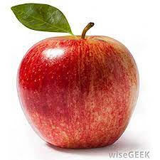

Slide 7
HI children

Slide 8
IN BK PG NO-16
NUMBER-16 IN NT BK
Notes:
Note book work

Slide 9
Circle and colour number 16
CW
03/01/22
14 10 16 13 16
16 14 11 16 13
10 13 16 14 16

Slide 10
Say and write the given number
HW
03/01/22
1 | 2 | 3 | 4 | 5
6 | 7 | 8 | 9 | 10

Slide 11
1 .Practice counting 1-5
ASSIGNMENT
03/01/22
1.Practice counting 11 to20
2.Complete the work given in nt bk
Notes:
2.Do bk pg no-63

Slide 12
THANKING YOU
ODM EDUCATIONAL GROUP

