Slide 1
WELCOME TO ON LINE CLASS
CLASS-UKG
SUBJECT-MATHS
TOPIC- NUMBER AND NUMBER
NAMES 21-50(ONCE AGAIN)
(DATE-29.7.21)

Slide 2
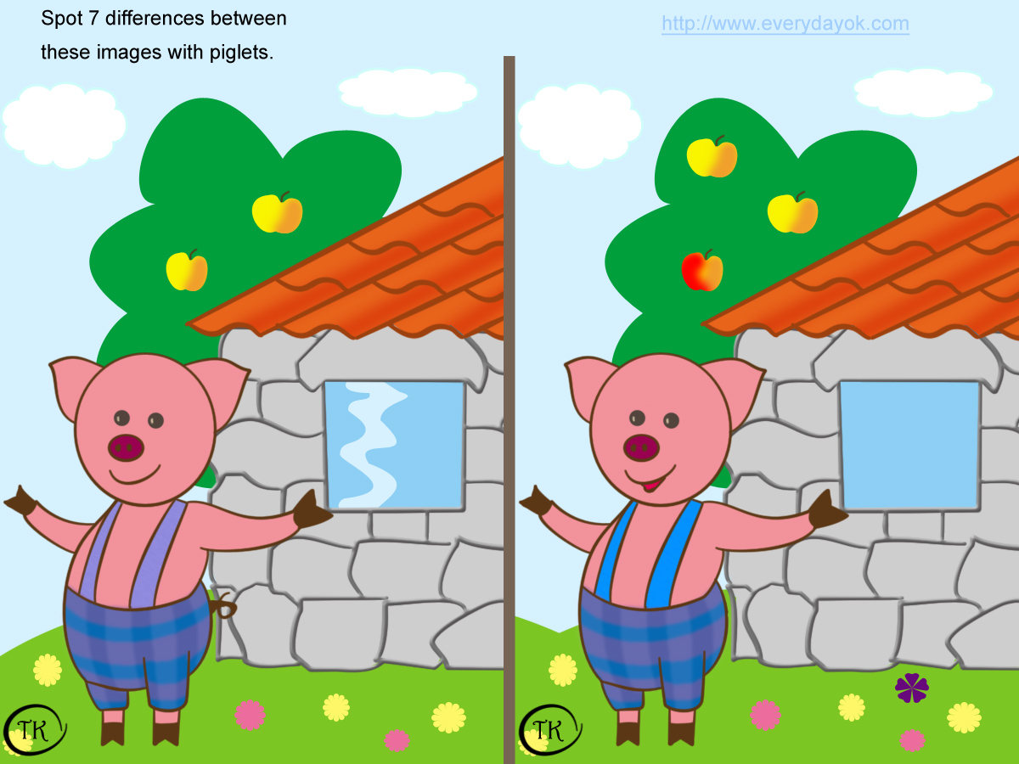
Find the missing numbers:
44
44
35
35
35
50
35
50
35
29
29
37
37
43
43
36
36
21
21

Slide 3
Match the number names with the correct numbers:
50
33
21
Twenty one
Fifty
37
40
45
Thirty three
Thirty seven
28
30
Forty
Twenty eight
Forty five
Thirty

Slide 4
Dictation
37
43
33
18
29
20
30
17
45
25

Slide 5
h/w 29.7.21
Rearrange the numbers and write them in correct order:
24
26
27
25
29
30
28
31
30
33
32
35
34
36
46
42
45
44
43
48
47

Slide 6
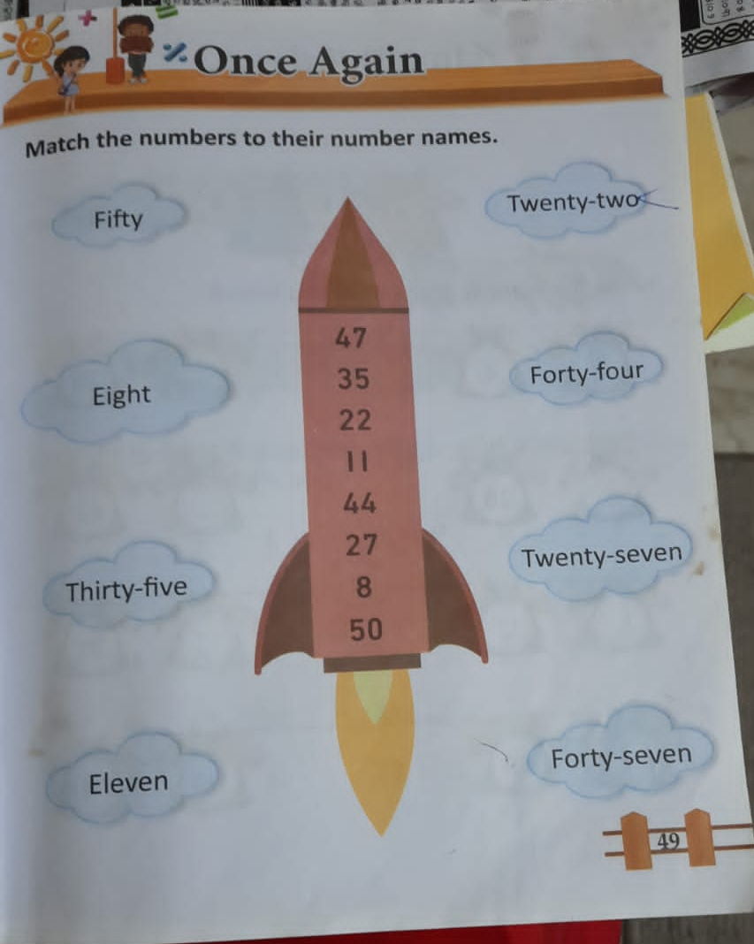
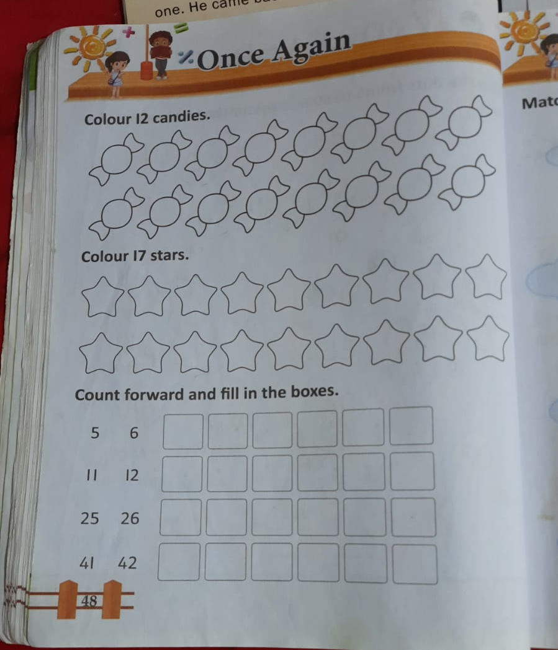
h/w 29.7.21

Slide 7
THANKING YOU
ODM EDUCATIONAL GROUP

