Slide 1
SUBJECT :-- (ENGLISH)
CHAPTER NUMBER:-- 8 (VISTAS)
CHAPTER NAME :-- MEMORIES OF CHILDHOOD

Slide 2
SUB-CONCEPTS
Trans-cultural Discrimination
Cultural Uniqueness
Accommodating Cultural Diversity
Social Superstitions
Evils of Casteism and Discrimination
Plight of Dalit Communities in India

Slide 3
LEARNING OBJECTIVES
Learn to appreciate one’s stand against social and racial discrimination and support social justice.
Learn the significance of cross-cultural influence and its impact on young minds.
Learn the impact of casteism and racialism in shaping social and cultural values.

Slide 4
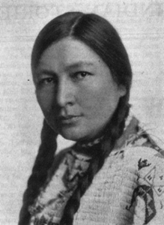
ABOUT THE AUTHOR
Zitkála-Šá, is also known as Gertrude Simmons Bonnin.
She was a prolific writer, editor, translator, musician, educator
and political activist. A short bio-data of the author is given below:-
Born: 22 February 1876, Yankton Reservation, South Dakota, United States
Died: 26 January 1938, Washington, D.C., United States
Spouse(s): Raymond Bonnin
Other names: Gertrude Simmons Bonnin
Children: Ohíya
Education: New England Conservatory of Music (1897–1899), Earlham College (1897)
Important Books Written by the author:-
Old Indian Legends (1901)
American Indian Stories (1921)
Dreams and Thunder (1923)
The soft hearted Sioux (1931)

Slide 5
STEP-WISE LEARNING PROCESS:- ( Page-93-96)
THE TOPIC:- The Cutting of my Long Hair—Zitkala-Sa
The topic is about racial and cultural prejudice and oppression.
Zitkala-Sa is the pen name of Gertrude Simmons Bonnin.
She is an extraordinarily talented native American woman.
She recalls her childhood experience in an American school.

Slide 6
Zitkala-Sa’s First Day at School:-
The setting began in a trans-cultural environment.
The author got admission into an American school.
She recalls the first day at school with some outlandish air around.
She feels isolated there amidst the sounds of clatter of shoes crashing noises of students.
She was feeling extremely nervous as she had not faced such kind of situation before.
The sense of insecurity she was feeling was the direct result of her complete detachment from her own culture.
The writer felt awkward when she observed the system of eating by formula in the canteen.
She was afraid looking at the pale-faced woman staring at her.
All the new changes were too much for her. She started crying instead of eating.

Slide 7
THE TERRIBLE WARNING:-
The narrator’s friend Judwin knew some English and she had overheard the pale-faced woman talk about cutting their long and heavy hair.
The narrator was so much fond of her hair and she learnt that the rule in that school was to keep short hair only.
Her friend’s information about hair cutting only aggravated her obsession with her long hair
The thought of having her hair cut was unacceptable and detestable to to the narrator.

Slide 8
THE NARRATOR’S PROTEST:-
Zitkala-Sa was determined to put up a fight against the cutting of her long hair.
She told her friend that she would not submit to the force of the authorities.
She got a chance to escape and went upstairs and crawled under a bed to hide in a dark room.
She had thought that she was secure there. But in reality she was being seriously searched for by the school authorities.
Now every moment of her life became an eternal torture.
She was on the verge of facing the most unexpected anxiety of her life.

Slide 9
AT LAST, ZITKALA-SA WAS CAUGHT:-
Zitkala-Sa was searched for everywhere and was finally captured from under the bed where he had hid.
This was the end of her resistance. She was forcefully dragged like an animal and at last her long hair was cut.
This gave her the most embarrassing experience of her life in a trans-cultural set-up
She was reminded of all the humiliations she went through since the day she parted with her mother.
The cutting of her long hair put her into the deepest pit of depression in that tender phase of her life.

Slide 10
DRILLING OF WORDS AND LINGUISTIC EXPRESSIONS
Marginalised:- confined to the neglected section of society.
Dogma:- rules or theories which are accepted unquestionably.
Serrated:- having a saw-toothed margin.
Belfry:- a bell tower
Bedlam:-a scene of great confusion or noise.
Shingled:- closely cropped or cut.
Moccasins:-soft leather shoes.
Immodestly:- indecently
Venture:- having the courage to do or say something.
Closet:- a small room or cabinet.
Novelties:- new and unusual things.
Oddities:- strange things or situations.

Slide 11
RELATED QUESTIONS FROM THE PORTIONS TAUGHT:-
What did Zitkala-Sa mean by eating by formula?
Why was Zit kala-Sa in tears on the first day in the land of apples?
Why did Zitkala-Sa resist the shingling of her hair?
How did Zitkala-Sa try to prevent the shingling of her hair?
What did Zitkala-Sa feel when her long hair was cut?

Slide 12
MESSAGE OF THE STORY
People find them in a stranger’s land while living in a trans-cultural set-up.
Children are the most vulnerable group when they have to live in a culture completely different from their own.
One needs some qualities of adaptability to survive in a different culture than one’s own.
Sympathy and tolerance can go a long way to create an inter-mingling of cordial culture.
People having upper hand over others in times of their susceptibility should understand the values of fellow-feeling and benign gesture.

Slide 13
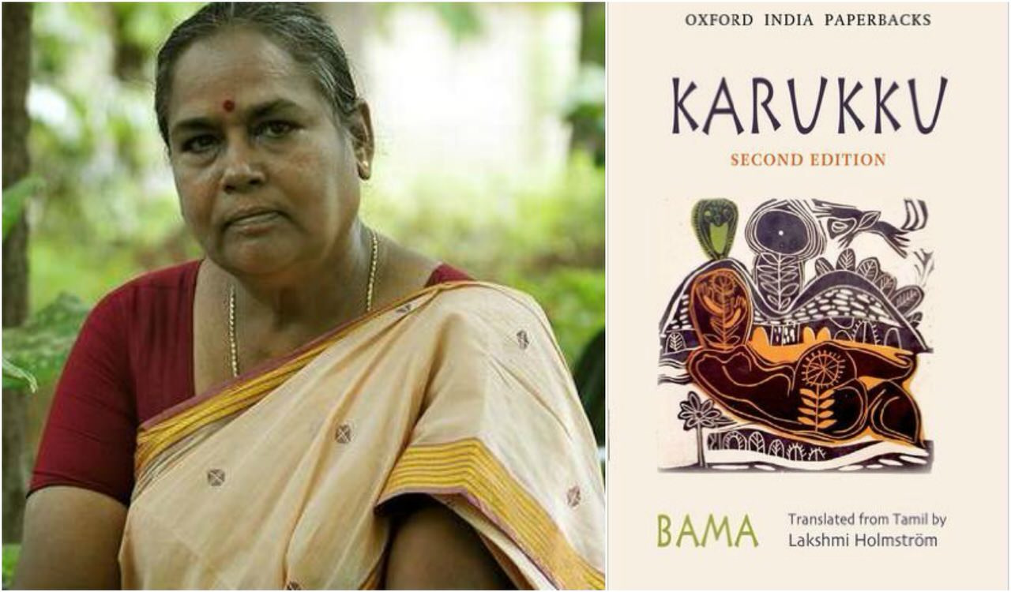
ABOUT THE AUTHOR:-
Bama (writer) ... Bama (born 1958), also known as Bama Faustina Soosairaj.
She is a Tamil Dalit feminist, committed teacher and novelist.
She rose to fame with her autobiographical novel Karukku (1992).
This book chronicles the joys and sorrows experienced by Dalit Christian women
in Tamil Nadu.
Important Books by the author:-
Karukku
Sangati
Vanmam
Caste System in India
EPISODE-2 :-(THE STORY OF BAMA)
WE TOO ARE HUMAN BEINGS:- (Page No:- 96-100)

Slide 14
WE TOO ARE HUMAN BEINGS:- (Page No:- 96-100)
THE NARRATOR’S ENTERTAINING WALK HOME:-
The narrator takes the readers back to her school days during her childhood.
She narrates a myriad things that show up on her way home from school and admits how because of these entertainments a ten minutes journey takes half- an-hour.
She enjoys all those things on her way to home and this walk becomes her favourite pastime.
She considers herself to be the happiest and the luckiest child to experience life at that stage.
Her perceptions about life fell flat when she became aware about the grim realities of life as a Dalit girl.

Slide 15
THE NARRATOR’S ENCOUNTER WITH UNTOUCHABILITY:-
Bama, the narrator, observes one day how one man of her community was carrying snacks for her landlord who belonged to a higher caste.
The man was holding the packet by its string in a meek and very careful way so that he could give the packet to the landlord without touching him.
Bama was puzzled to see such scenario because she had never witnessed a person carrying things like this.
She decided to know all about this from his elder brother who was educated enough to explain these things.

Slide 16
LAUGHTER TURNS INTO SADNESS:-
At first Bama was laughing at the funny way in which the man was carrying and handing over the snacks to the landlord.
But her brother (Annan) was not amused at this story narrated by Bama. He informs that this was due to the practice of untouchability in societies.
After getting to know this Bama sinks into deep sadness and depression.
Bama could not have imagined such a kind of horrible practice prevalent in society.
She wants answers to the myriad questions that crop up in her mind.
She desperately longs for a just and fair society with equality and justice.

Slide 17
ANNAN’S ADVICE TO THE NARRATOR:-
Annan explained to Bama they were born into lower community as a result of which they have been suppressed in life.
Annan also advised Bama as to come out of this cursed situation.
He told that getting good education and working hard at it would take away this social stigma from them.
These words made a deep impression on Bama. She takes Annan’s advice into heart and studied hard and ultimately stands first in the class.
This fulfilled her desire to stand on an equal footing with others.

Slide 18
DRILLING OF WORDS AND LINGUISTIC EXPRESSIONS
Spur on :- incite or stimulate
Hunter gypsy :- a member of a group of wandering hunters
Lemur :- a breed of monkey
Smart :- pain sharply
Savoury :- with pleasing taste or smell
Iced lollies :- ice cream on a small wooden stick
Vadais :- an Indian snack made from ground pulses and deep fried.
Run errands :- do the menial work on somebody’s order.
Stripped of :- deprived of
Thambi :- fellow
Harangue :- deliver a long pompous speech.

Slide 19
THE MESSAGE OF THE STORY:-
The practice of untouchability is a social stigma upon the Dalit community.
The so called higher class people of society are responsible for the backwardness of the population in a society.
The injustice done to the downtrodden must be resisted sooner or later by virtue of their perception of inherent equality of life.
Hard work and determination can work wonders for the exaltation of one’s life.

Slide 20
SUMMING - UP OF THE CHAPTER:-
The first episode of the chapter the story of Zitkala-Sa, gives an account of trans-cultural adjustments and cultural domination over others.
The second episode, the story of Bama, depicts the curse of casteism and social oppression of the Dalit community.
In both these cases we find how the memories of two small girls, Zitkala-Sa and Bama, have been nightmarish and a patch of bad phase of their lives.
From this two accounts we get a reflection of the social life of the people belonging to that era.

Slide 21
RELATED QUESTIONS ON THE PORTIONS TAUGHT:-
What sort of shows of entertainment attracted Bama?
When did Bama first come to know of the social discrimination faced by the people of her community?
What comic incident did Bama narrate to her brother? Why was not he amused?
What was the advise that Annan gave to Bama?
What impact did Annan’s advice have on Bama?

Slide 22
THANKING YOU
ODM EDUCATIONAL GROUP

