Slide 1
MOTION
CHAPTER NO.8 SUB: PHYSICS

Slide 2
LEARNING OBJECTIVE
Students will be able to
Define uniform circular motion

Slide 3
Uniform circular motion
When an object moves in a circular path at a constant speed then motion of the object is called
uniform circular motion.
If the speed of motion is constant for a particle moving in a circular motion still the particles
accelerates because of constantly changing direction of the velocity.

Slide 4
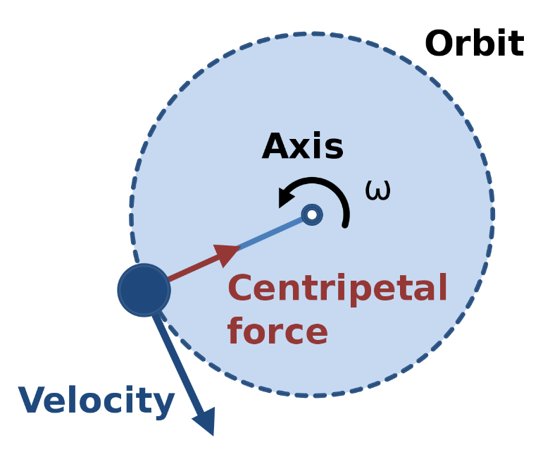
If an object moves in a circular path with uniform speed, its motion is called uniform circular motion
Force which is needed to make body travel in a circular path is called centripetal force.
One thing we must keep in mind is that uniform linear motion is not accelerated but uniform circular motion is accelerated motion.

Slide 5
HOME ASSIGNMENT
What is circular motion ?
What is uniform circular motion?

Slide 6
THANKING YOU
ODM EDUCATIONAL GROUP

