Slide 1
SESSION : 2
CLASS : 5
SUBJECT : SOCIAL SCIENCE CHAPTER NUMBER: 16
CHAPTER NAME : SOME PEOPLE NEVER DIE
SUBTOPIC : INTRODUCTION, MARTIN LUTHER KING, MOTHER TERESA

Slide 2
LEARNING OBJECTIVES:
Enable the learner to know about:
The personality of great persons and their contribution to the society.
How people conduct their lives to determine ways to help improve lives.

Slide 3
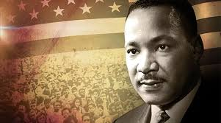
Martin Luther King
Born on 15th January 1929 in Atlanta, Georgia.
He devoted his life to fighting for the rights of the African-Americans in USA.
He inspired millions with his speeches and his writings.
He was inspired by Gandhiji’s non-violence policy.
Segregation finally ended in the USA with the passing of the Civil Rights Act of 1964 and the Voting Rights Act of 1965.
He was shot dead in 1968 at the age of 39.
Martin Luther King

Slide 4
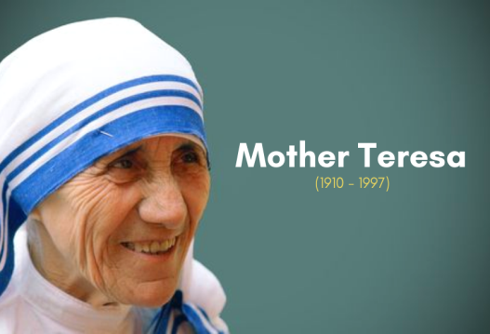
Mother Teresa
Agnes Gonxha Bojaxhiu was born in 1910.
At the age of 18, she was sent to India to teach at a convent in Kolkata.
She left convert and started looking after the poor and needy children.
In 1950, she and her supporter set up a new order called ‘Missionaries of Charity’.
She believed that serving the poor meant serving Christ himself.
Missionaries of Charity opened schools, homes for the dying poor in India and other countries.
For her selfless service for the poor she received many awards.
Among them are the Bharat Ratna from the Indian government, the Magsaysay Award and the Nobel Peace Prize.
She died in the year 1997.

Slide 5
SHORT QUESTION AND ANSWER
B. Match the columns.
1. President of the USA a. Martin Luther King (3)
2. ‘Great soul’ b. Mother Teresa (4)
3. March on Washington c. Abraham Lincoln (1)
4. Bharat Ratna d. Mahatma Gandhi (2)
Multiple choice questions.
1. Who among these fought against the practice of slavery?
a. Abraham Lincoln b. Mahatma Gandhi
c. Mother Teresa d. Martin Luther King
2. In the Satyagraha movement, Gandhiji told the people to fight against the British using
a. force b. arms
c. peaceful methods d. combination of all these methods

Slide 6
3. Which other leader used Gandhiji’s method to fight injustice ?
a. Abraham Lincoln b. Mother Teresa
c. Martin Luther King d. all of them
4. Which of these leaders was shot dead by someone opposing the cause he was fighting for?
a. Abraham Lincoln b. Mahatma Gandhi c. Martin Luther King d. all of them

Slide 7
SUMMARY:
Life style and achievements of Martin Luther King and Mother Teresa

Slide 8
LET’S REVISE:
https://quizizz.com/admin/quiz/5ee2142a525da6001eb36cef?source=quiz_share

Slide 9
HOMEWORK:
Write a few lines on slavery in America as it existed a few years ago with one picture in the project record - 5 lines

Slide 10
LEARNING OUTCOME:
By the end of the class, learners will be able to know:
The personality of great persons and their contribution to the society.
How people conduct their lives to determine ways to help improve lives.

Slide 11
THANKING YOU
ODM EDUCATIONAL GROUP

