Slide 1
PLANT KINGDOM
ALGAE
SUBJECT : BIOLOGY
CHAPTER NUMBER: 3
CHAPTER NAME : PLANT KINGDOM

Slide 2
ALGAE
• Chlorophyll bearing, simple, thalloid, autotrophic and mostly aquatic organisms. Moist stone, soils and wood are the other habitat.
• The size ranges from microscopic unicellular forms like Chlamydomonas, to colonial forms like Volvox and to filamentous forms like Ulothrix and Spirogyra. A few marine forms such as kelps, form massive plant bodies.
• Reproduce vegetatively by fragmentation.
• Reproduce asexually mostly by producing motile spore called zoospores.
• Reproduce sexually by producing gametes.
• Isogamous: both gametes are same size and motile.e.g- Chlamydomonas , Spirogyra
• Anisogamous: both gametes are dissimilar in size but motile. e.g- Chlamydomonas
• Oogamous: male gamete is smaller but motile, female gamete is large and non- motile. e.g., Volvox , Fucus .

Slide 3
IMPORTANCE OF ALGAE
At least half of the total carbon dioxide fixation on earth carried out by them.
Increase oxygen level in the environment.
Many species like Laminaria, Sargassum etc. are used as food.
Agar obtained from Gelidium and Gracilaria is used in ice-creams and jellies and also used to culture bacteria.
Algin obtained from brown algae and carrageen from red algae used commercially.
Chlorella and Spirullina are unicellular algae, rich in protein and used as food supplement even by space travelers.

Slide 4
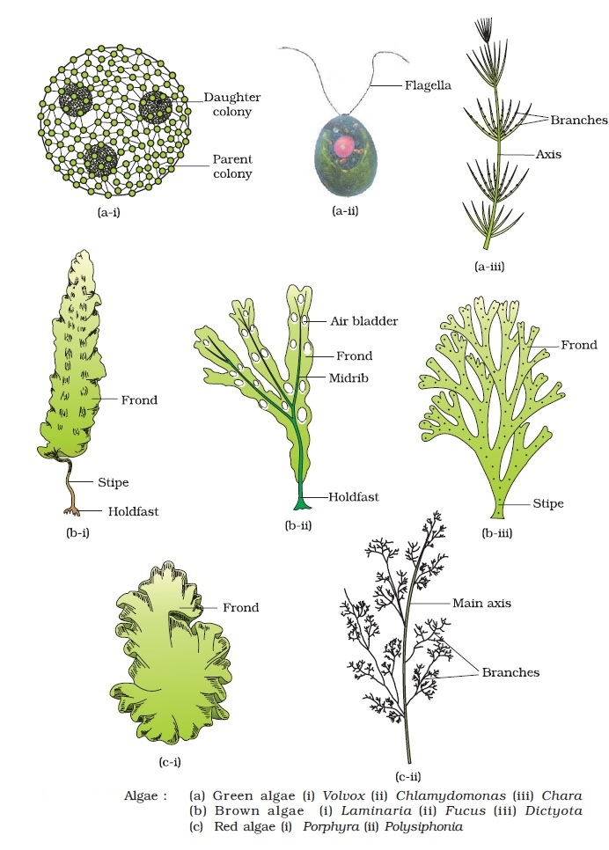
ALGAE DIVIDED INTO 3 CLASSES
The algae are divided into three main classes:
Chlorophyceae- Green algae
Phaeophyceae- Brown algae
Rhodophyceae- Red alage

Slide 5
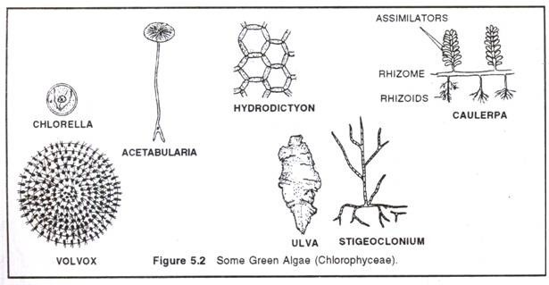
Chlorophyceae
1.CHLOROPHYCEAE
Commonly known as green algae, their plant body may be unicellular, colonial or filamentous.
They are usually grass green as a result of the dominance of pigments chlorophyll a and b.
The pigments are localised in definite chloroplasts.
Most of the members have one or more storage bodies called pyrenoids(contain protein-based starch) found in the chloroplasts.
Vegetative reproduction usually takes place by the formation of different types of spores or fragmentation.
Asexual reproduction is by flagellated zoospores produced in zoosporangia.
The sexual reproduction depicts variation in the formation and type of sex cells and it may be isogamous, anisogamous or oogamous.
Examples: Chlamydomonas, Volvox, Ulothrix, Spirogyra

Slide 6
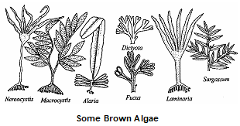
Phaeophyceae
Commonly known as brown algae, these are found in marine habitats.
They range from simple branched, filamentous forms (Ectocarpus) to profusely branched forms as represented by kelps.
Brown algae possesses chlorophyll a, c and xanthophylls, carotenoids.
Food is stored as complex carbohydrates, which may be in the form of laminarin or mannitol.
The vegetative cells have a cellulosic wall usually covered on the outside by a gelatinous coating of algin.
In addition to plastids, the protoplast contains a centrally located vacuole and nucleus.
The plant body is usually attached to the substratum by a holdfast, and has a stalk, the stipe and the frond( leaf-like photosynthetic organ).
Asexual reproduction in most brown algae is by biflagellate zoospores that are pear-shaped and have two unequal laterally attached flagella.
Vegetative reproduction takes place by fragmentation.
Sexual reproduction may be isogamous, anisogamous or oogamous.
Examples – Ectocarpus, Dictyota, Laminaria, Sargassum and Fucus.

Slide 7
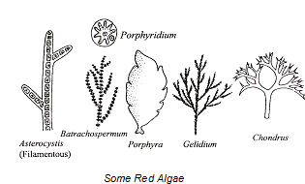
Rhodophyceae
Commonly called red algae due to the predominance of the red pigment, r-phycoerythrin in their body.
Most of these are marine with greater concentrations found in the warmer areas.
They are found in both well-lighted regions close to the surface of water and also at great depths in oceans where relatively little light seeps in.
Some of them have complex body organisation.
The food is stored as floridean starch which is very similar to amylopectin and glycogen in structure.
Reproduce vegetatively by fragmentation.
They reproduce sexually by non-motile gametes and asexually by non-motile spores.
Sexual reproduction is oogamous following complex post fertilisation developments.
Examples : Gelidium, Porphyra, Polysiphonia, Gracilaria

Slide 8
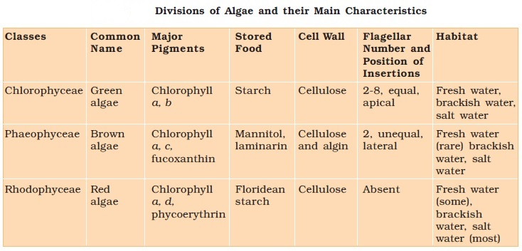

Slide 9
THANKING YOU
ODM EDUCATIONAL GROUP

