Slide 1
MUSCLE TISSUE AND NEURAL TISSUE
STRUCTURE OF MUSCLE TISSUE,TYPES OF MUSCLE TISSUE,STRUCTURE OF NEURONS
SUBJECT : BIOLOGY
CHAPTER NUMBER: 07
CHAPTER NAME : STRUCTURAL ORGANISATION IN ANIMALS

Slide 2
MUSCLE TISSUE
Each muscle is made of many long, cylindrical fibres arranged in parallel arrays.
These fibres are composed of numerous fine fibrils, called myofibrils.
Muscle fibres contract (shorten) in response to stimulation, then relax (lengthen) and return to their uncontracted state in a coordinated fashion.
Their action moves the body to adjust to the changes in the environment and to maintain the positions of the various parts of the body.
In general, muscles play an active role in all the movements of the body.

Slide 3
MUSCLE TISSUE
TYPES OF MUSCLE TISSUE
Muscles are of three types:
1. skeletal
2. Smooth
3. Cardiac.

Slide 4
MUSCLE TISSUE
SKELETAL MUSCLE
Skeletal muscle tissue is closely attached to skeletal bones.
In a typical muscle such as the biceps, striated (striped) skeletal muscle fibres are bundled together in a parallel fashion.
A sheath of tough connective tissue encloses several bundles of muscle fibres.

Slide 5
MUSCLE TISSUE
SMOOTH MUSCLE
The smooth muscle fibres taper at both ends (fusiform) and do not show striations.
Cell junctions hold them together and they are bundled together in a connective tissue sheath.
The wall of internal organs such as the blood vessels, stomach and intestine contains this type of muscle tissue.
Smooth muscles are ‘involuntary’ as their functioning cannot be directly controlled.

Slide 6
MUSCLE TISSUE
CARDIAC MUSCLE TISSUE
Cardiac muscle tissue is a contractile tissue present only in the heart.
Cell junctions fuse the plasma membranes of cardiac muscle cells and make them stick together.
Communication junctions (intercalated discs) at some fusion points allow the cells to contract as a unit, i.e., when one cell receives a signal to contract, its neighbours are also stimulated to contract.

Slide 7
NEURAL TISSUE
Neural tissue exerts the greatest control over the body’s responsiveness to changing conditions.
Neurons, the unit of neural system are excitable cells.
The neuroglial cell which constitute the rest of the neural system protect and support neurons.
Neuroglia make up more than one half the volume of neural tissue in our body.
When a neuron is suitably stimulated, an electrical disturbance is generated which swiftly travels along its plasma.

Slide 8
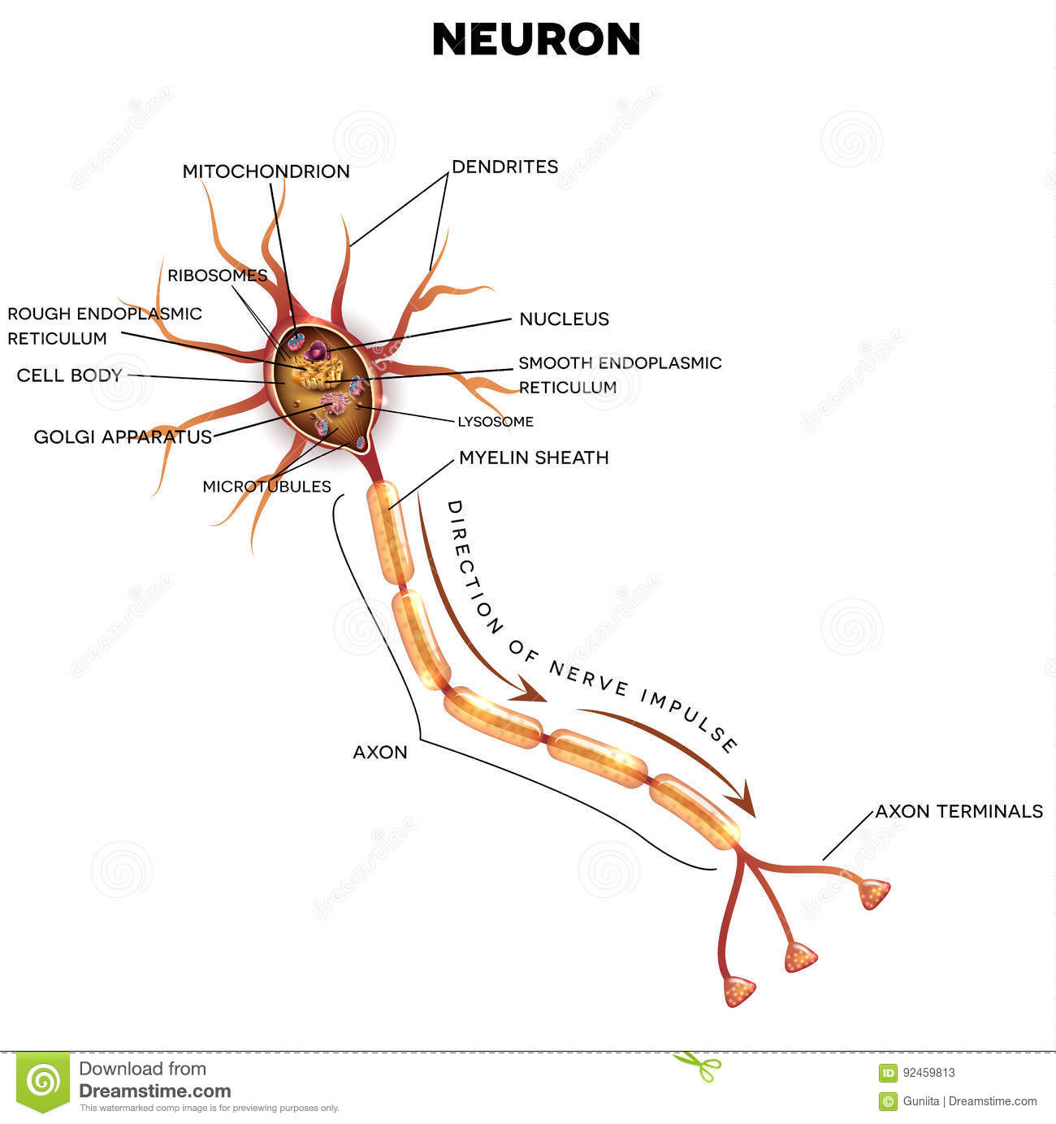

Slide 9
THANKING YOU
ODM EDUCATIONAL GROUP

