Slide 1
MORPHOLOGY OF COCKROACH
BODY STRUCTURE,WINGS,APPENDAGES,MOUTH PARTS,SEX ORGANS
SUBJECT : BIOLOGY
CHAPTER NUMBER: 07
CHAPTER NAME : STRUCTURAL ORGANISATION IN ANIMALS

Slide 2
GENERAL CHARACTERISTICS OF COCKROACH
Cockroaches are brown or black bodied animals that are included in Class Insecta of Phylum Arthropoda.
Bright yellow, red and green coloured cockroaches have also been reported in tropical regions.
Their size ranges from ¼ inches to 3 inches (0.6-7.6 cm) and have long antenna, legs and flat extension of the upper body wall that conceals head.
They are nocturnal omnivores that live in damp places throughout the world.
They have become residents of human homes and thus are serious pests and vectors of several diseases.

Slide 3
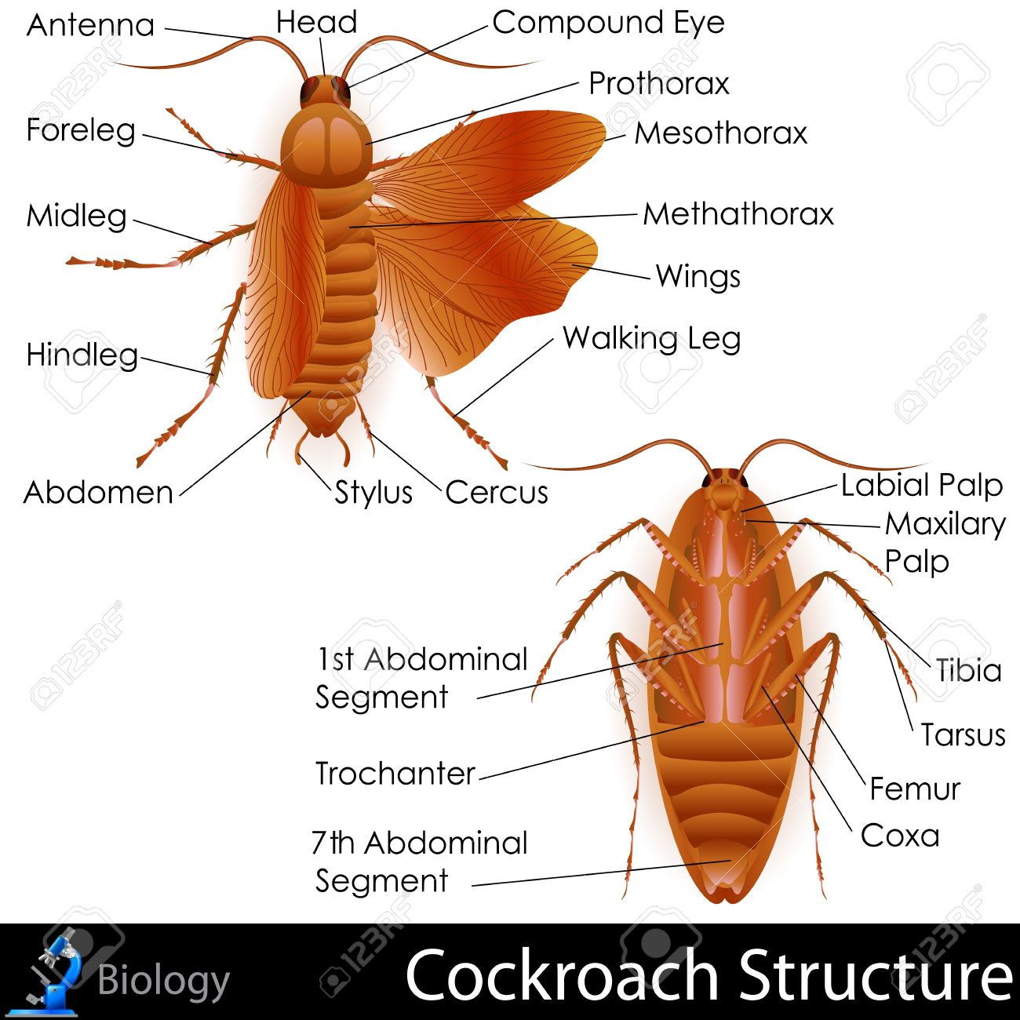
GENERAL CHARACTERISTICS OF COCKROACH

Slide 4
MORPHOLOGY OF COCKROACH
The adults of the common species of cockroach, Periplaneta americana are about 34-53 mm long with wings that extend beyond the tip of the abdomen in males.
The body of the cockroach is segmented and divisible into three distinct regions – head, thorax and abdomen.
The entire body is covered by a hard chitinous exoskeleton (brown in colour).
In each segment, exoskeleton has hardened plates called sclerites (tergites dorsally and sternites ventrally) that are joined to each other by a thin and flexible articular membrane (arthrodial membrane).

Slide 5
MORPHOLOGY OF COCKROACH
HEAD AND MOUTH PARTS
Head is triangular in shape and lies anteriorly at right angles to the longitudinal body axis. It is formed by the fusion of six segments and shows great mobility in all directions due to flexible neck.
The head capsule bears a pair of compound eyes. A pair of thread like antennae arise from membranous sockets lying in front of eyes.
Antennae have sensory receptors that help in monitoring the environment. Anterior end of the head bears appendages forming biting and chewing type of mouth parts.
The mouthparts consisting of a labrum (upper lip), a pair of mandibles, a pair of maxillae and a labium (lower lip).
A median flexible lobe, acting as tongue (hypopharynx), lies within the cavity enclosed by the mouthparts.

Slide 6
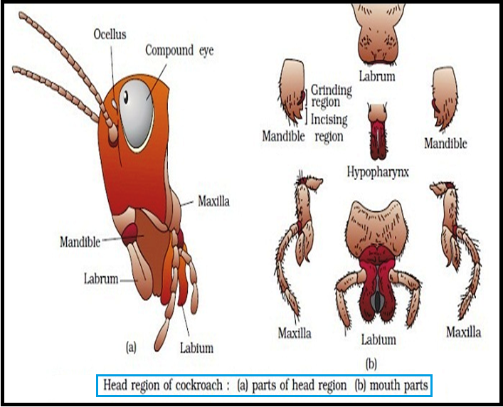
HEAD AND MOUTH PARTS

Slide 7
MORPHOLOGY OF COCKROACH
THORACIC REGION
Thorax consists of three parts – prothorax, mesothorax and metathorax.
The head is connected with thorax by a short extension of the prothorax known as the neck.
Each thoracic segment bears a pair of walking legs.
The first pair of wings arises from mesothorax and the second pair from metathorax.
Forewings (mesothoracic) called tegmina are opaque dark and leathery and cover the hind wings when at rest.
The hind wings are transparent, membranous and are used in flight.

Slide 8
THORACIC REGION

Slide 9
ABDOMEN REGION
The abdomen in both males and females consists of 10 segments.
In females, the 7th sternum is boat shaped and together with the 8th sterna forms a brood or genital pouch whose anterior part contains female gonopore, spermathecal pores and collateral glands.
In males, genital pouch or chamber lies at the hind end of abdomen bounded dorsally by 9th and 10th terga and ventrally by the 9th sternum.
It contains dorsal anus, ventral male genital pore and gonapophysis.
Males bear a pair of short, thread like anal styles which are absent in females.
In both sexes, the 10th Segment bears a pair of jointed filamentous structures called anal cerci.

Slide 10
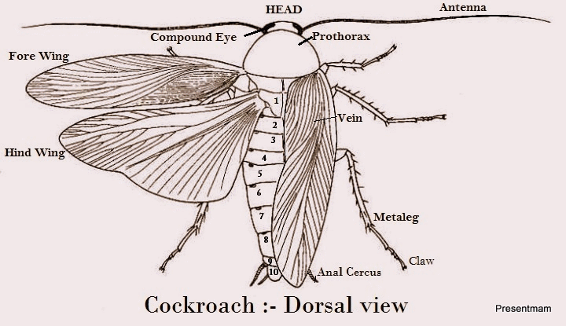
ABDOMEN REGION

Slide 11
THANKING YOU
ODM EDUCATIONAL GROUP

