Slide 1
SUBJECT:BIOLOGY
CHAPTER:6
CHAPTER NAME: THE CIRCULATORY SYSTEM.
PERIOD-6

Slide 2
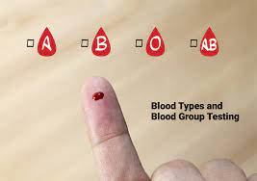
Blood groups
A blood type is a classification of blood, based on the presence and absence of antibodies and inherited antigenic substances on the surface of red blood cells. These antigens may be proteins, carbohydrates, glycoproteins, or glycolipids, depending on the blood group system.
There are 4 main blood groups (types of blood) – A, B, AB and O. Your blood group is determined by the genes you inherit from your parents.

Slide 4
Matching of blood groups

Slide 5
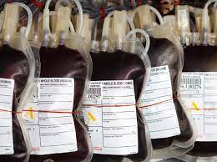
Blood donation and blood bank
Also known as Giving Blood, Donating Blood, Blood Drive, Apheresis. Volunteer blood donation is a safe and simple procedure that involves a donor giving one of the following blood products: whole blood, red blood cells, plasma, or platelets.
A blood bank is a center where blood gathered as a result of blood donation is stored and preserved for later use in blood transfusion

Slide 6
Heart related conditions
Palpitations
Hypertension
Heart attack
Cardiac arrest

Slide 7
https://www.youtube.com/watch?v=zEzDcElrYgs

Slide 8
Keeping the heart healthy

Slide 9
THANKING YOU
ODM EDUCATIONAL GROUP.

