Slide 1
POETS AND PANCAKES
ASHOKMITRAN
SUBJECT : (ENGLISH)
CHAPTER NUMBER: 6
CHAPTER NAME : POETS AND PANCAKES

Slide 2
LEARNING OUTCOMES
Students can relate their ideas on Chennai’s movie making industry which can enhance their thinking, analytical and literary skills.
Students will be able to understand the Gemini Studios of Madras was one of India's pioneering and prominent film-producing organizations of India.
It was established in the 1940s. The intelligent and talented S.S. Vasan founded it, it had a staff of over 600 people.
Students can interpret from the text what Asokamitran talks about many notions about the film industry, particularly in India.

Slide 3
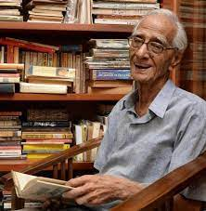
ABOUT THE AUTHOR
ASHOKMITRAN
Asokamitran (22 September 1931-23 March 2017) was a famous Tamil writer and Sahitya Akademi, winner.
He was one of the few writers who wrote fluently in both Tamil and English.
In a career spanning over six decades, he wrote 8 novels, 20 novellas and hundreds of short stories, on a wide range of issues.
He spent the initial years of his career in the famous Gemini Studios of Chennai.

Slide 4
VIDEO CLIPS
https://www.youtube.com/watch?v=_XIqnlMvrs4
Documentary on Ashokmitran

Slide 5
THEME
‘Poets and Pancakes’ fondly remembers the glorious Gemini Studios which was the hub of activity for all the people associated with films.
It is a sarcastic and humorous depiction of the various people who visited the place.
The extract is autobiographical in nature and subtly hints at the changes brought in by the passage of time.
The author has used an easy and conversational style to sketch the humorous image of what went on at the studio.
The entire extract is marked by subtle satire, a gorgeous undercurrent of humour and an engrossing portrayal of people who thrive despite hardships.
The story focuses on the many aspects of contemporary life and on human situations and tendencies.

Slide 6
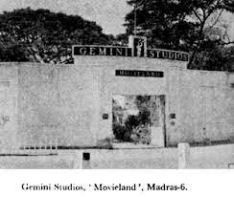
INTRODUCTION
The title ‘Poets and Pancakes’ refers to poets who were scriptwriters at the studio and also to a brand of make-up ‘pancake’ that was liberally used.
The author’s job in the studio was to cut newspaper clippings on various topics and maintain a file of the same.
The story is based on the functioning of the Gemini Studios during its years of glory.
The author provides the reader with a glimpse of Independent India in its infancy.

Slide 7
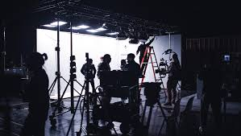
CHAPTER ANALYSIS (PAGE NO.57&58)
The Make-up Department
The make-up room was like hair cutting salon with incandescent lights and mirrors, fiery misery subjected to make-up.
Headed by a Bengali first, later by Maharashtrian, helped by an Andhdraite, a Madras
Christian and Anglo-Burmese and a local Tamil.
Example of National Integration
Strict Hierarchy was followed in the make-up room.
Chief actors and actresses
Assistant to paint the second hero

Slide 8
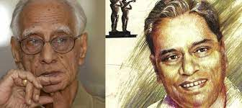
CHAPTER ANALYSIS (PAGE NO.59)
The Office Boy
was in early forties and did make up of the crowd.
Joined to become an actor, or a screenwriter, director or lyric writer,
was a bit poet.
Hopes shattered, seemed frustrated.
Ashokmitran
Duty of the writer was insignificant, he used to cut out newspaper clipping day in and day out.
everyone thought him as free and would barge into my cubicle and deliver an extended lecture.
office boy expressed his angeron how the literary talent was being allowed to go waste in such dept.

Slide 9
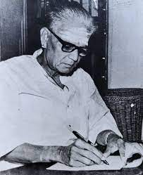
CHAPTER ANALYSIS (PAGE NO.59&60)
Kothamangalam Subbu
Kothamangalam Subbu – No. 2 at Gemini Studios.
always accompanied the boss was in story department.
story department had lawyer, writers and poets.
was cheerful and loyal habit of being nice.
was charitable and could suggest many ways of filming a scene.
was a poet, an amazing actor.
had many enemies, office boy being the main.

Slide 10
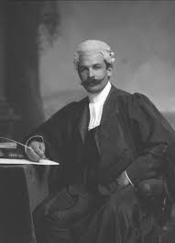
CHAPTER ANALYSIS (PAGE NO.61)
The Lawyer
Belong to story department
Was not very popular
Played the recording and the actress outburst and left her career.
She left acting after this as she failed to recover from the terror that she felt.
He dressed in pant, coat and tie differently than others.
Story dept was closed and he lost the job.

Slide 11
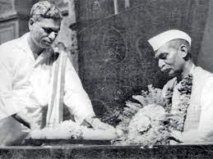
CHAPTER ANALYSIS (PAGE NO.61)
Gemini Studios – The Favourite Meeting Place of Poets
Mr. Vasan the boss, was editor of Tamil weekly – Ananda Vikatan.
Main prominent poets and writers visited the studio.
They wore khadi, were against communism 1952 Frank Buchman’s moral Re-Armament
army visited studio.
Tamil plays copied their sets for years.
Hosting two hundred people of twenty nationalities was great change.

Slide 12
CHAPTER ANALYSIS (PAGE NO.62&63)
Arrival of MRA
The feeling of communism were widespread in South India.
The Moral Re-Armament Army was a sort of anti-communism movement. It visited Gemini Studios in 1952.
They presented two plays ‘Jonathan Valley’ and the ‘Forgotten Factor’ in a most professional manner. The Gemini family were greatly impressed by their plays.
For many years the Tamil drama imitated- The sunrise and sunset scenes presented by MRA.
But the MRA did not influence the outlook of the Gemini boss.
The staff had enjoyed hosting the MRA.

Slide 13
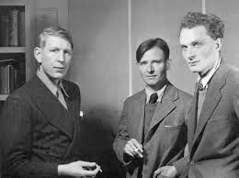
CHAPTER ANALYSIS (PAGE NO.64&65)
Visit of an Englishman
A few months later Gemini Studios received another guest- An Englishman.
Some said he was a poet and some believed him as Editor.
The Englishman was welcomed by the Boss, Mr.Vasan.
He read out a long speech talking of freedom and democracy.
His visit remained a mystery.

Slide 14
CHAPTER ANALYSIS (PAGE NO.65&66)
Mystery resolved
The author saw a notice in The Hindu, The Encounter, a British Periodical organizing a short story contest.
He wanted to send the entry for which he visited British Council Library, there he found copies of The Encounter.
He learned as his editor was Stephen Spender- who visited The Gemini Studios.
One day he saw a pile of low priced paperback editions of ‘The God that Failed’, He brought a copy, which contained six different essays by different writers.
They describe the writers ‘Journeys into communism and the disillusioned return.
One of the writer was Stephen Spender.

Slide 15
DIFFICULT WORDS
Incandescent- emitting light as a result of being heated; burning
Fiery- red-hot; scorching
Misery- a state or feeling of great physical or mental distress or discomfort
Hideous- extremely ugly
Crimson hue- deep red colour
Potions- a liquid mixture
Cubicle- a small partitioned-off area of a room
Barge in- to walk into a room quickly, without being invited
Enlightened-having or showing a rational, modern and well-informed outlook
Epics- an exceptionally long and arduous task or activity
Perverts- a person whose sexual behaviour is regarded as abnormal and unacceptable.
Covertly- secretly
Woes- distress
Ignominy- public shame or disgrace

Slide 16
DIFFICULT WORDS
Ignominy- public shame or disgrace
Contrary- opposite in nature, direction or meaning
Virtue- behaviour showing high moral standards; here, good luck
Affluent- having a great deal of money; wealthy
Lead – main
Subsidiary- secondary, supporting
Main players- actors performing the main roles
Genuine- true
Conscious- aware
Improvident- a person who does not plan his expenses and ends up wasting money
Demeanour- manner; attitude
Sycophant- a person who acts obsequiously (excessively obedient) towards someone important in order to gain advantage
Direst- terrible

Slide 17
QUESTIONS
What does the writer mean by the ‘fiery misery of those subjected to make-up’?
What is the example of ‘national integration ’that the author refers to in the Gemini Studios?
What work did the ‘Office Boy’ do in the Gemini Studio?
Why was the office boy frustrated?
Why did the author appear to be doing nothing at Gemini Studios?
Why was the legal adviser referred to as the opposite by others?
What made the lawyer stand out from the others at Gemini Studios?
Did the people at Gemini Studios have any particular political affiliations? Explain.
Why was the Moral Re-Armament Army welcomed at the Gemini Studios?
Name one example to show that Gemini studio was influenced by plays staged by MRA.

Slide 18
THANKING YOU
ODM EDUCATIONAL GROUP

