Slide 1
THE FUNDAMENTAL UNIT OF LIFE
SUBJECT- BIOLOGY
CHAPTER NO- 5
Comparison between plant cell and animal cell, Cell cycle- mitosis and meiosis
PERIOD-11

Slide 2
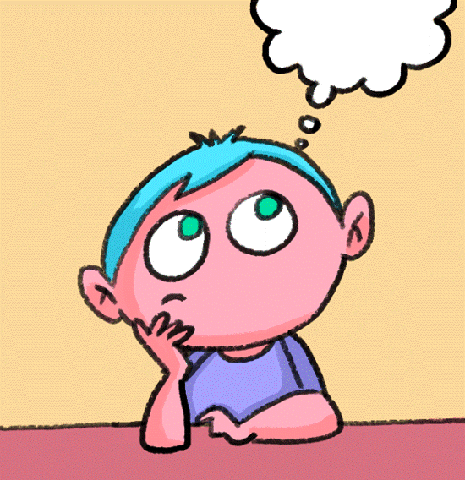
LEARNING OBJECTIVE
They will be able to analyze and compare plant and animal cells
Learners will be sensitized about some of the organelles which are absent in plant cells but present in an animal cell and vice versa.
Learners will be sensitized about cell cycle- mitosis and meiosis
Students will be able to understand the cells where mitotic and meiotic division takes place.

Slide 3
Introduction
Recapitulation of previous topics by the teacher by conducting a Group activity by segregating students into 2 groups- one group representing plant cell and other group representing animal cell.
Both the groups will be given their respective cell chart and will identify different organelles and draw and label it in note copy.
Followed by sharing of ideas between 2 groups.

Slide 5
Cell cycle

Slide 6
Detailed explanation of cell cycle https://youtu.be/g7iAVCLZWuM

Slide 7
MITOSIS
Mitosis is that step in the cell cycle where the newly formed DNA is separated and two new cells are formed with the same number and kind of chromosomes as the parent nucleus.
https://youtu.be/ofjyw7ARP1c

Slide 9
MEIOSIS
Meiosis is the type of cell division that results in four daughter cells, each with half the number of chromosomes of the parent cell.
https://youtu.be/nMEyeKQClqI

Slide 10
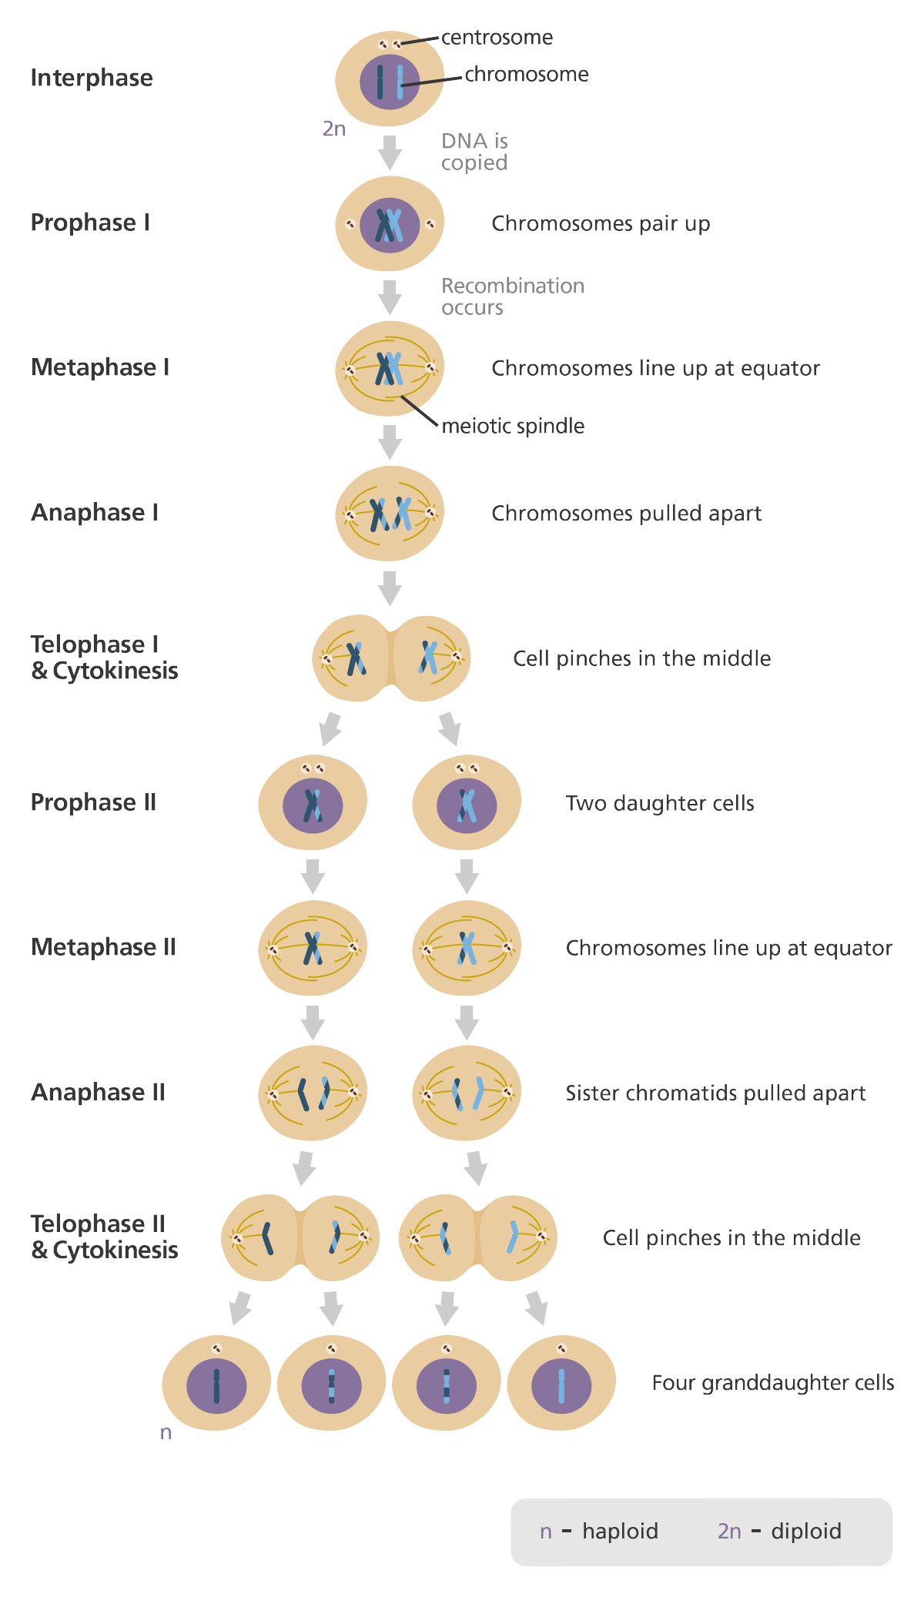

Slide 11
HOME ASSIGNMENT
Q. List some of the similarities between plant and animal cell
Q. List some of the differences between plant and animal cell
Q. Draw labelled diagram comparing plant cell and animal cell
Q. Differentiate between mitosis and meiosis

Slide 12
THANKING YOU
ODM EDUCATIONAL GROUP

