Slide 1
LIFE PROCESSES.
SUBJECT:BIOLOGY
CHAPTER:6.
EXCRETION IN HUMAN BEINGS
PERIOD-11

Slide 2
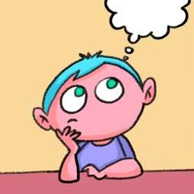
LEARNING OBJECTIVE
Student will be able to apprise the importance of kidney in the body.
Student will be able to analyze the detailed structure of a nephron.
They will be able to analyze various components of human excretory system.

Slide 3
WARM UP QUESTIONS
1.Name the constituent present in glomerular filtrate.
2.From where do the ureters arise?
3.Name an anticoagulant used in dialysis.
4.why do the excretory products pass from the blood to the dialyzing fluid?

Slide 4
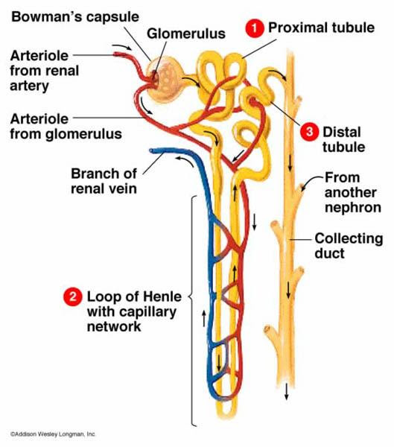
NEPHRON
Nephron: It is composed of a tangled mess of tubes and a filtering part; called glomerulus. Glomerulus is a network of blood capillaries to which renal artery is attached. The artery which takes blood to the glomerulus is called afferent arteriole and the one receiving blood from the glomerulus is called efferent arteriole. Glomerulus is enclosed in a capsule like portion; called Bowman’s capsule. The Bowman’s capsule extends into a fine tube which is highly coiled. Tubes from various nephrons converge into collecting duct; which finally goes to the ureter.

Slide 5
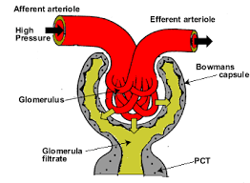
GLOMERULAR FILTRATION
Filtration happens because of very high pressure inside the glomerulus. The lumen of efferent arteriole is smaller than that of afferent arteriole. Due to this, the blood entering the glomerulus experiences very high pressure and due to this, the waste products are filtered out through the thin membrane of capillaries in the glomerulus. The filtered blood is sent to the systemic circulation through efferent arteriole and the filtrate goes to the Bowman’s capsule. That is how urine is formed inside the kidneys. Reabsorption of water and some other filtrates takes place in the tubular part of the nephron. This increases the concentration of urine. The human urine is mainly composed of water and urea.

Slide 6
https://www.youtube.com/watch?v=j9qZwRooBXc

Slide 7
HEMODIALYSIS

Slide 8
HOME ASSIGNMENT
In Box Question -3 pg no-112 and Exercise Question No-13

Slide 9
THANKING YOU
ODM EDUCATIONAL GROUP.

