Slide 1
FORCE
SUBJECT-PHYSICS
CHAPTER NO- 3
Effects of a force
PERIOD-2

Slide 2
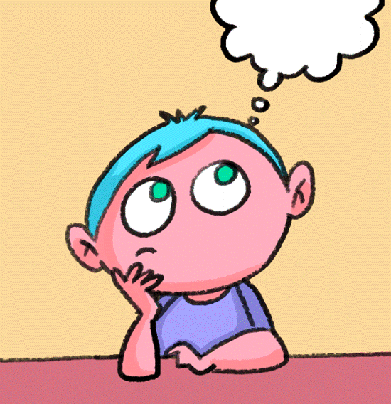
LEARNING OBJECTIVE
Students will be able to
Familiarize with the effects of force
Describe the different effects of force with appropriate examples
Relate different effects of force in real life situations.

Slide 3
WARM UP ACTIVITY
Recapitulate the previous topic by asking the following questions.
Define force.
Give an example of force as push and pull
Explain force as stretch with the help of an example.

Slide 4
Effects of force
force can
move a body originally at rest
stop a moving body
make a moving body to move faster
slow down a moving body
change the direction of motion of a moving body
change the shape or size of the body

Slide 5
show the following videos for better understanding of the concept
https://youtu.be/B6mi1-YoRT4
https://youtu.be/9tg3csrFVJw

Slide 6
EFFECTS OF FORCE

Slide 7
HOME ASSIGNMENT
Exercise- B 3,4
Describe the different effects of force with appropriate examples
Explain along with examples that a force can
change the direction of motion of a moving body
change the shape or size of the body

Slide 8
THANKING YOU
ODM EDUCATIONAL GROUP

